Slide 1

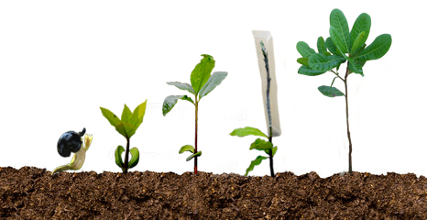
Innovative ways to enhance production and productivity in Cashew
Venkatesh N Hubballi, Director
Directorate of Cashewnut and Cocoa Development, Cochin
20-02-2016

Slide 2

Introduced in India (Goa) in 16th Century by Portuguese.
History & Development
Commercial planting commenced in 1960’s.
Development programmes started in the beginning of 1992 onwards
Presently, cashew is the 3rd most important export crop in Agriculture.

Slide 3

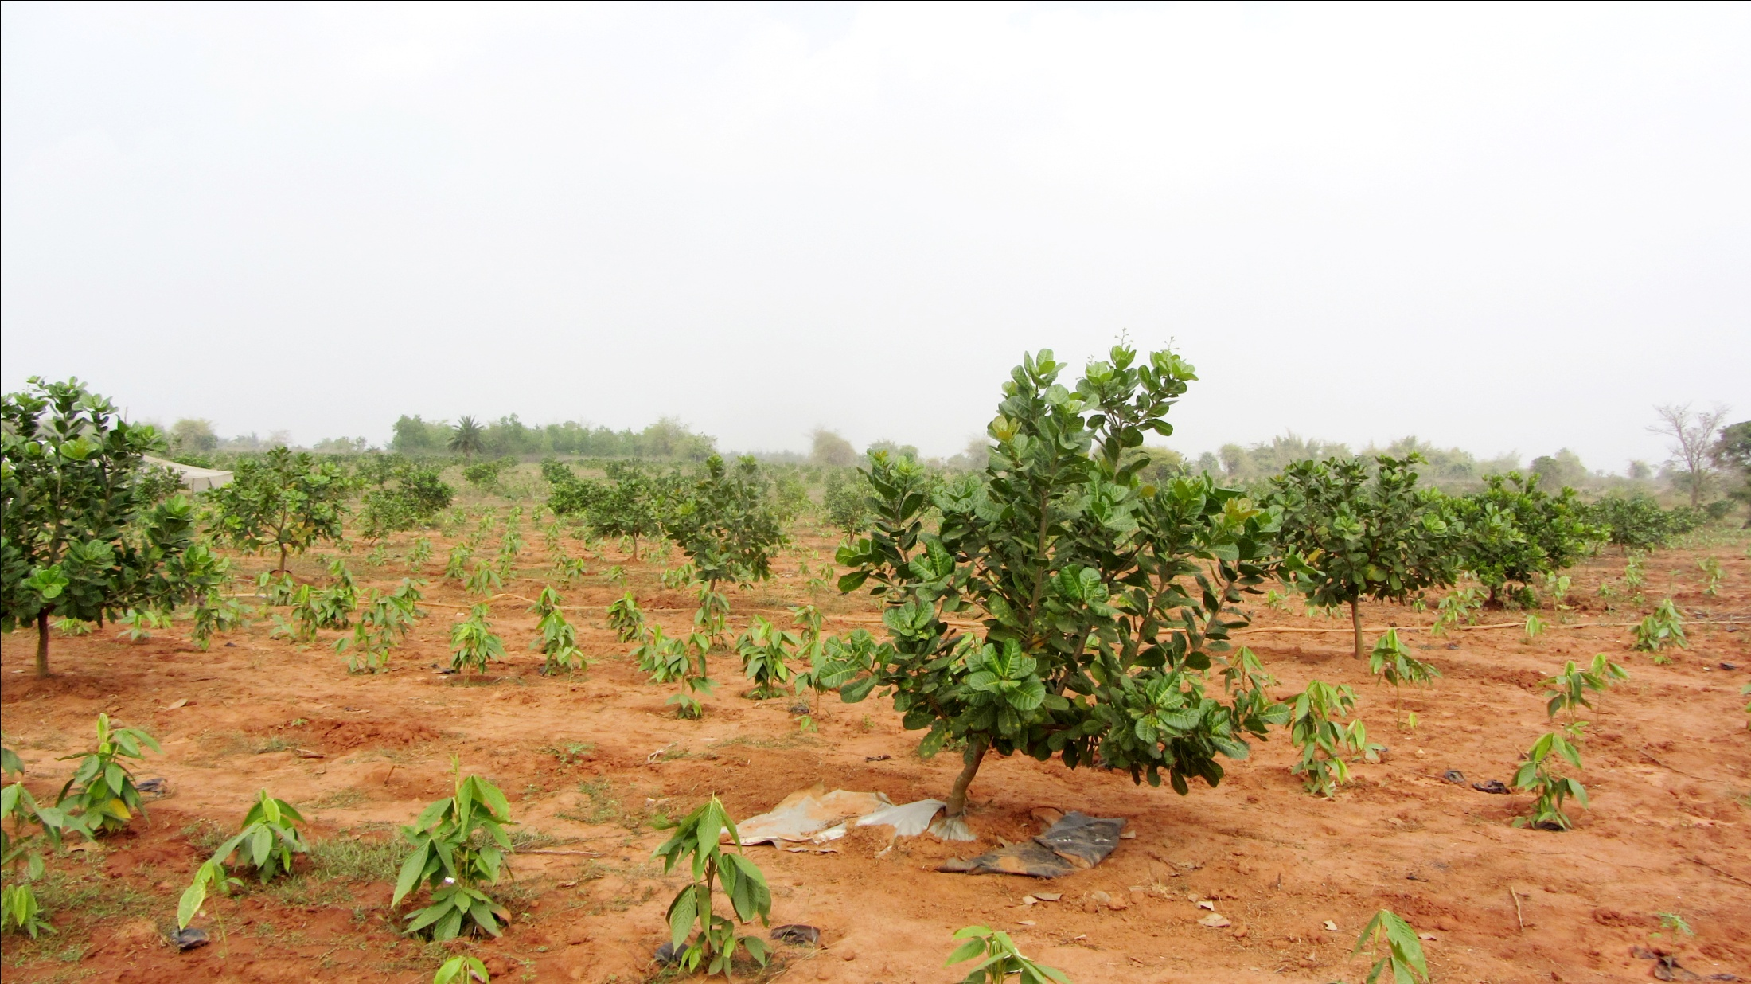
Vision
Promote cashew cultivation in India by adopting good agriculture practices with intensive transfer of technology programme.

Slide 4

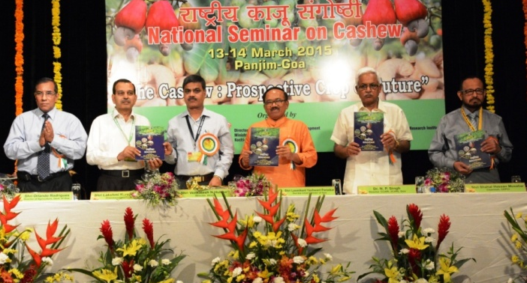
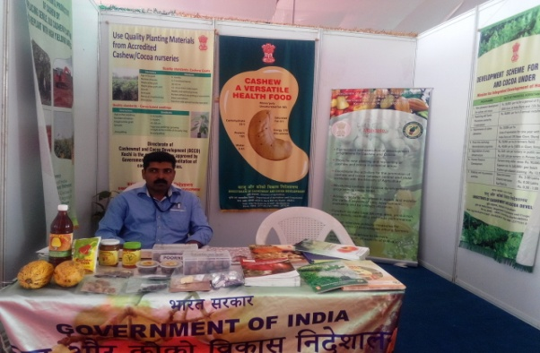
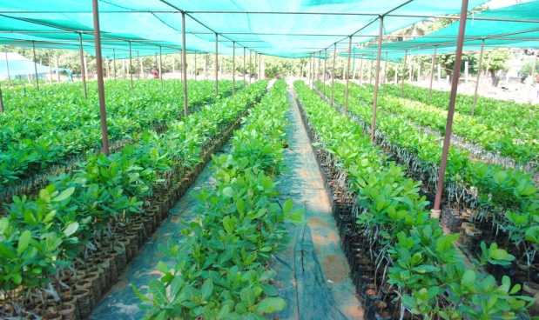
Mission
Developing coordination and linkages among all stake holders to maximize efficiency and effectiveness of various programme.
Identifying lacunas prioritizing and supporting.
Endorsing healthy and transparent practices for development of cashew plantation.
Collaboration in organic certification programme

Slide 5
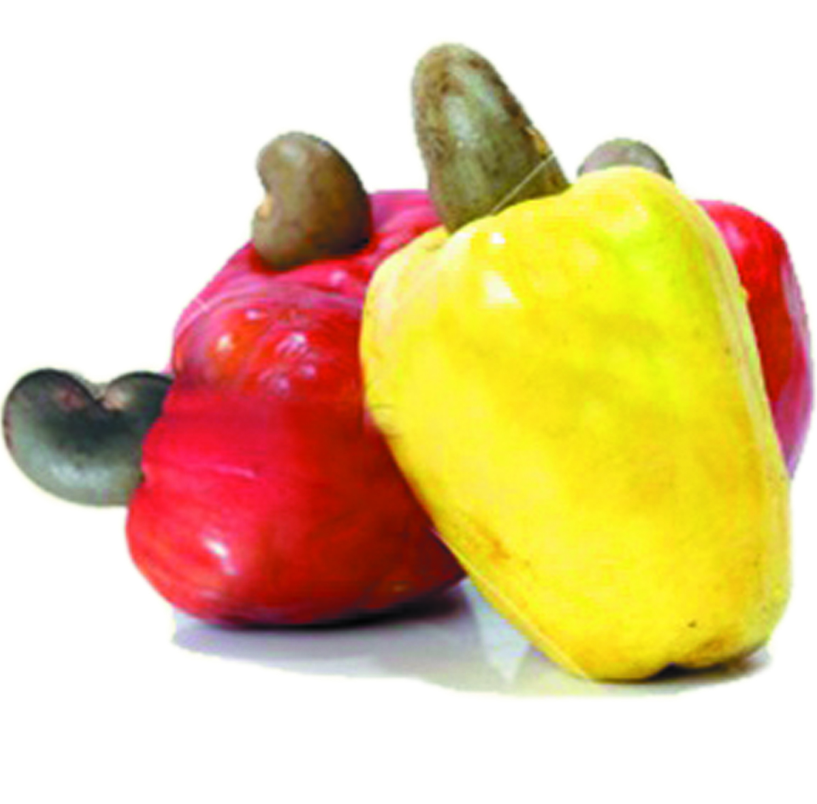
Programmes
Establishment of model nurseries in cashew.
Area Expansion in traditional and non traditional areas.
Replanting of cashew under State level Corporations
Contract farming in association with processing industries
Village adoption .
Micro irrigation in cashew clusters
Intensive transfer of technology programmes
Organic certification in collaboration with certification agencies
Popularization of cashew apple utilisation
Establishment of Model farm

Slide 6
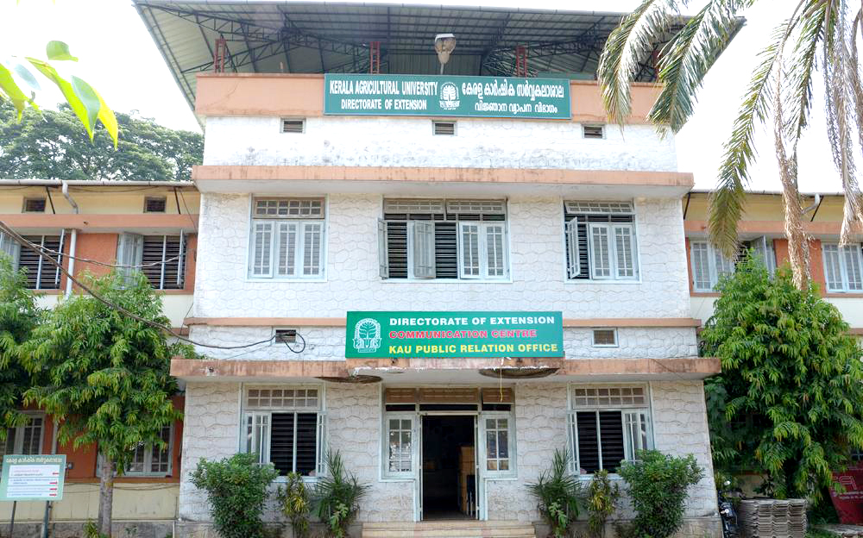
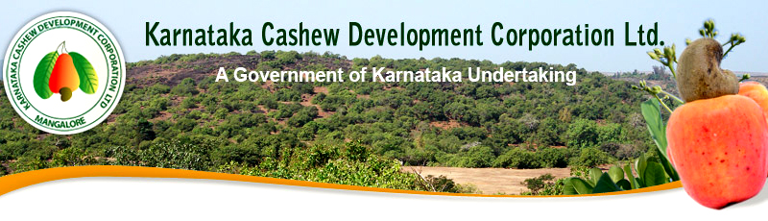
Collaboration
Research organizations
Horticulture departments
State level corporations
Non government organizations
Processing industries
Farmer cooperative societies
Nationalised banks
Institutes of excellence in government and private
International organizations

Slide 7
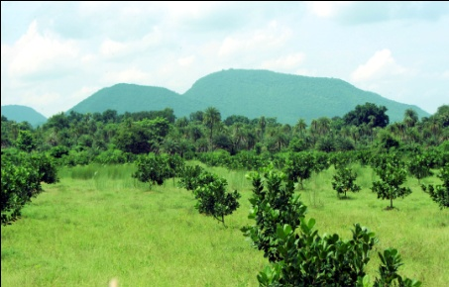
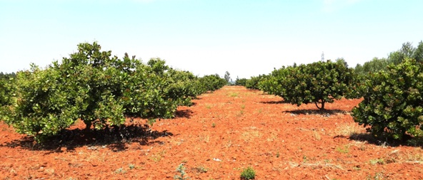
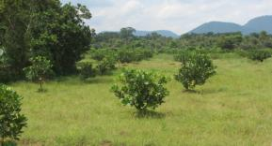
Indian Cashew Scenario
Cultivation | 17 states
Area | 1.027million ha (2015-16)
Production | 0.725 million MT (2015-16) 0.181 million MT (Processed Kernel equiv.)
Productivity (Av) | 706 Kg/ha(2015-16)
Major cashew growing states | Maharashtra, Kerala, Goa, Karnataka, Tamil Nadu Andhra Pradesh, Orissa and West Bengal. Spread to non traditional areas of central and NE region of the country

Slide 8
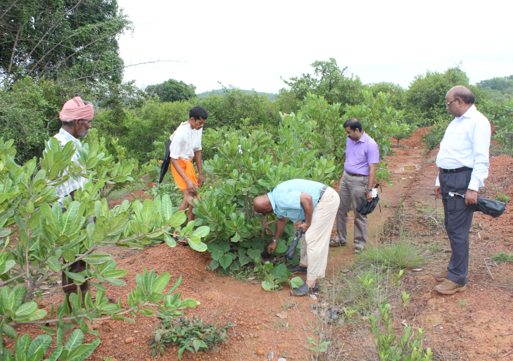
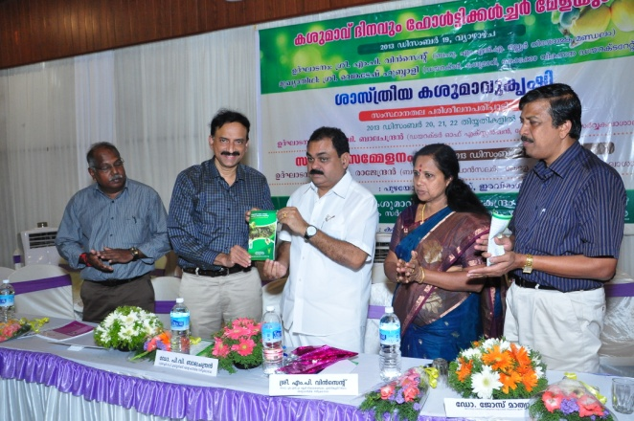
Area to concentrate
Removal of senile plantations and replanting with HYV
New plantation development in nontraditional areas
Contract/lease farming by processing industries
Infrastructure for cashew apple processing
Human resource development

Slide 9

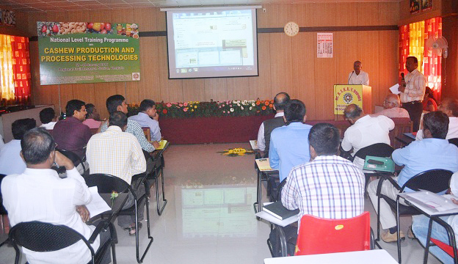
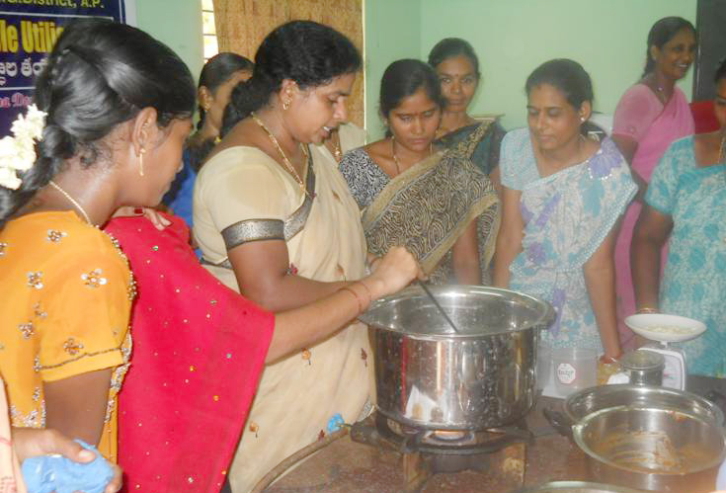
Future Strategies for next decade
Massive replanting programme.
Area expansion in traditional and non-traditional areas
Organizing intensive thematic campaigns and farmers training.

Slide 10
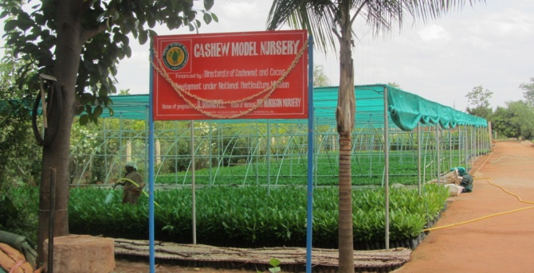
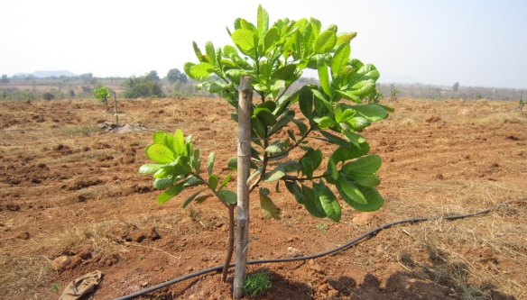
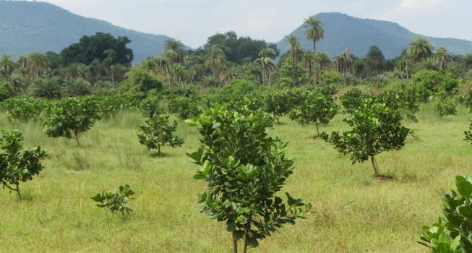
Future Strategies
Working together and effective coordination among all stake holders
Single set of criteria to harmonize the standards of delivery mechanism
India is ahead of technologies but needs to ensure field level implementation
Private participation with government support

Slide 11
Govt of India’s Initiatives
Financial assistance extended for integrated development of cashew in the country through adoption of end to end holistic approach.
New plantation development in potential areas.
Removal of senile plantations and replanting with HYV
Model nurseries
Human resource development
Intensive technology transfer
Post harvest management and processing with value addition.

Slide 12

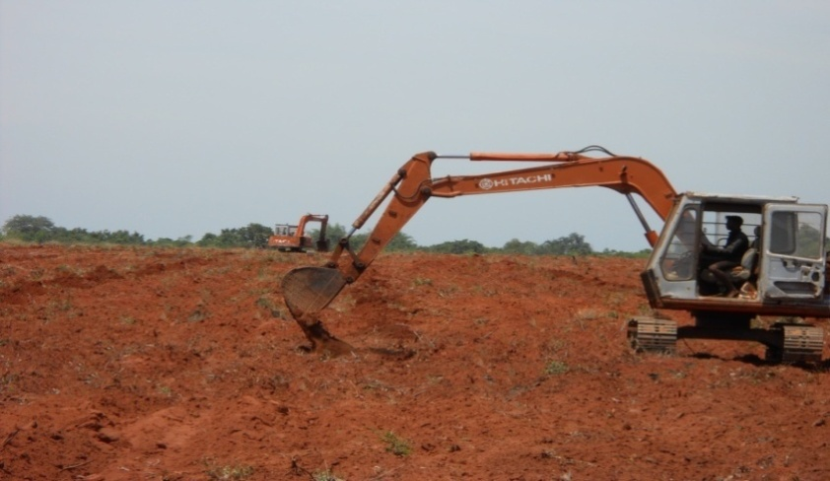
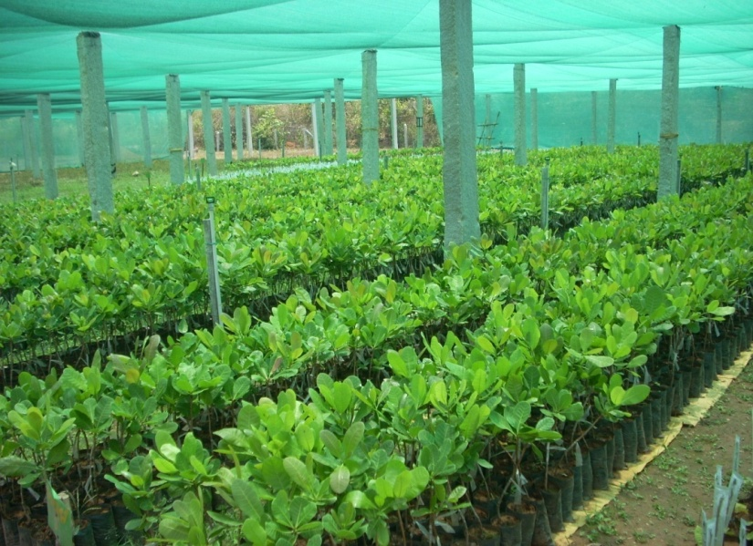
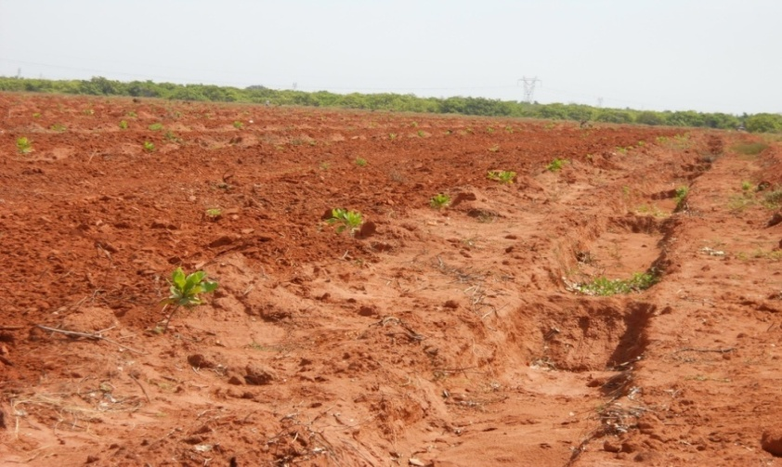
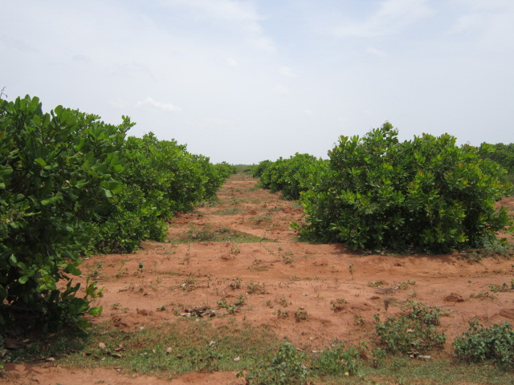
Good Agricultural practices for cashew cultivation
Preparation of Land for planting
Selection of HYV of cashew
Planting of cashew grafts of HYV
Well maintained cashew garden

