Slide 1
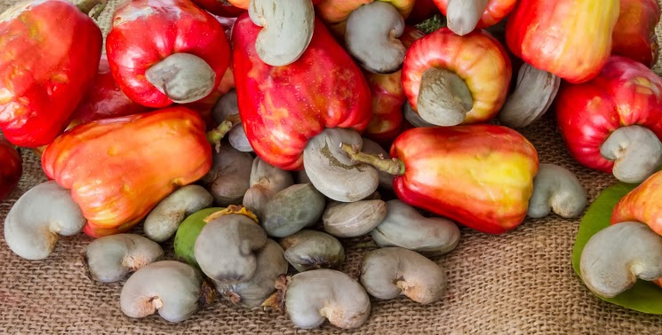
‘India’ the most preferred Cashew Destination!
WCC Singapore – Feb 11th 2017
Rajendra Sabat
President, OCPA | Cashew Expert & Consultant
+91-94385-52266
sabat47@yahoo.com

Slide 2

Executive Summary
Cashew timeline – India
Health benefits of Cashew
Cashew – India Facts | Economic Importance
Cashew value-chain
  India way ahead!
  India’s niche skill & expertise
India – Vision 2025

Slide 3

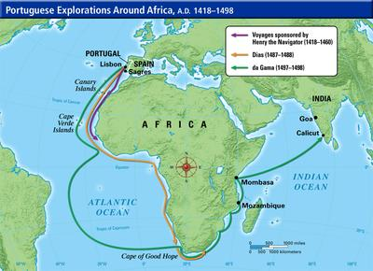

Cashew timeline – India
The Portuguese brought Cashew to India in the 16th Century
Gradually cashew saw a boom in cultivation from West Coast to East Coast
India was one of the first countries to process & export cashew from Kerala for over 100 years
India still is ‘one of the most favored & trusted’ nations for Cashew trade

Slide 4

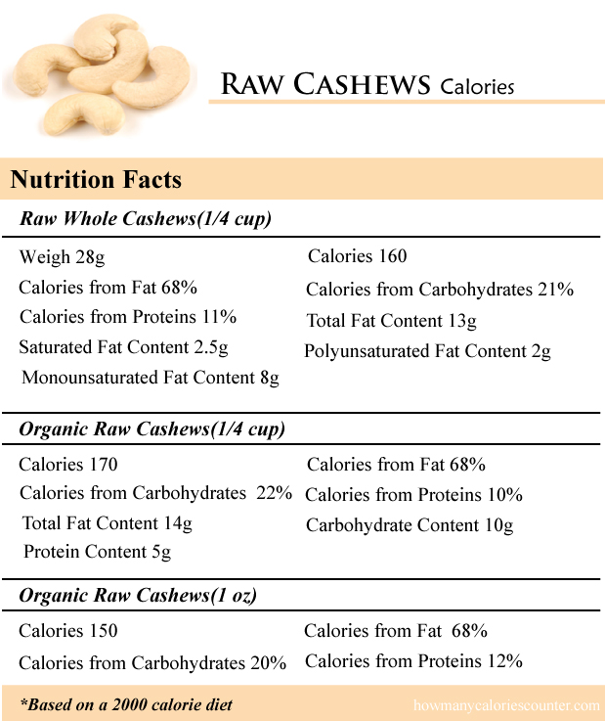

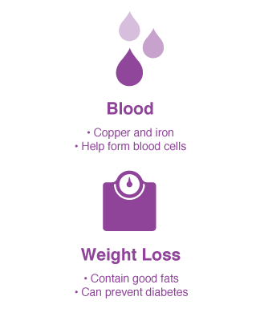
health benefits of Cashew
Cashew is one of the most healthiest dry fruits
It contains rare minerals like zinc, copper, magnesium, manganese and phosphorus, and is of high nutrition value
Cashew is an antioxidant with essential vitamins and monounsaturated fat such as Oleic Acid
Cashew nut (Anacardium occidentale),
Source: http://www.whfoods.com/genpage.php?tname=foodspice&dbid=98

Slide 5

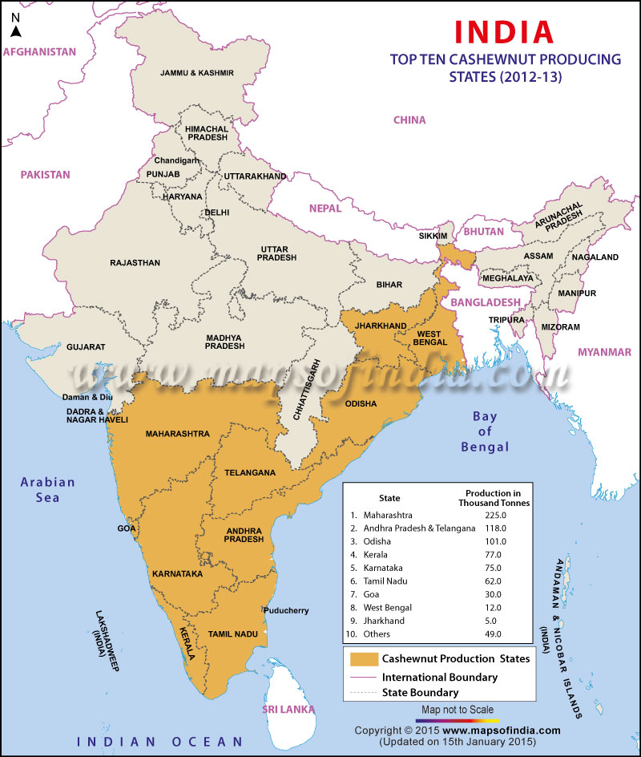
Cashew – INDIA FACTS
India is number one in Cashew cultivation, production, processing and consumption
Vietnam beats India when it comes to Cashew exports
India has around 10 Lac Hectares of land under cashew cultivation
Total RCN production stands at 7 Lac Metric Tons per annum
More than 16 Lac Metric Tons of RCN is processed in India
We see around 9 to 10 Lac Metric Tons of RCN is being imported
The reason for low cashew production:
  30-40% of plantations are old, senile and belong to government organizations
  The past 5 years has seen 5-7 lac hectares of new cashew plantation, which are yet to provide the optimum yield

Slide 6

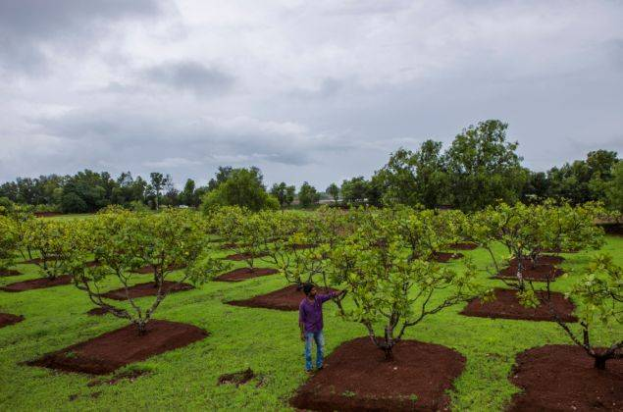
Cashew – Economic importance
Cashew is one of the highest earning crop with minimum care
All the products of the cashew tree has global demand
Cultivation Tips:
  Usage of latest technology – high-yielding hybrid grafts
  Drip irrigation and water harvesting system
  Mulching, timely fertigation, pruning & training to the plants
  Pest & disease management
  Post harvest management
  More than 20 kilograms of yield per tree can be achieved with the above techniques in mind
Usually 200 trees can be planted per hectare which can earn up to US $4000 with a scenario of 2 metric tons yield per hectare, as per Indian market
Inter-cropping can help maintain the Cashew plantation with extra earnings

Slide 7

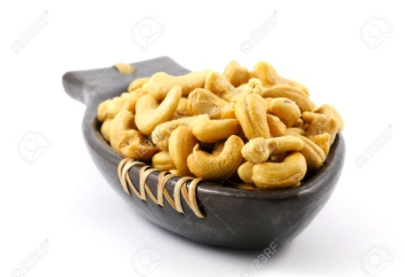
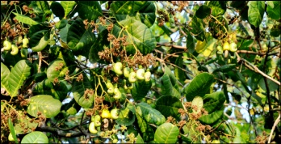
Cashew Value chain
Nursery
RCN Traders
Processor
Farmer
DOMESTIC
EXPORT
Tree to Table
Consumer
Retailer

Slide 8
Linkages of Processing
PROCESSORS
BACKWARD
FORWARD
SERVICE PROVIDERS

Slide 9
Linkages Contd. – Backward
PROCESSORS
FARMER’s
FARMER’s
TRADER’s
TRADER’s
BACKWARD
TRANSPORTER’s
TRANSPORTER’s
MACHINE SUPPLIER’s
MACHINE SUPPLIER’s
PACKING MATERIAL SUPPLIER’s
PACKING MATERIAL SUPPLIER’s

Slide 10
Linkages Contd. – Forward
PROCESSORS
WHOLE SELLER’s
IMPORTER’s
FORWARD
TRANSPORTER’s (Road & Sea)
RETAILER’s & PACKER’s
CONSUMER’s

Slide 11
Linkages Contd. – Service Providers
PROCESSORS
POLICY MAKER’s & INCENTIVES
INFRASTRUCTURE PROVIDER’s
SERVICE PROVIDERS
FINANCIAL INSTITUITIONS / BANK’s
TECHNOLOGY and R&D
THREAT CREATORS

Slide 12

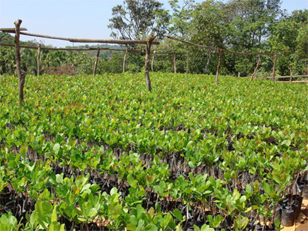
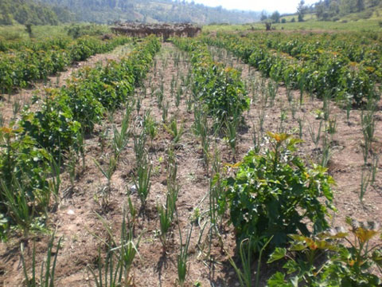
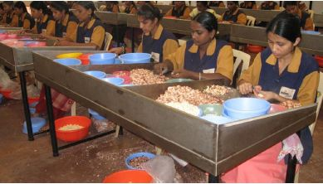
Cashew value chain – India's importance – Skills and expertise!
NURSERY
  R&D centers
  Role of scientists
FARMERS
  Land development
  Selection of graft
  Space management
  Planting Procedure
  Farm management
  Water management
  Fertigation
  Pest & disease management
  Post harvest management
  Inter-cropping
  Organic farming
PROCESSORS
  Latest automated machinery
  Sanitation
  Quality management
  Packaging
  Taxation & flexible government policies

Slide 13

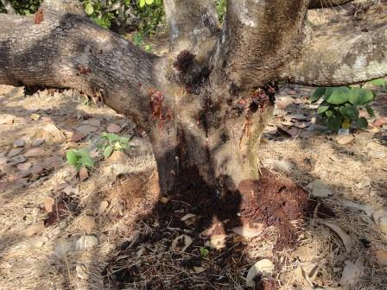
India –
Looking at the current Cashew prices and earnings – farmers are enthusiastic to grow cashew
Expected production is estimated to be about 2 million tons per year
Cultivation areas is expected to reach 1.5 million hectares by the year 2025
Old and senile plantations will be replaced with high yielding hybrid plants to reach the vision 2025 production goal
To provision the yield Govt. of India is proactive and encouraging farmers to cultivate Cashew
R&D centers in India are constantly in search of quality planting materials to increase yield
Research centers are also engaged in finding best possible solutions for pest management and disease control (stem borer)

Slide 14

Conclusion
Looking at the potential of India in R&D, availability of land, proactive farmers and domestic consumption, utilization of broken kernels, export potential, commitment – INDIA will continue to be the pioneer in CASHEW INDUSTRY, and will regain it’s number ONE position as an EXPORTER by 2025!

Slide 15


