Slide 1




Organised By
Advantages & Opportunities of Investing in the Nigerian Cashew Industry
Mr Olusegun Awolowo
11 February 2017
Title Sponsor
Platinum Sponsor
09-11 February, 2017
Grand Copthorne, Singapore

Slide 2
Nigeria Cashew profile
10 - among top 10 Global Raw Cashew Nut (RCN) producing countries
4th largest producer in Africa after Cote d’Ivoire, Guinea-Bissau and Tanzania
17 out of 36 States in Nigeria grow cashew in commercial quantities. Cashew grows in almost every state
325,000 hectare cultivation area
0.4MT/Ha average yield per hectare
175,000MT produced in 2016
$300M earned in 2016
160,000MT of RCN exported in 2015
175,000MT targeted for 2016

Slide 3
Production - progressive trend

Slide 4
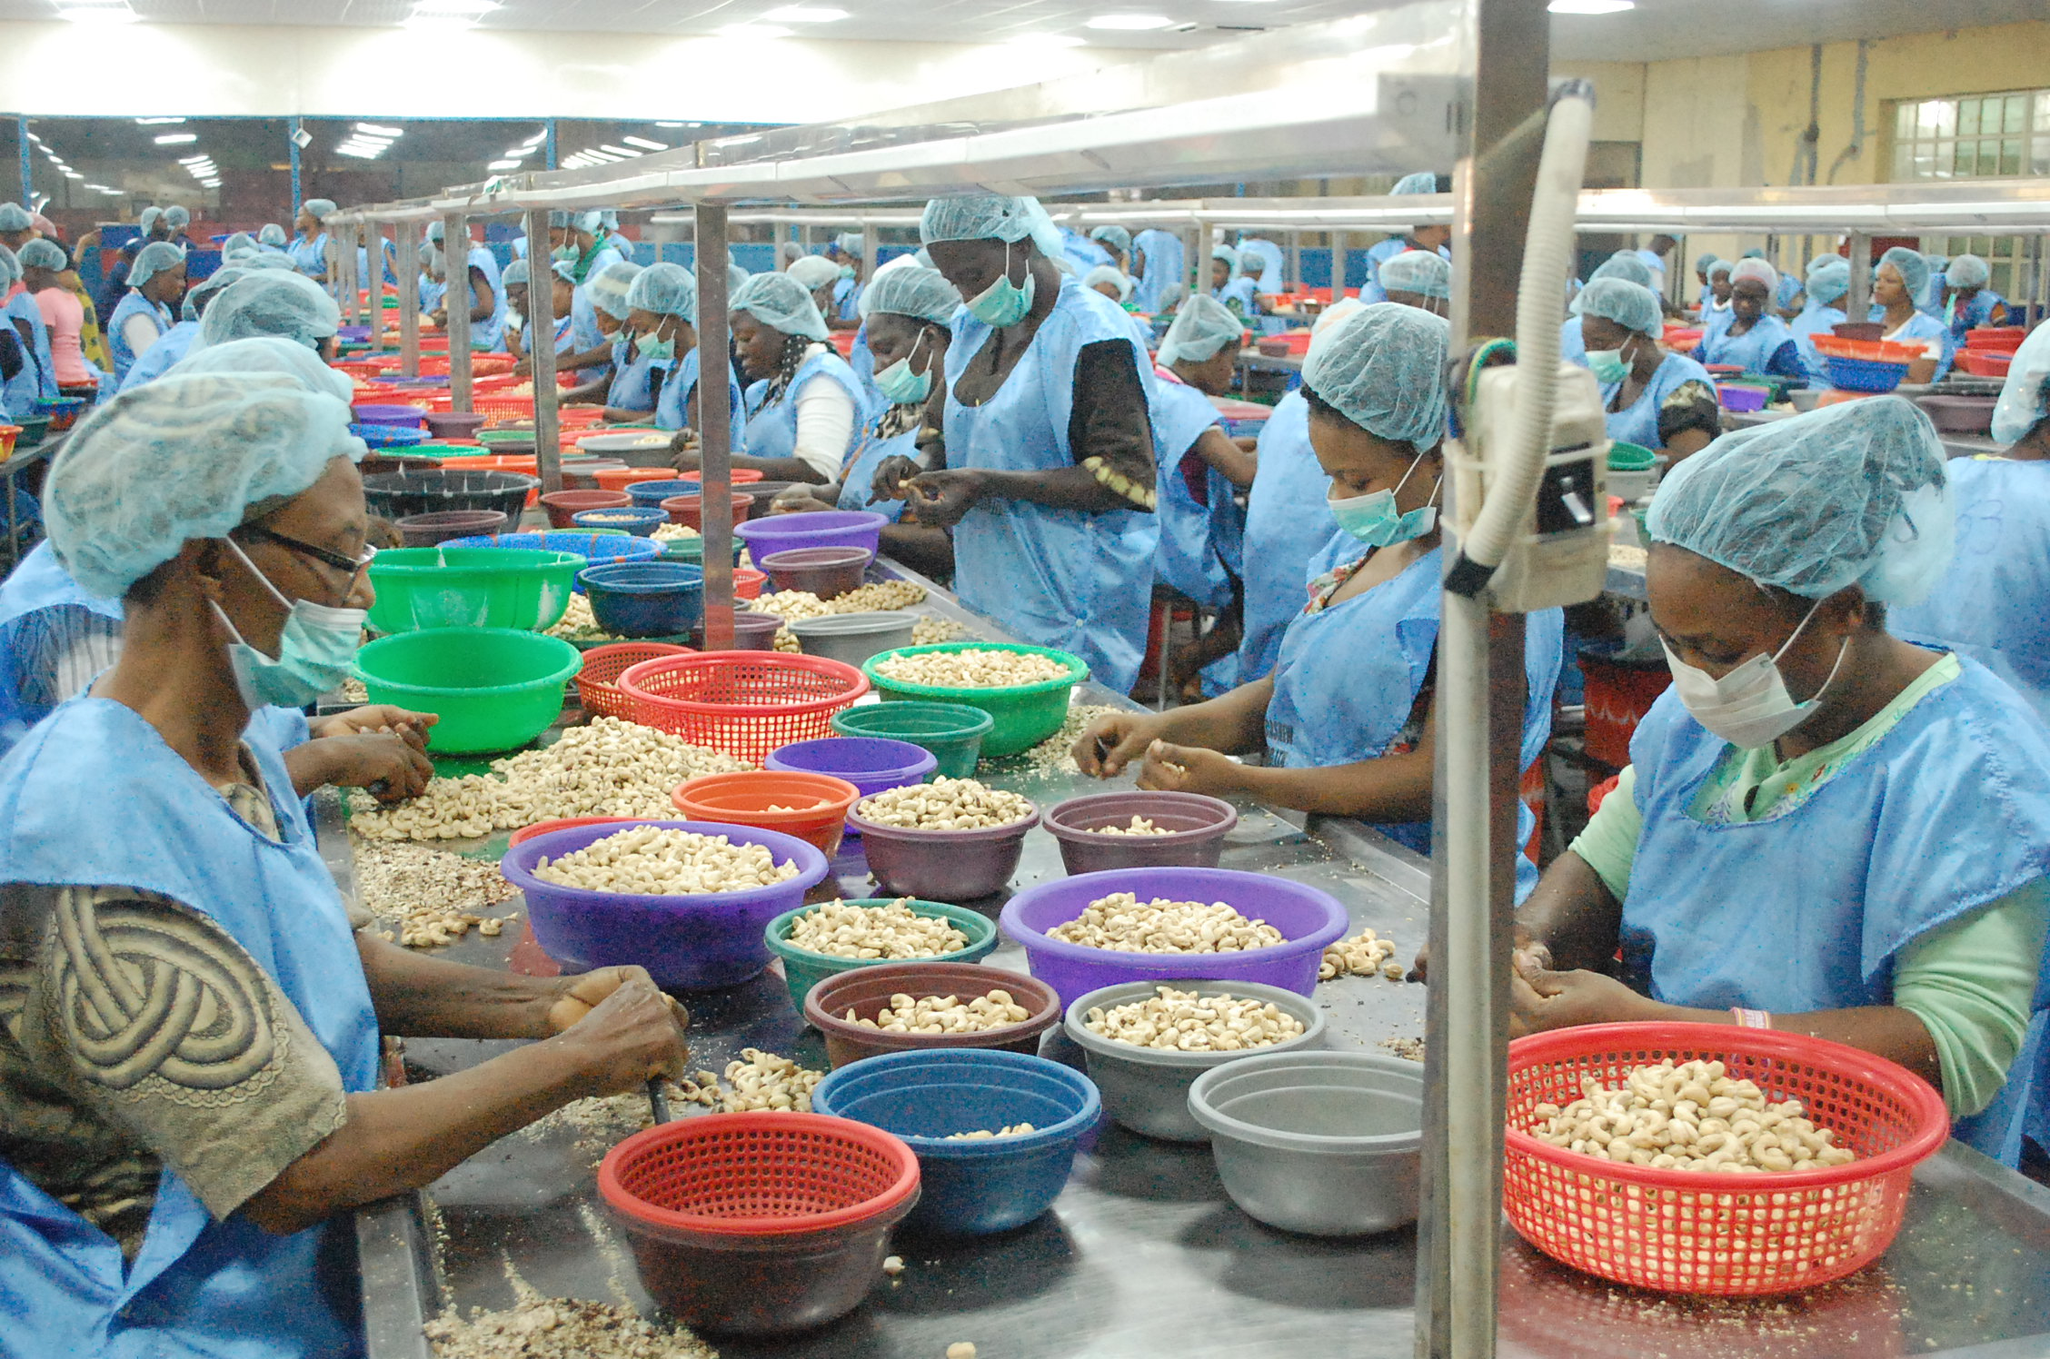
Where are the opportunities?
Production
Processing
Packaging
Business management
Plant and machinery
Technology and innovation
Value addition
Capacity building and skills enhancement
Inputs
Research and Development
Valency factory – Ogun State, Nigeria

Slide 5
Advantages
170Million population in Nigeria
300Million people in ECOWAS
Access to major international markets in Europe, America and the Middle East
Captive work force – Young people and women
Largely under tapped sector
Government focus on agriculture for economic growth
Cashew is a priority product for the government
Business environment is improving
New financing provisions from the Central Bank through national banks, DFIs and ECAs
Over 90% of total land size in Nigeria is arable
Large work force; 72% under the age of 30
Strategic position gives access to a market of 300million people
Strong government focus on agriculture for economic growth

Slide 6

What the government is doing - Zero oil plan
Identifies 24 major products to replace oil as main source of foreign exchange for Nigeria
Zero Oil programme Framework (DONE!)
Zero Oil Sectorial Activities
(Ongoing)
Petrochemicals & Methanol;
Soybeans;
Sugar;
Cotton & Yarn;
Nitrogenous Fertilizer & Ammonia;
Palm Oil;
Rice;
Rubber;
Hides and Leather;
Cocoa;
Gold;
Category B Products- Cashew, Tomato, Ginger, Sesame etc.

Slide 7
What the government is doing - APP
Agricultural Promotion Policy – promotes a Government enabled, private sector led growth driver for Agricultural sector.
Policy thrusts cover
Research &Development
Infrastructure
Finance
Mechanisation
Storage
Processing
Irrigation
Market & Trade
Quality & Standards
Entrepreneurship

Slide 8

What the government is doing –
National Economic Recovery and Growth Plan
Organized around 5 thematic areas
Macro policies
Revenue enhancement
Cost optimization
Monetary policy and banking system
Governance & enablers
Governance
Security
Subnational coordination
Public service delivery
Growth drivers
Agriculture
Manufacturing
Solid minerals
Services
NERGP
A
National Economic Recovery Plan
National Economic Recovery and Growth Plan
Objectives: Articulate medium-term economic policies to implement over 2016-20, and prioritize key turnaround interventions and enablers generate concrete, visible impact by 2017
Key actions will be articulated based on the SIP and other national reports
E
B
D
C
Investing in our people
Job creation and inclusive growth
Social safety net
Public service delivery
Competitiveness
Business environment
Infrastructure (transportation, power)

Slide 9
Presidential Enabling Business Environment Council
Chaired by the Vice President, aims to position Nigeria among top 100 countries on the Ease of Doing Business Index by 2019.
Areas of focus include:
Entry/Exit of People – including Visa reforms
Entry/Exit of Goods (Trading across borders)
Government Transparency and digitization (starting with websites and procurement process)
Business registration
Access to credit
Paying Taxes
Land Registration reforms (Lagos & Kano)
Construction Permits (Lagos & Kano)

Slide 10
Statutory incentives and sector specific incentives
Pioneer status: 3 - 5 years tax holiday
100% repatriation of profits allowed
Capital allowances:
– 140% of R&D expenses incurred
– 20% of infrastructure costs
Low value added tax (5%)
Tax relief on interest income in the agriculture/agro-allied sector
0% duty for power generation and distribution machinery
0% import duty & import value added tax for commercial aircrafts and spare parts imported for local use
0% import duty & import value added tax for machinery imported to develop solid mineral resources
The Nigerian Investment Promotion Act 16 of 1995 allows foreigners to invest and participate in the operation of any Nigerian enterprise without restrictions

Slide 11
Conclusion
Cashew sector has witnessed progressive growth over the last few years
The sector needs more investment and attention to reach its potential – e.g. Nigeria produces 0.4MT/ha compared to Vietnam’s 1000kg/ha
The Federal Government of Nigeria recognises agriculture as a key growth driver for the economy
Agriculture contributes 40% to GDP
The business environment is improving, there is more coherence and synergy in government planning, policy and actions
We invite you to partner with us on our growth movement.

Slide 12
Thank you

