Slide 1
MAKE IN INDIA
KALBAVI PRAKASH RAO

Slide 2

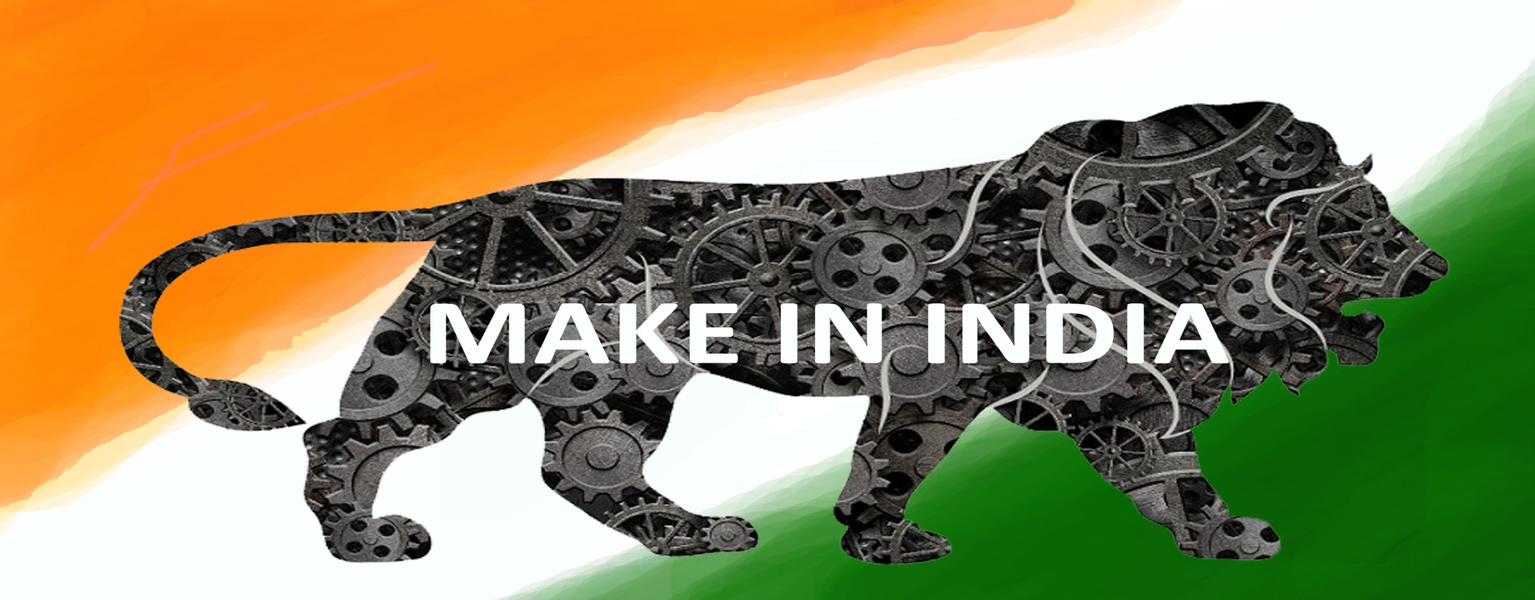

Slide 3

WHY INDIA??
SEVENTH LARGEST, MOST POPULOUS AND VIBRANT DEMOCRACY
POLITICALLY – VERY MATURE AND STABLE
GDP GROWING > 7%... CONSISTENTLY
FASTEST GROWING ECONOMIES IN THE WORLD TODAY

Slide 4

WHY MAKE IN INDIA ??
LARGEST PRODUCER, MANUFACTURER AND CONSUMER
SUSTANABLE GROWTH
MOST EFFICEINT CONVERTOR
SUPPORTIVE GOVERNMENT

Slide 5

CASHEW LEGACY IN INDIA
YEAR | PRODUCTION | PROCESSING | % GROWTH
1970-80 | 250,000 MT | 250,000 MT
1980-90 | 375,000 MT | 500,000 MT | 100%
1990-2000 | 520,000 MT | 825,000 MT | 65%
2000-10 | 615,000MT | 12,65,000 MT | 55%
2010-17 | 725,000 MT | 172,5000 MT | 38%
2020-30 | 15,00,000 MT | 27,00,000 MT | 58%

Slide 6

RAW MATERIAL
PRODUCES 750,000 MT OF RCN IN ONE MLN HECTARES
DIRECTORATE OF CASHEW RESEARCH(DCR), ARS AND UAS
DIRECTRATE OF CASHEW & COCOA DEVELOPMENT
CASHEW GROWN IN OVER 17 STATES
PRODUCTION –SET TO DOUBLE NEXT DECADECASHEW
HIGHLY VIABLE AND SUSTAINABLE CROP IN INDIA

Slide 7

INDUSTRY STATUS
INDUSTRY -A PAN INDIA PHENONMENON
SIZE OF THE INDUSTRY- OVER 2000 …SME SECTOR
PROCESSING 1.7 MLN MT OF RCN
WELL ESTABLISHED PROCESSING TECHNOLOGY
MECHANISATION- STILL EVOLVING
LABOUR COMPONENT: > 600,000 RURAL WOMEN

Slide 8

INDIAN MARKETS
@ 300,000 MT-LARGEST CONSUMER IN THE WORLD
GROWING @7-8 % PER ANUM
OGANISED RETAIL GROWING @10-12%
GROWTH SEGMENT-AS AN INGRDIENT
PRICES OF BROKENS =WHOLES !!
HIGHEST VALUE REALIZ ATION IN PROCESSING-THE SUSTANCE FACTOR

Slide 9

BANKING SECTOR
93 COMMERCIAL BANKS-PUBLIC,PRIVATE & FOREIGN
27 PUBLIC SECTOR BANKS
FLUSH WITH FUNDS… LOW INTREST REGIME
EXCELLENT NETWORK,TECHNOLOGY
OVERALL.. VERY STRONG SECTOR

Slide 10

GOVERNMENT SUPPORT
STATE SUBSIDIES,INCENTIVES FOR NEW INDUTRIES
CENTRAL INCENTIVES FOR EXPORTS
NATONAL HORTICULTURE MISSION(NHM) INCENTIVES

Slide 11

DESTINATION INDIA
OVER 7 DECADES OF EXPERIENCE
TIME TESTED BUSINESS HOUSES- GREAT OPPORTUNITY FOR STRATEGIC PARTNERSHIPS
BIGGEST TAX REFORM ON THE ANVIL-GST
SKILLED WORKFORCE-AVAILABLE PAN INDIA

Slide 12

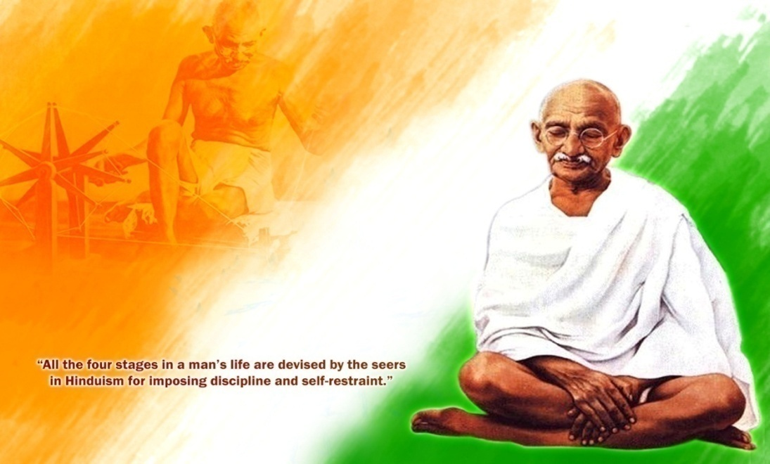
INDIA….
Is a land of peace and Diversity
People are said to be intellectual and spiritual
“I visit every country as a tourist.. But I visit India like a pilgrim
…..Martin Luther King

