Slide 1

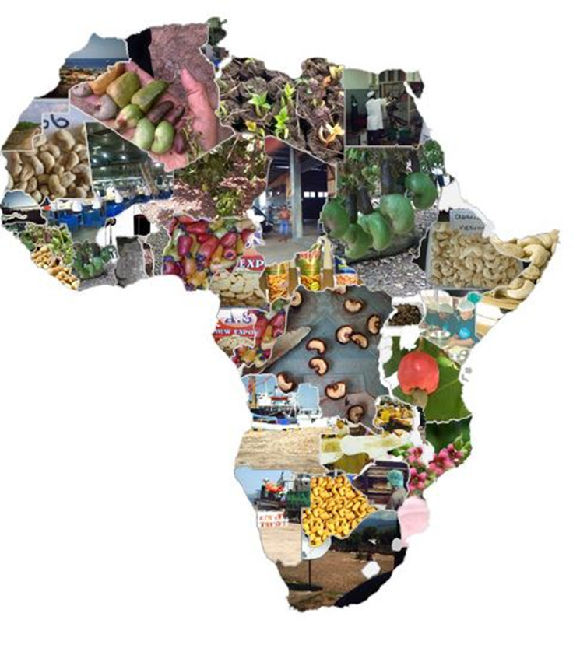



Organized By
Africa Investment Forum
Title Sponsor
Platinum Sponsor
09-11 February, 2017
Grand Copthorne, Singapore

Slide 2
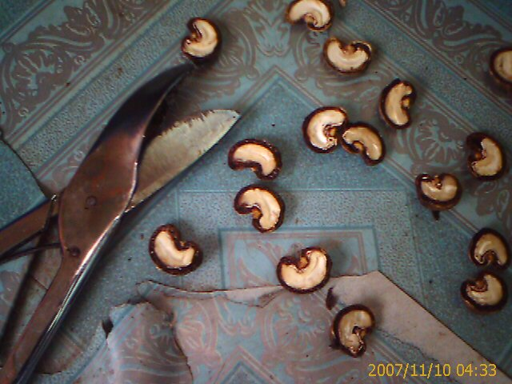
Agenda
Introduction
Three short presentations
Discussion with Deepak Kacher
Q/A --- 15 minutes
Your company logo

Slide 3

Introducing our speakers
Olusegun Awolowo
NEPC, Nigeria
Jauad Bruno
Investment
Promotion Agency
Guinea Bissau
Deepak Kacher
Fludor, Benin
Karim Berthe
CCA
Cote D’Ivoire

Slide 4
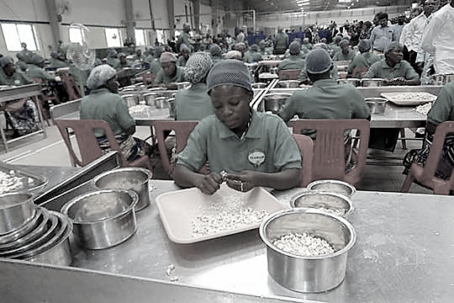
Investment Opportunities
& Challenges

Slide 5
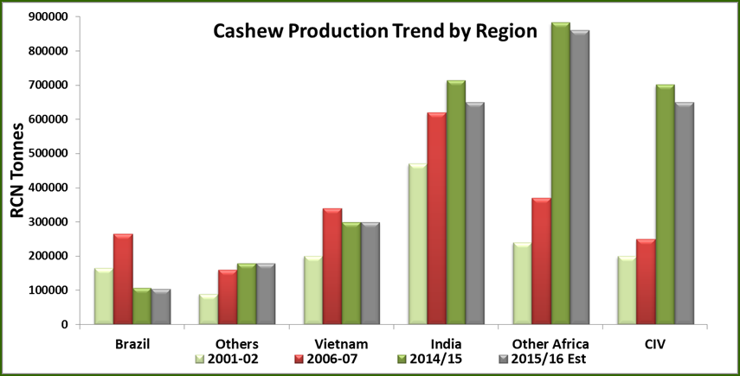
Cashew Production

Slide 6
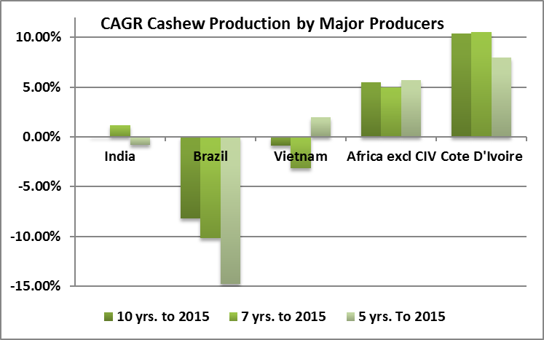

Slide 7
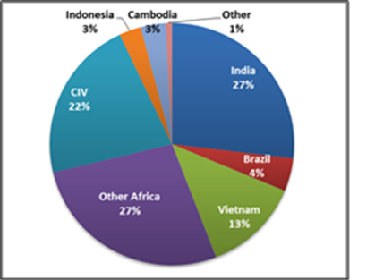

Cashew World Production 2025
Africa 49%
India 27%
Vietnam 13%
Africa 58%
India 18%
Vietnam 9%

Slide 8

Buyer behavior
Default of contract
Late collection of raw cashew nuts
Late payments
Other Risks
Lack of knowledge of buyer’s requirements
Bushfires
Land tenure issues (land loss)
Producer level risks suggest processors are losing out due to own behavior and late availability of working capital.

Slide 9
Key Operational Risks
Lack of Management skills
Low cost competitiveness
High raw material prices
High energy costs
Other Risks
Working Capital failure
Failure to build supply chains
Processor level Risks were mainly operational in nature and relate to their ability to remain cost competitive.

Slide 10
Turning Production growth into value addition
Cashew Processing entrepreneurs need investors / Investors need processors who think business development not just trading .
Cashew processors need finance / Financial institutions need processors with good business plans, secure supply chains , management systems and markets
Cashew processors need customers / Buyers need suppliers who will develop relationships , are competitive, meet their quality and other requirements , develop their process and honour their contracts.
Processors need developed supply chains./ Growers need buyers who pay market prices and develop relationships
Notes:
This is about the type of relationships we choose to develop.

