Slide 1





Organised By
Augmentation of Productivity in Cashew – Challenges & Approaches
Dr. D.L. Maheswar
Vice Chancellor
University of Horticultural Sciences, Bagalkot
Karnataka, INDIA- 587 104
Title Sponsor
Platinum Sponsor
09-11 February, 2017
Grand Copthorne, Singapore

Slide 2
CASHEW IN INDIA- AN OVERVIEW
7.25 lakh tonnes production (2015-16).
Domestic kernel demand: 2.5 L MTs (2/3rd of production)
Export - 1.5 L MTs of kernel
Import- 8.5 L MTs of raw nuts
Raw Cashew Nut Productivity- 720 kg/ha.
National Raw Nut requirement - 16-17 L MTs
National target by 2025- 20-25 L MTs
Potential yield- 3-4 MTs/ha.
UHSB
Notes:
Cashew – Anacardium occidentale L.
Native of Brazil.
Introduced into India during 16th Century to control soil erosion
India nourished this crop and made it a commodity of International trade and acclaim.
International trade in cashew kernels began during early part of the 20th Century.
Cultivated in east coast, west coast regions and also to some extent in plains region and NEH region.

Slide 3
STATE WISE STATUS OF CASHEW IN INDIA
State | 2014-15
 | A | P | APY
Kerala | 85 | 80 | 946
Karnataka | 125 | 81 | 645
Goa | 58 | 32 | 550
Maharashtra | 186 | 235 | 1262
Tamil Nadu | 140 | 67 | 478
Andhra Pradesh | 185 | 100 | 539
Orissa | 180 | 86 | 474
West Bengal | 11 | 13 | 1096
Others | 56 | 32 | 658
Total | 1027 | 725 | 706
A - Area in '000 Ha, P - Production in '000 MT, APY - Average Productivity in Kg per Ha
UHSB
Notes:
Area: Maharashtra (First ) followed by Andra Pradesh, Orissa, Tamil Nadu &
Karnataka (5th Position)
Production: Maharashtra (First ) followed by Andra Pradesh, Orissa & Karnataka (4th)
Productivity: Maharashtra (First ) followed by West Bengal, Kerala & Karnataka (4th)

Slide 4
CONSTRAINTS IN CASHEW PROMOTION IN INDIA
Large area (30%)under senile plantation, yielding less than 200 Kg/ha
Lack of focussed attention due to competitive crops
Mainly grown on marginal lands
Lack of availability of quality planting material
Limited adoption of good management practices & technologies
Under utilization of processing capacity of Industries
Inadequate utilization of cashew apple & by-products
Lack of remunerative prices
Lack of organized farmers groups/institutions
UHSB
Notes:
Early cashew plantations were established with poor quality seedling progeny and are now unproductive.
Poor soil fertility in cashew growing areas, seedling progeny of indistinct origin and neglect of crops.
Senile plantations were more prevalent in Karnataka, Goa, Andhra Pradesh, Orissa and Tamil Nadu.
The lack of transfer of technology programmes to better equip farmers.

Slide 5
VARIETIES TO AUGUMENT PRODUCTVITY
State | Recommended varieties
Karnataka | NRCC Sel-2, Bhaskara, Ullal-1, Ullal-3, Ullal-4, UN-50, Vengurla-1 (Uttara Kannada), Vengurla-4 (Uttara Kannada), Vengurla-7 (Uttara Kannada)
Karnataka (maidan part) | Chintamani-1, Chintamani-2, Dhana (H-1608)
Kerala | BLA-39-4 (Madak-1), NDR-2-1 (Madak-2), K-22-1, Kanaka (H 1598), Dhana (H 1608), Priyanka (H 1591), Amrutha (H 1597), VRI-3
Maharashtra | Vengurla-1, Vengurla-4, Vengurla-6, Vengurla-7 , V-8
Goa | Goa-1, Goa-2, Vengurla-1, Vengurla-4, Vengurla-6, Vengurla-7 , V-8
West Bengal | Jhargram-1, Jhargram-2, BPP-8
Orissa | Bhubaneswar-1, BPP-8, Dhana
Tamil Nadu | VRI-3, VRI(cw)5
Andhra Pradesh | BPP-4, BPP-6, BPP-8
UHSB

Slide 6
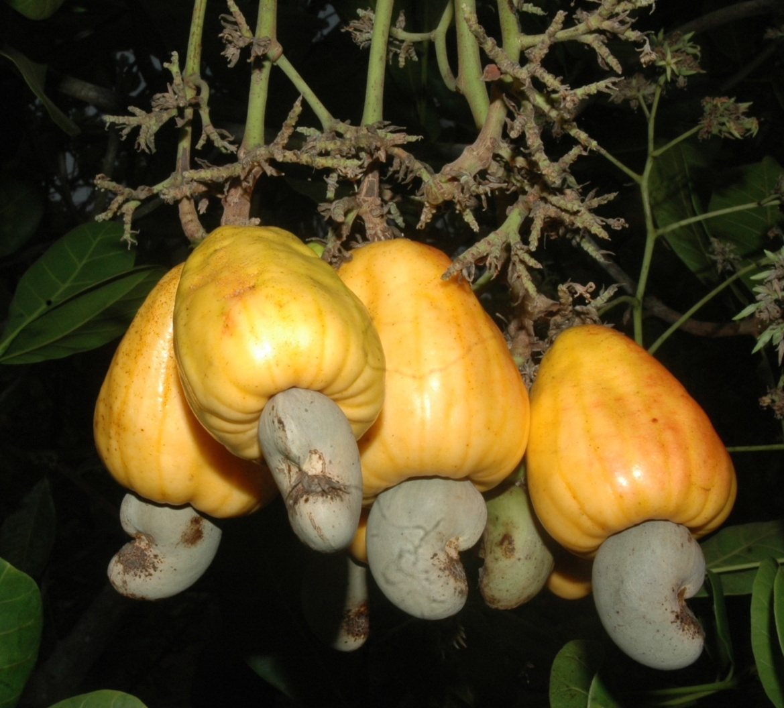
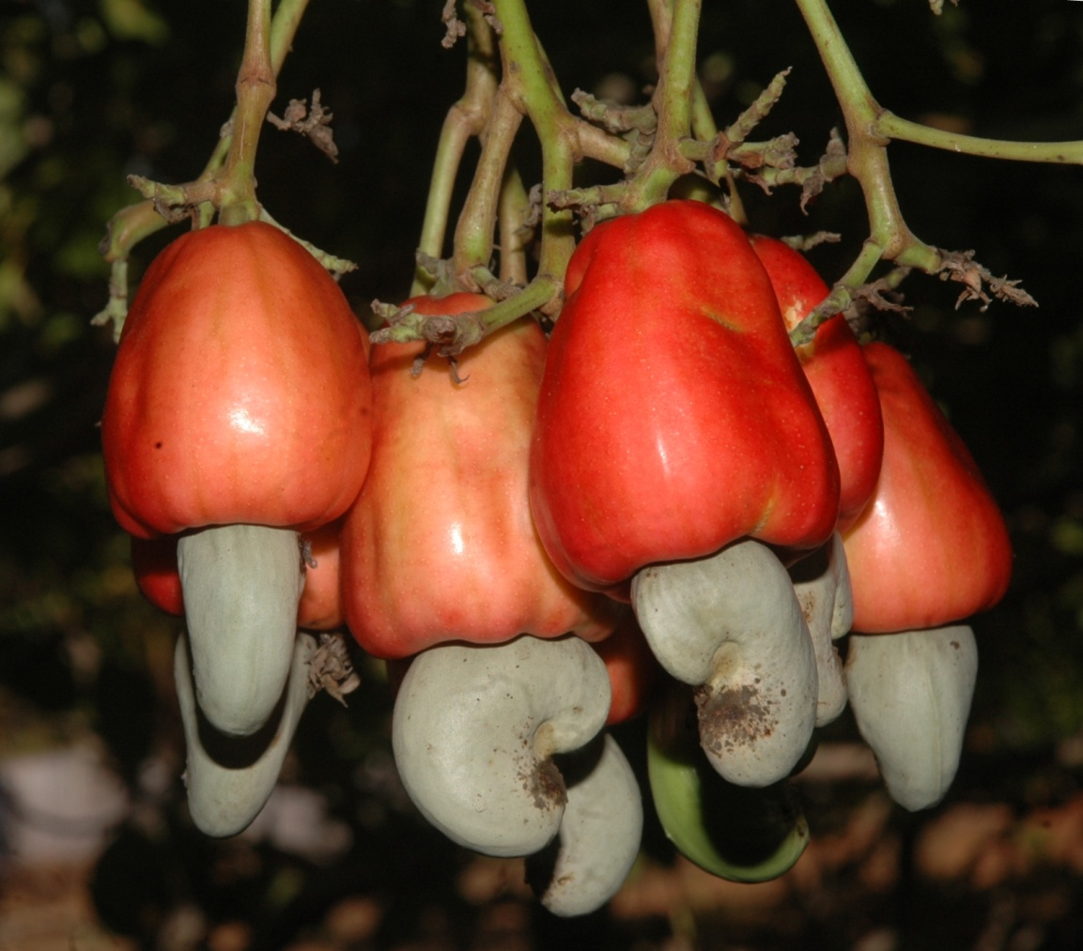
COMMERCIAL VARIETIES
ULLAL-1
ULLAL-3
UHSB
Notes:
Ullal-1:
Medium spreading canopy with mean nut yield of 16 Kg/tree
Ullal-3
Open canopy with mean nut yield of 14.7Kg/tree

Slide 7
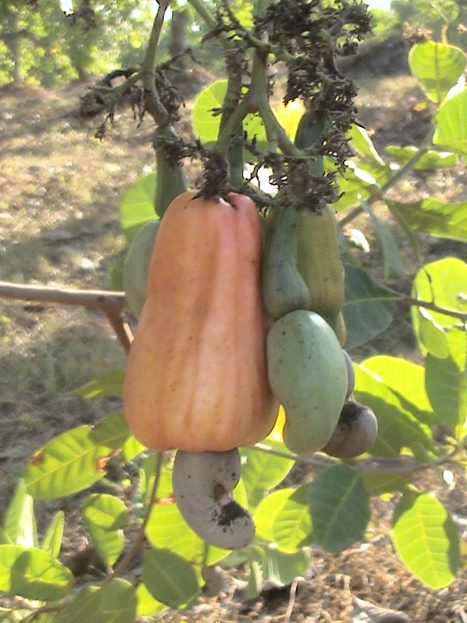
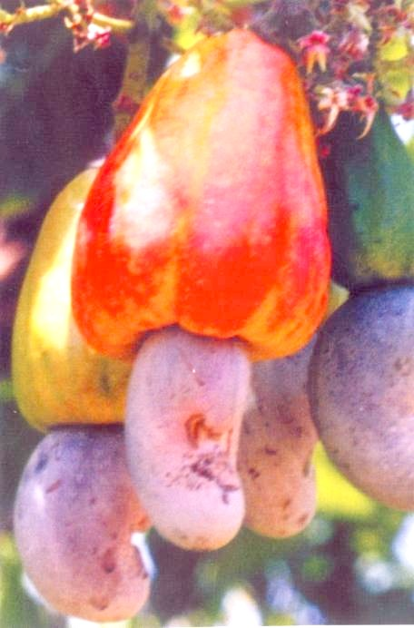
COMMERCIAL VARIETIES
UN – 50
CHINTAMANI-1
UHSB
Notes:
U N 50 : (Ullal Nileswar -50)
Medium canopy with mean nut yield of 10.5 Kg/tree
Chintamani -1
Open canopy with mean nut yield of 7.2 Kg/tree

Slide 8
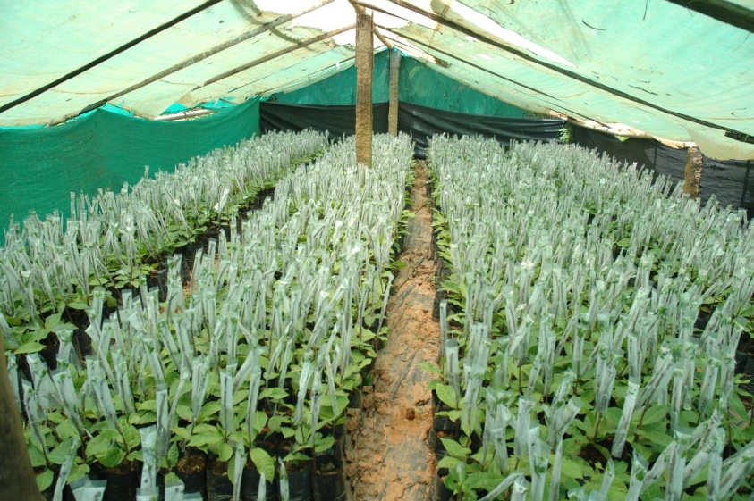
QUALITY PLANTING MATERIAL
Soft wood grafting– approach for large scale planting materials
UHSB

Slide 9
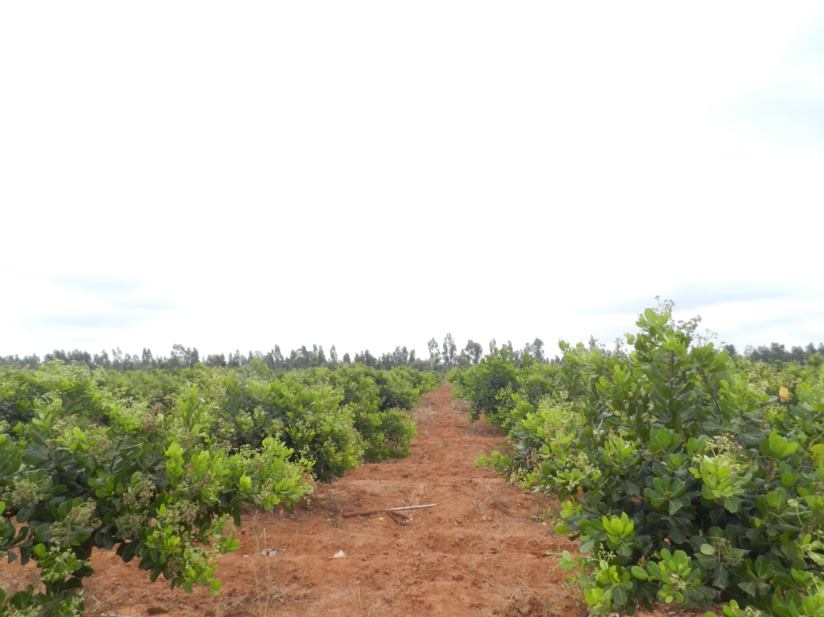
HIGH DENSITY PLANTING
Research Block at UHS GKVK, Bengaluru(4X4 M=625Plants /ha)
UHSB
Notes:
High density planting with 4 x 4 m spacing (625 plants/ha) was shown to be better than traditional spacing (8 x 8 m)
Increase in yield over 2.5 times

Slide 10
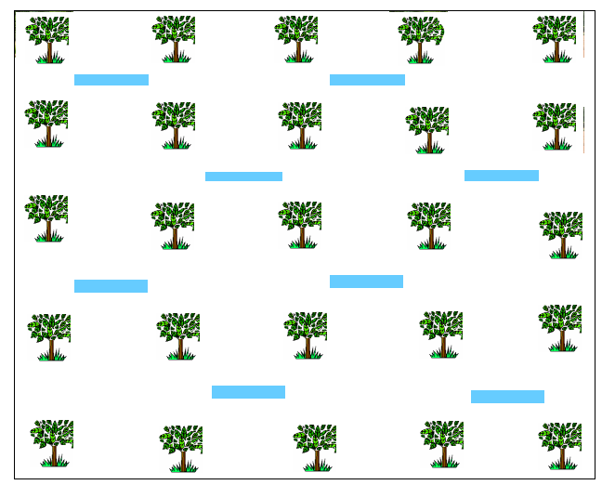
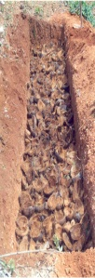
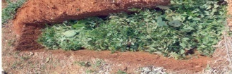
MOISTURE RETENTION-Trenches, Mulching, Biochar, Hydrogel
UHSB
Notes:
Coconut husk burial to extend moisture availability by one month
Staggered trenches,
Degradation of husk increase soil porosity & improve soil health

Slide 11
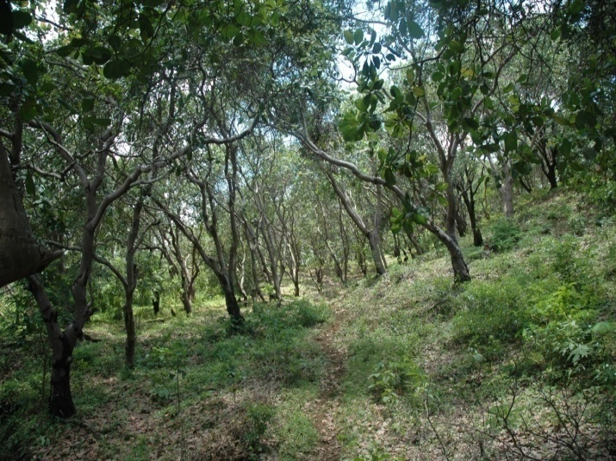
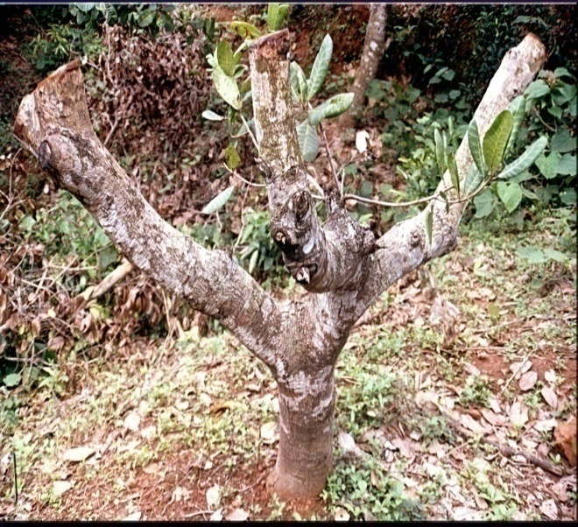
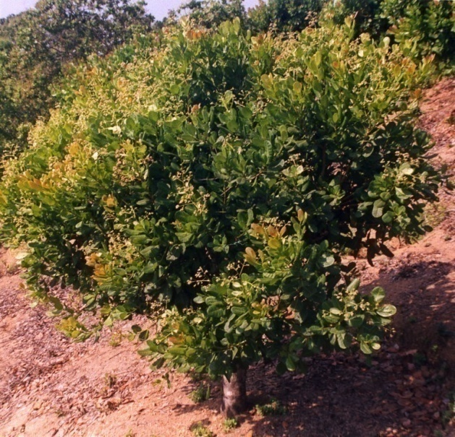
REJUVENATION OF CASHEW BY LIMB PRUNING
Senile plantation
Limb pruning
Rejuvenated plant
Yield performance of rejuvenated trees
Varieties | Yield/tree (kg)
 | 1st year | 2nd year | 3rd year
VRI-1 | 1.62 | 3.19 | 8.01
ULLAL-1 | 2.95 | 4.42 | 8.84
VTH-30/4 | 1.81 | 4.61 | 9.30
NRCC Selectionl-1 | 0.72 | 1.23 | 8.10
Unpruned (Control) | 3.25 | 3.01 | 5.59
UHSB

Slide 12
TECHNOLOGICAL INTERVENTIONS
Cashew varieties viz., Ullal - 1, Ullal -2, Ullal – 3, UIlal -4, UN-50, Chintamani – 1, Chintamani – 2 were released and recommended.
Fertilizers application of 500:250:250g of NPK/per plant/year
Sealer & healer treatment for management of CSRB.
Rejuvenation of low yielding, poor quality producing trees was standardized.
Technology for improving fruit setting with growth hormones (2,4, D and NAA).
Medium high density planting technology (6x6 mt, 5x5 mt)
Inter cropping and mixed cropping technologies.
Canopy pruning once in 2 to 3 years for increased productivity
UHSB

Slide 13
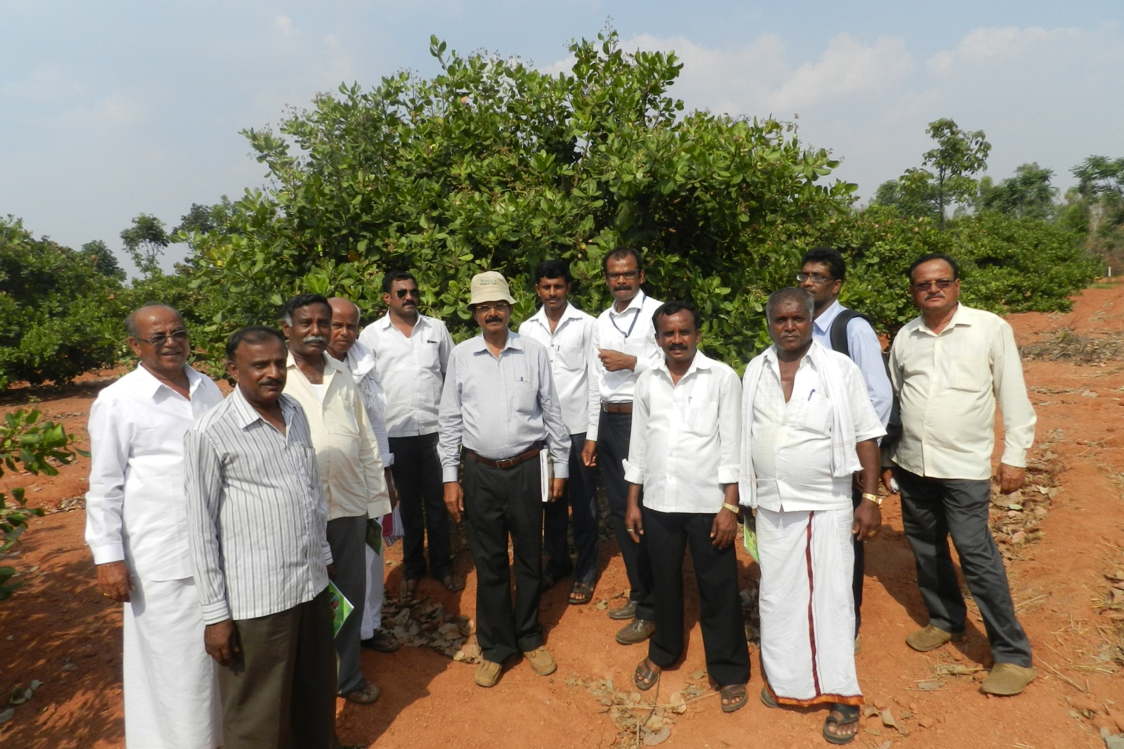
INNOVATIVE FARMERS EXPLORING CASHEW CROP
UHSB
Notes:
Exposure to farmers of non-traditional area for encashing the
potentiality

Slide 14
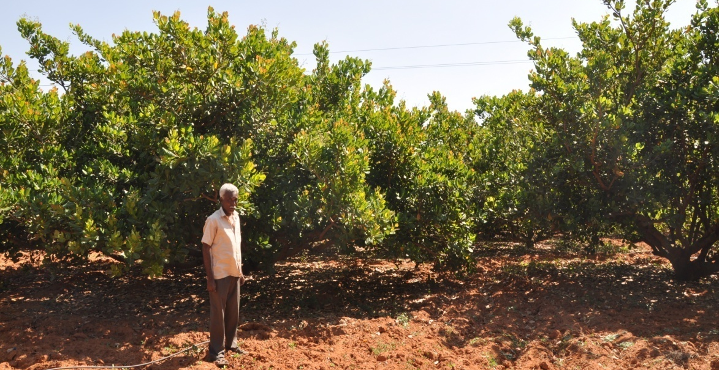
CASHEW AS A SUCCESSFUL SUBSTITUTE
Cashew substituted mango plantation
Mr. Nagaraj, from Kaalanayakana Halli, realized 90,000 net profit per acre
UHSB
Notes:
Senile and unproductive mango orchard was replaced with cashew

Slide 15
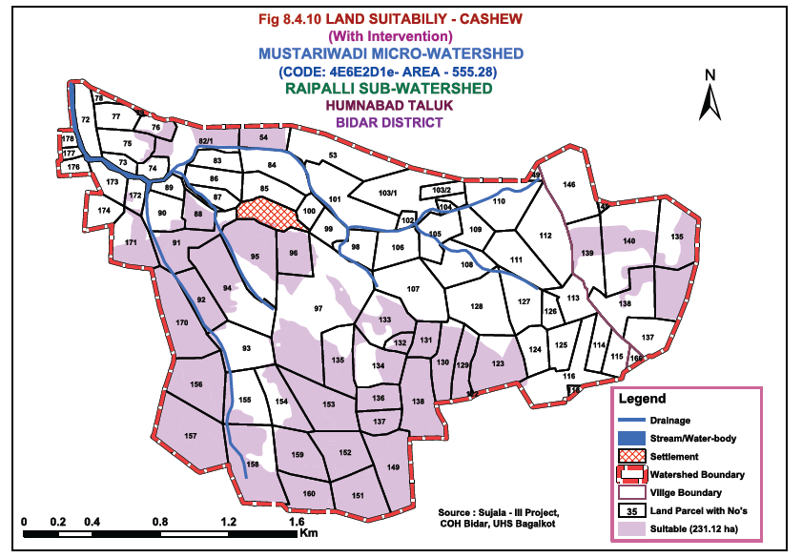
INTERVENTIONS FOR PROMOTION OF CASHEW IN DEGRADED /LATERITE MINED SOILS IN WATERSHED AREAS OF BIDAR
UHSB
Notes:
In Watershed area of Bidar Cashew finds good cash crop and well suited for the region

Slide 16
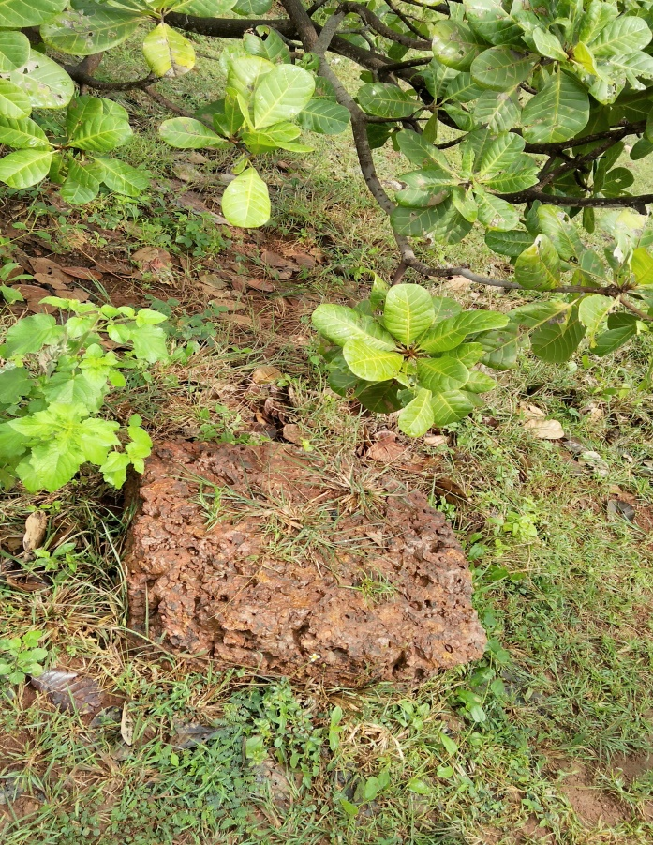
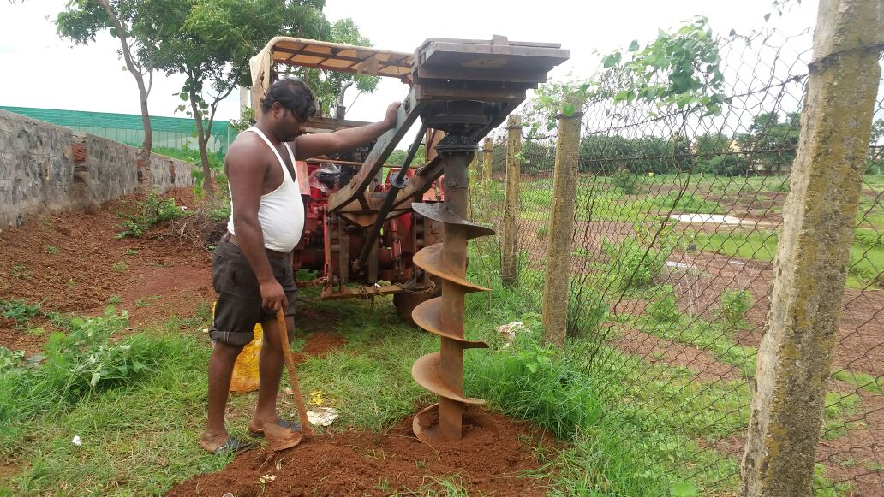
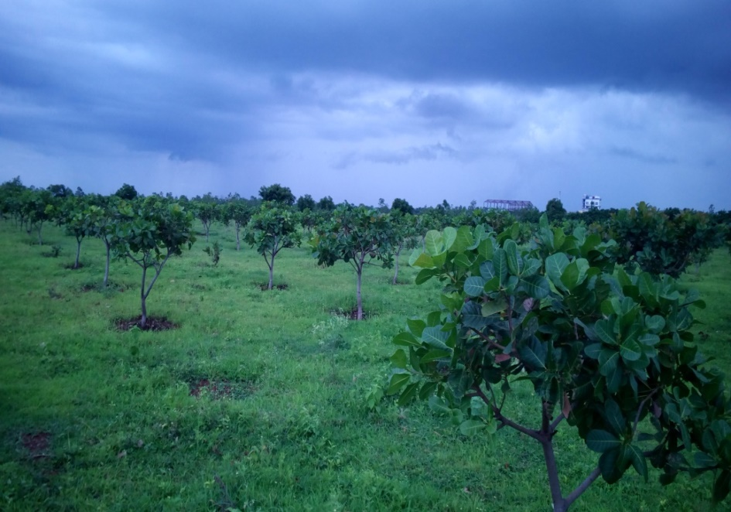
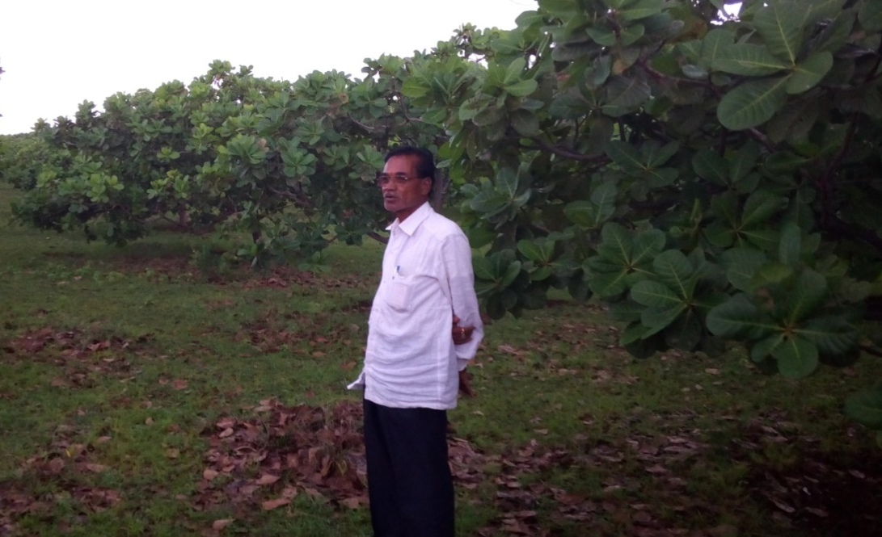
ESTABLISHMENT OF CASHEW IN DEGRADED LANDS
UHSB
Notes:
Cashew - become good cash crop in hardy, rocky and basalt soils

Slide 17
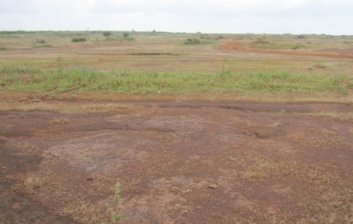
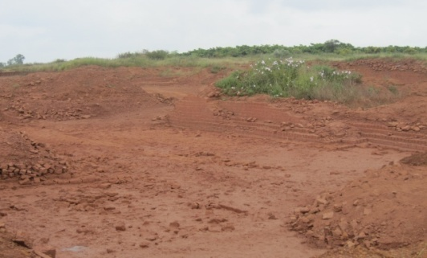
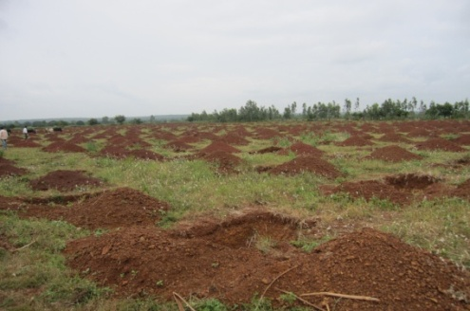
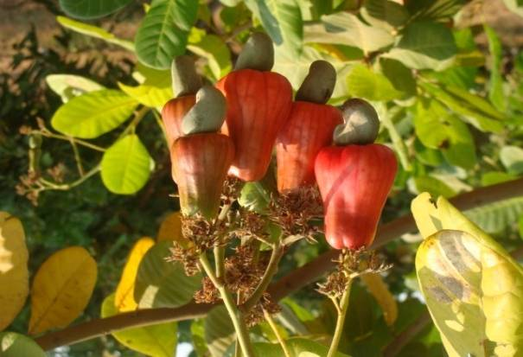
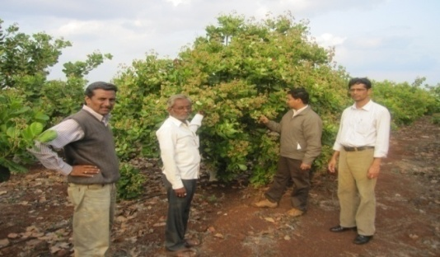
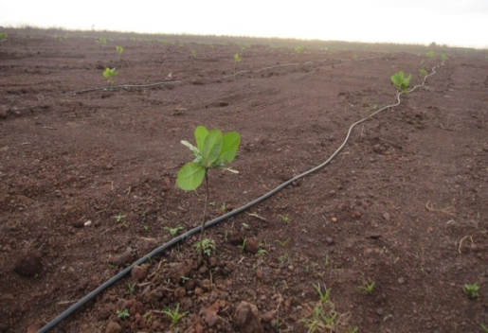
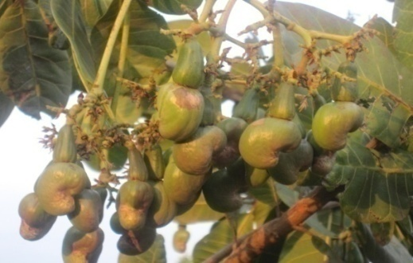
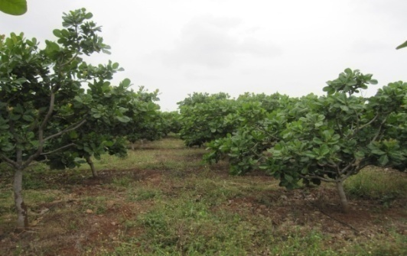
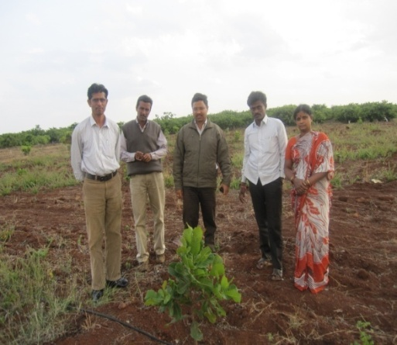
TRANSFORMATION OF DEGRADED LANDS WITH CASHEW
UHSB

Slide 18
ROAD-MAP FOR CASHEW PROMOTION
Promotion of Cashew Farmers Producer Organizers
Mission Mode programme through PPP-ICD
Hands on support for processing industries
Development of an exclusive cashew promotion policy
Liberalized incentives for area expansion & technology promotion
Promotional plans for industry status
Enhanced R & D support for PHM ad value addition
Massive planting programme in non-traditional areas
Transfer of technology – ICT, Crop Apps, FLD, Exposures etc
Creation of exclusive crop experts group for cashew
Skill enhancement courses for young cashew growers
UHSB

Slide 19
Thank You
UHSB
09-11 February, 2017

