Slide 1




Organised By
INVEST IN GUINEA BISSAU
Bruno Jauad
09 Feb 2017
Title Sponsor
Platinum Sponsor
09-11 February, 2017
Grand Copthorne, Singapore

Slide 2


Slide 3
The Guinea Bissau home in 2025 Reform in the Business and Investment Environment
GUINEA BISSAU 2025
-
Sol
Na
Iardi
CATALYTIC SECTOR
GROTH
DOMESTIC
ENGINES
SECTORS
Information
Mines
Housing
Technology
Tourism
Construction
Fishing
Energy
Commerce and
Agriculture and Agro-Industry
distribution
-
Biodiversity
Human Capital
Infrastructure and Urban Development
Business Environment
Good Governance

Slide 4
Business Environment
Reform of the legal and regulatory framework for the business environment
Creation of Economics Special Zones (multisectorials)
Private Sector
Development
Creation of integrated industrial platforms
Establishment of a competetive, transparent and predictable framework.
Notes:
It was elaborated and approved the DENARPII (second generation), a document of reference for any kind of intervention such as in the economic, social and environmental domain. This document also reflects among other concerns, the achievement of a strong and sustainable growth in the next 5 years, and that this growth is also inclusive, that is, be able to reduce above all, the number of people living with less than one (1) USD per day

Slide 5
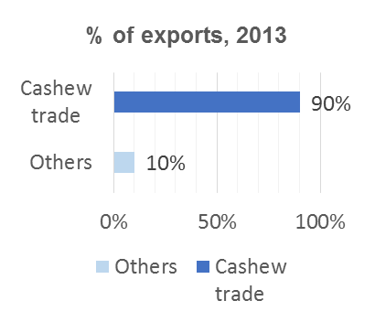
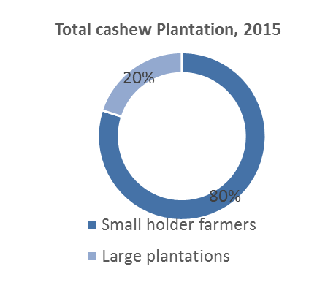
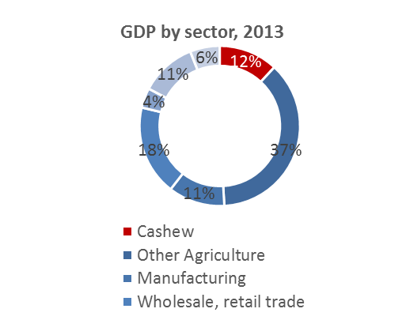
As oil is to Saudi Arabia, Cashew is for Guinea-Bissau; holding a critical role in overall economy
~80% of cashew plantations in the country cultivated by small farmers
Raw cashew nut trade constitutes ~90% of country’s exports
Cashew cultivation accounts for ~12% of the country’s GDP
Total land under cashew plantations is ~600,000 Ha in 2015
~80% of the rural population is engaged in cashew cultivation
Production of cashew nuts remains the mainstay of the economy, accounted for ~90% of total exports
Primary sector represented 49%, Secondary represented 38% & tertiary represented 13% of GDP in 2013
Cashew sector accounts for 12 – 15% of the GDP
*ECOWAS represents Economic Community of West African States
Source: Country Strategic Plan; DENARP II; World Bank; Literature search

Slide 6
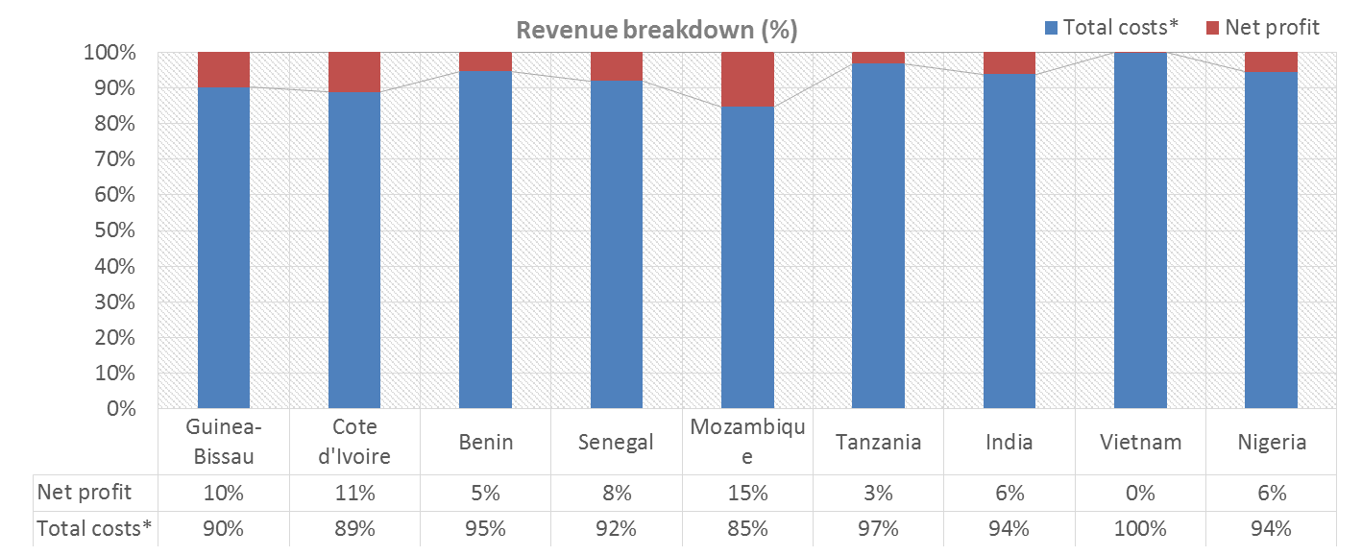
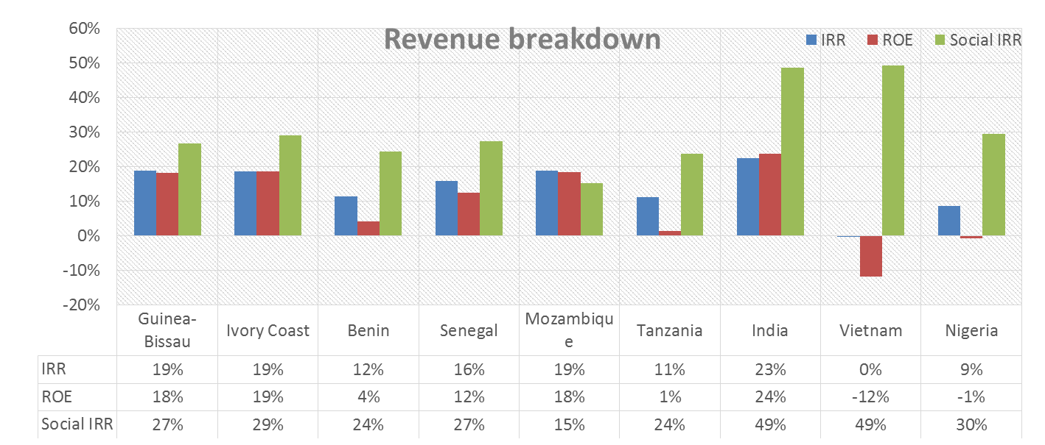
Benchmarking analysis: Guinea-Bissau cashew processing opportunity delivers healthy profits compared to West African peers
*Total costs includes all fixed, variable, financial costs and corporate tax
Source: TNS analysis
Benchmarking analysis assumptions:
Plants are semi-mechanized, 5000MT capacity
Plant operating at ~83% capacity, year 3

Slide 7
Under prevailing conditions, RCN processing opportunity most likely to yield benefit for investors in Guinea-Bissau
RAW cashew NUT PROCESSING
BY PRODUCTS PROCESSING
SUPPLEMENTAL SERVICES
Involves processes of de-shelling, peeling, grading, packaging. etc. Variable models to undertaken these processes possible based on scale & investment
Semi-mechanized mix
Highly mechanized: Brazilian
Innovative ways have been discovered to commercialize non-kernel cashew derivatives:
Extraction of Cashew Nut Shell Liquid (CNSL)
Production of Cajuina/ juices
Cashew pulp production
Possible to develop Support industries simultaneously with core cashew nut processing:
Cashew processing equipment manufacture
Cashew investment fund – sector specific
Transit warehouses business
Transport of raw materials business
Development services of Local expertise
OPPORTUNITY
Guinea-Bissau has plentiful of high quality RCN with cost advantage; can process kernels at competitive price
CNSL production not viable at current price level; can be considered as a joint project in the long-run
Equipment manufacturing can be pursed after RCN processing is established
Current infrastructure in GB not suited to produce high-end machinery
JUSTIFICATION
SUITABILITY FOR GUINEA-BISSAU
HIGH
LOW
LOW

Slide 8
Earning potential better with higher volumes & automation; semi-mech. & Brazilian tech. with 3000-5000MT capacity well suited for G.Bissau based on its Capex & W.Capital requirements
8 Year comparison
 | SEMI-MECHANIZED |  |  | HIGHLY MECHANIZED
 | Small (1500-3000MT) | Medium (3000-5000MT) | Large with CNSL (5000-10,000MT) | Brazilian medium (3000-5000MT) | Brazilian Large (5000-10,000MT)
FINANCIALS
Investment ($) | 1,361,426 | 2,161,254 | 3,381,961 | 2,493,526 | 2,619,814
Total Equity ($) | 1,361,426 | 2,161,254 | 3,381,961 | 2,493,526 | 2,619,814
IRR | 16.73% | 18.87% | 24.20% | 20.33% | 29.86%
NPV | 892,846 | 1,997,333 | 4,910,853 | 2,754,413 | 5,709,685
Payback (years) | 5.2 | 4 | 4 | 4 | 3
ROE | 12.45% | 18.06% | 26.00% | 23.48% | 37.88%
CAPEX
Year 1 ($) | 1,279,858 | 2,032,244 | 3,185,792 | 2,358,002 | 2,466,502
Year 2-4 ($) | 407,999 | 661,990 | 924,289 | 215,525 | 1,468,602
Year 5-8 ($) | 294,943 | 422,833 | 610,165 | 253,825 | 264,325
Total 8 year investment | 1,982,800 | 3,117,067 | 4,720,246 | 2,827,352 | 4,199,429
OPERATIONS
Utilized capacity | 93% | 96% | 95% | 96% | 95%
W.Capital Requirement ($) year 4 | 1,869,171 | 3,689,164 | 6,115,325 | 3,153,942 | 6,591,504
SOCIAL METRICS
Jobs created, Year 8 | 417 | 655 | 1132 | 430 | 756
Social IRR | 25% | 27% | 31% | 21% | 28%
Source: TNS analysis

Slide 9
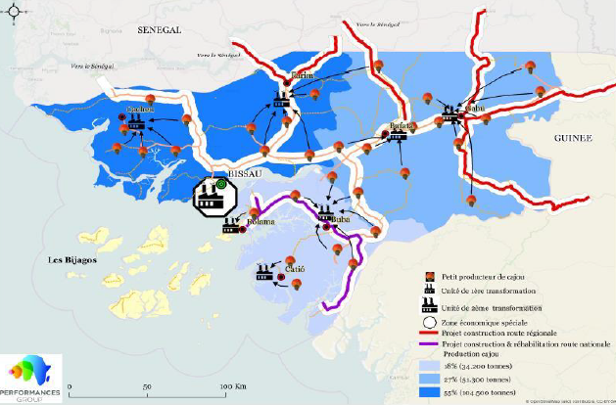
Optimal processing locations are able to leverage proximity to producers, access to labor and other facilities, etc.
Northern region has some inherent benefits over other regions
Region contributes ~50% of RCN production
Closest to Bissau which has best infrastructure and access to other facilities within country
REGION | 2015 POPULATION (est.)
Bafatá | 254,633
Gabú | 261,329
Bissau | 470,338
Bolama (Bijagos) | 41,907
Cacheu | 233,415
Oio | 272,380
Biombo | 117,758
Quinara | 77,127
Tombali | 115,113
Total | 1,844,000
Northern region collectively contains ~27% of national population
Source: Guinea-Bissau country strategic report; Guinea-Bissau Cashew Value chain, Mendes 2014; Technoserve analysis
Notes:
Opportunity & Potential

Slide 10
WARRANTIES AND INVESTMENT PROTECTION
Investment Incentives:
Reduction of time and bureaucratic procedures costs ('one-stop administrative shopping' )
Currency : CFA Francs , freely convertible and indexed to the Euro
Full membership of the Multilateral Investment Guarantee Agency (MIGA) / International Finance Corporation (IFC), World Bank Group
FOREIGN CURRENCY TRANSFER WARRANTY
The state garanties external transfer, through bank dividend and profit system
Transfer operations, sale or liquidation of investments between non-residents and foreign investors are free and the export of disposals is guaranteed

Slide 11

Guinea-Bissau seeks to attract viable investment projects:
Wealth generation for promoters/ investors
Protect the investments
double taxation agreements
Improve legislation and Investment-related regulation
Wealth creation and value creation for the Country

