Slide 1





Organised By
CHINA MARKET
MR VU THAI SON
(GENERAL DIRECTOR)
February 10, 2017
Title Sponsor
Platinum Sponsor
09-11 February, 2017
Grand Copthorne, Singapore

Slide 2
BUYING POWER
By 2016, population of China is around 1,380 billion of about 1/5 of world population
Average per capita in come US$ 7,200 and growing fast (above average)
Like to eat nut including cashew so buying power should be good.

Slide 3
EATING HABIT
Very famous in the world for their own way of foods and flavor.
Like to eat nut as snack as well as cooked nut with foods. Good market for low quality of cashew kernels. When mixed and cooked with other foods, it is hard to know that they are low quality cashews.
Like to add flavor, so they can buy even off flavor cashew (good market for low quality)

Slide 4
FOOD SAFETY
Not demanding high food safety
Not demanding HACCP or very clean factory
Not checking pesticide residue and other chemical
* An easy market for food safety, easy for small and medium factories to supply

Slide 5
QUALITY PREFERENCE
Like white color and dry cashew
But in fact they can pay for all quality. Good quality good price, bad quality (not AFI standard) pay less price.
For sure they like uniform, not mixture of lower grades.

Slide 6
BUSINESS CULTURE
Very similar to Vietnam culture, most of them can speak Vietnamese
Like gentleman agreement, words and fax scan of grades, price is enough, no written contract needed. No 3rd party make inspection before loading. Mainly base on trust

Slide 7
BUSINESS CULTURE (Continued)
Cash payment is still popular, that’s why still like to buy through land border (with higher freight) but manage to pay less VAT.
Not very much direct sales to roasters, mainly through trading companies because trading companies will give roasters credit.
Often buy much volume linking to big event like: Lunar New Year, Mid Autumn Festival

Slide 8
China import data from Vietnam (not from other source like from India or Indonesia)

Slide 9
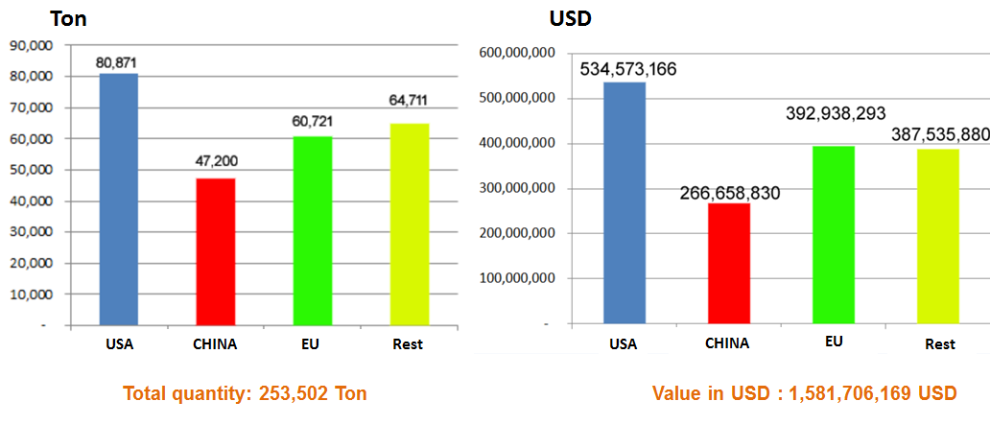
YEAR 2013

Slide 10
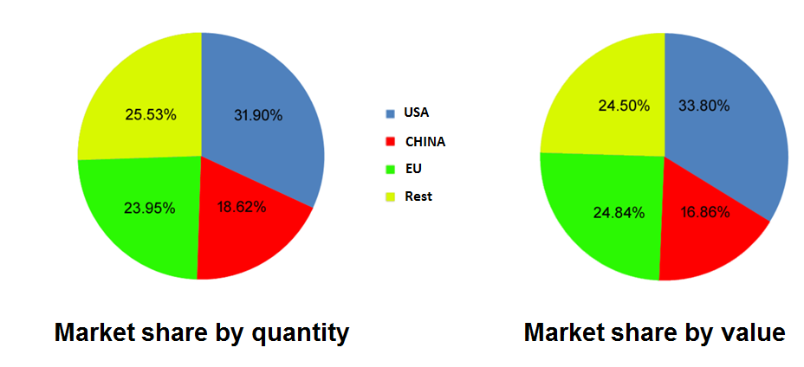
YEAR 2013 (Continued)

Slide 11
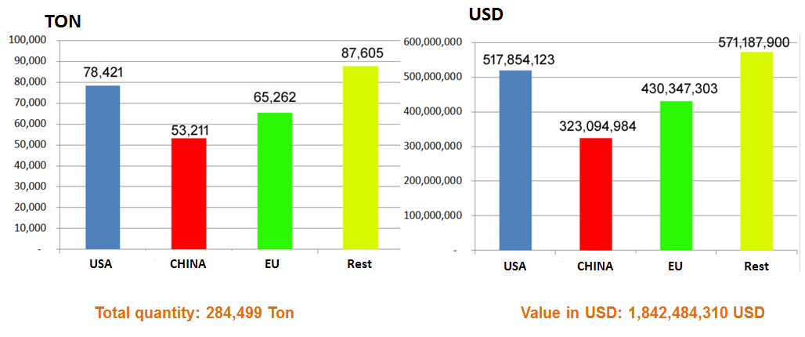
YEAR 2014

Slide 12
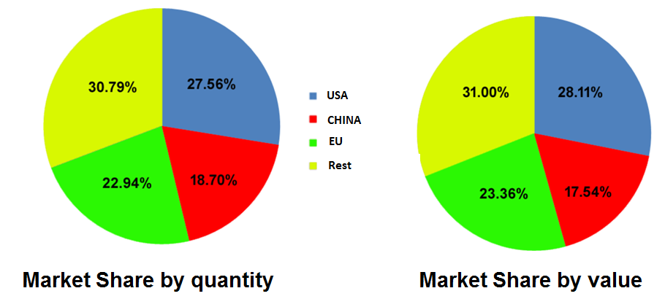
YEAR 2014 (Continued)

Slide 13
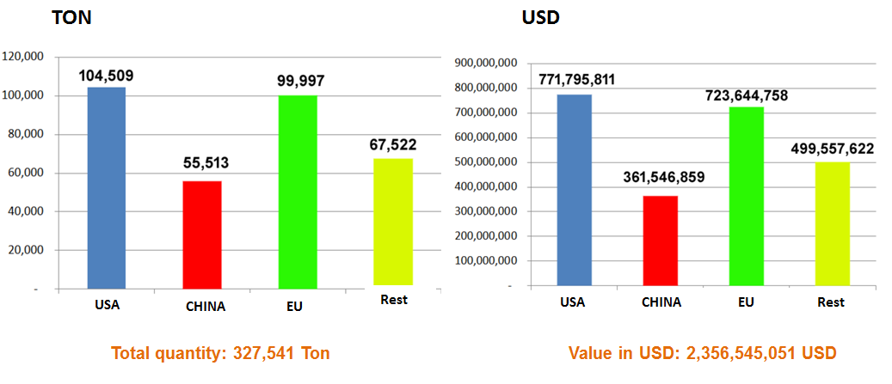
YEAR 2015

Slide 14
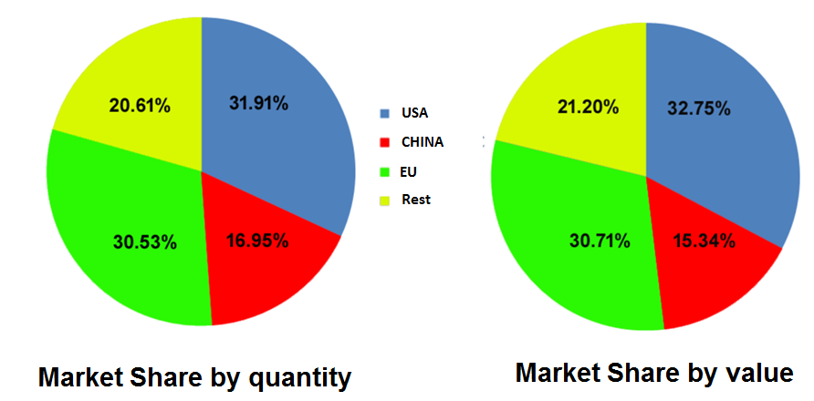
YEAR 2015 (Continued)

Slide 15
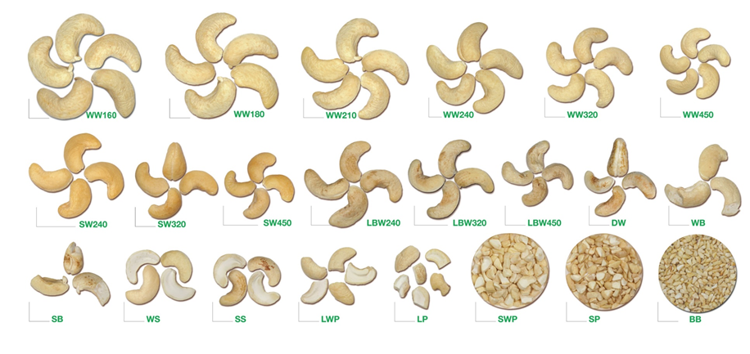
GRADES FOR ALL MARKET

Slide 16
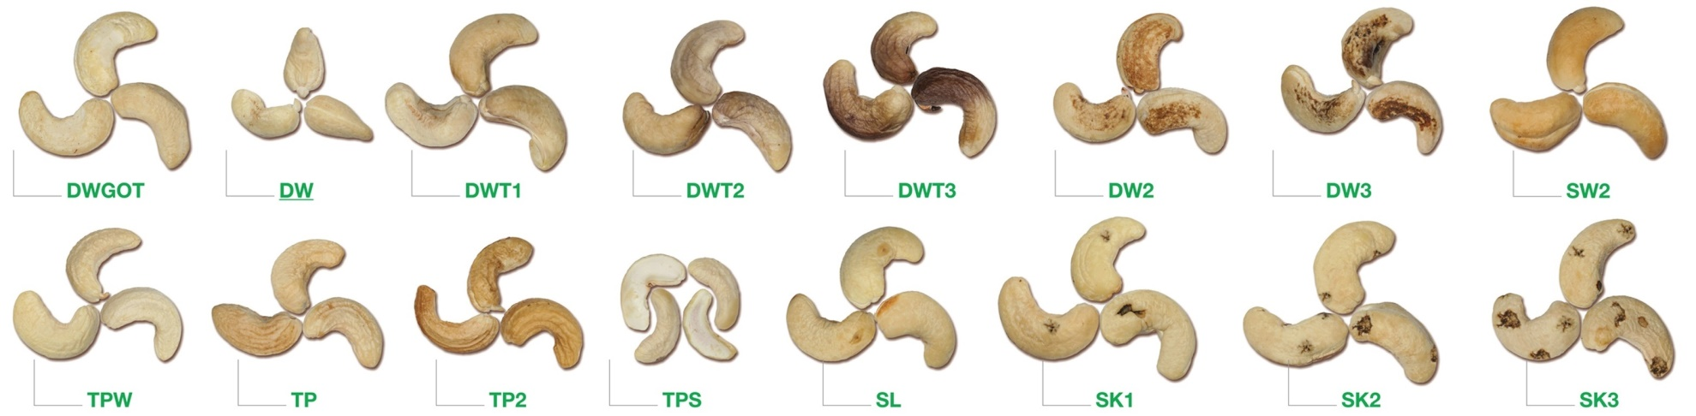
GRADES ONLY FOR CHINA MARKET

Slide 17
CONCLUSION
With very big population and good buying power and the eating habit, China market plays very important role especially if you process African cashew where you have many lower grades.
China have their own culture which is very different from Western culture, so to be successful in China market you need to understand and follow the culture

Slide 18
THANK YOU VERY MUCH!

