Slide 1



Organised By
Maersk Trade Finance
Single window: Flow of goods and money
Vipul Sardana
10th Feb, 2017
09-11 February, 2017
Grand Copthorne, Singapore

Slide 2


The structure of modern trade is difficult for small teams to navigate
Complex relationships
Wasted resources
Lost time
Lack of status
Unfavorable terms
Collateral heavy
=
Flow of Money
Flow of Goods
page 1

Slide 3
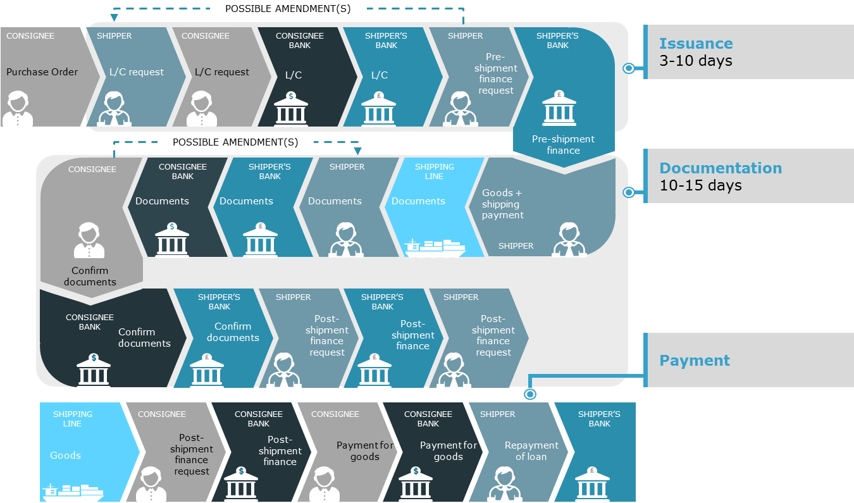
Maersk Line can apply simple and secured solutions to make trade finance rewarding for you
CONSIGNEE
SHIPPER
MAERSK LINE
SHIPPER
MAERSK LINE
CONSIGNEE
MAERSK LINE
Purchase Order
Finance request
Payment for goods
Financing
Goods
Goods
Goods
We want to partner with you to simplify your trade finance process
page 2

Slide 4

We understand what is needed for a successful 2017 Raw Cashew Nut season
The road to USD 1.5 BN*
Acceptable tenors to cover buying terms
Extension of adhoc limits for a short production season
Acceptable transit times
Working capital for procurement & processing
Availability of space upon loading
Access to containers for stuffing
* USD 1.5 Bn is the total expected market for raw cashew nut cross border trade in the 2017 season
page 3

Slide 5




Trade Finance product offering
CURRENT PRODUCT OFFERING
PRODUCT VARIATIONS –
Any combination
PRE SHIPMENT FINANCING
Usance
Payment received after release of goods as per contract and PO terms
Without Usance
Payment at sight. Goods to be released after receipt of payment
With recourse
In case of non payment by buyer, exporter pays
Without recourse
Payment guarantee to exporter, in case of buyer insolvency
PRE SHIPMENT FINANCING
page 4

Slide 6
We have an instant Export Finance upto 50 K USD
Product
Post shipment finance transactions on CAD basis
Salient features
Minimal documentation (The only financial doc we are asking is latest audited financials)
Eligibility criteria *
  Basic financial checks
  Credit limit upto 50 K USD
Digital process– Completely paperless
* Terms and conditions apply
page 5

Slide 7
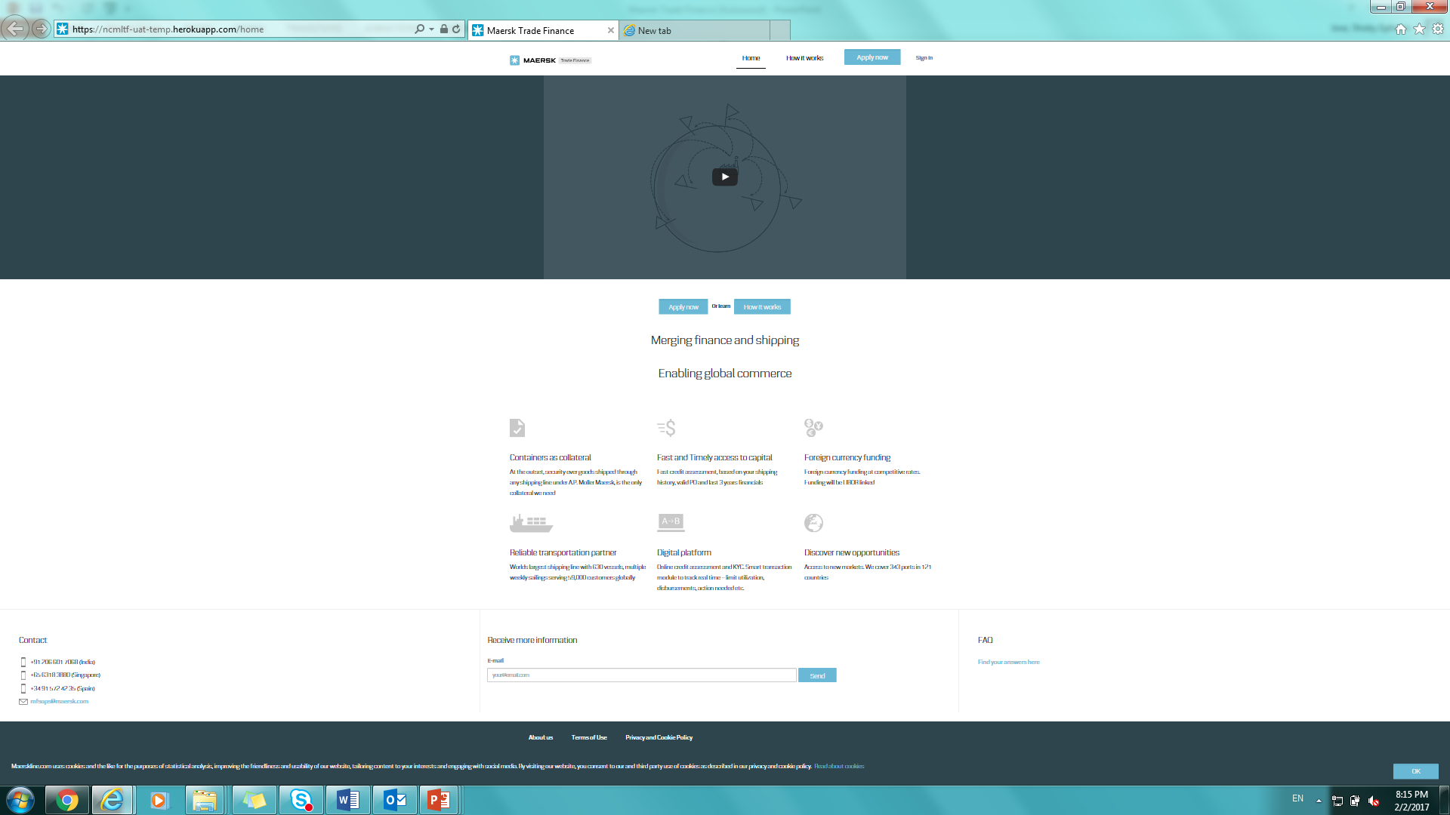
For all other products, please go on to fs.maerskline.com.. and apply:
We need Last 3 year Audited Financials (Balance Sheet and P&L) to be submitted digitally and an online Financial Information Form
page 6

Slide 8
Contacts from Maersk Line:
Vipul Sardana
Head Trade Finance
Maersk Global Service Centres
3RD Floor, Prudential Building,
Central Avenue Road,
Hiranandani Business Park
Powai,Mumbai 400076.
Telephone +91 22 33409655
Mobile +91 99 30360618
E-mail: Vipul.sardana@maersk.com
Benjamin Hadfield
Country Representative
Maersk Trade Finance
Maersk Singapore Pte Ltd
200 Cantonment Road
#10-00 Southpoint
Singapore 089763
Telephone +65 63183880
Mobile +65 91724703
E-mail: Benjamin.hadfield@maersk.com
Mayur Chawda
Business Development Manager
Maersk Trade Finance
Maersk Singapore Pte Ltd
200 Cantonment Road
#10-00 Southpoint
Singapore 089763
Telephone +65 63183800
Mobile +65 97204786
E-mail: mayur.chawda@maersk.com
Kanishka Chaudhary
Head - Finance
Maersk Global Service Centres
3RD Floor, Prudential Building,
Central Avenue Road,
Hiranandani Business Park
Powai,Mumbai 400076.
Telephone +91 22 33409909
Mobile +91 98 20 568513
E-mail: Kanishka.Chaudhary@Maersk.com
page 7

Slide 9
Appendix

Slide 10

Pre+Post Shipment finance process :
High level overview: Flow of funds and goods
Shipper
3. On-boarding, Credit assessment and Contracting
Maersk Trade Finance
4. Request for disbursement
5. Payment:80% of shipment value
Maersk Line
6. Manufacture & ships goods
9. Payment of (20% minus interest charges)
1. Contract
2. PO
Buyer
7. Payment for goods i.e. 100% of shipment value
8. Maersk Line hands over goods
page 11

Slide 11
Post Shipment finance process :
High level overview: Flow of funds and goods
Shipper
3. Request for disbursement after handling over goods
Maersk Line - Origin
4. Payment:80% of shipment value
5. Ships goods
8. Payment of (20% minus interest charges)
1. Contract
2. PO
Consignee/ Buyer
6. Payment for goods i.e. 100% of shipment value*
7. Maersk Line hands over goods
page 12

