Slide 1





Organized By
Cashew Industry: Growth & Prospects in FMCG sector
Somnath Chatterjee
Head- Procurement & Logistics
ITC Limited- Foods Division
Title Sponsor
Platinum Sponsor
09-11 February, 2017
Grand Copthorne, Singapore

Slide 2
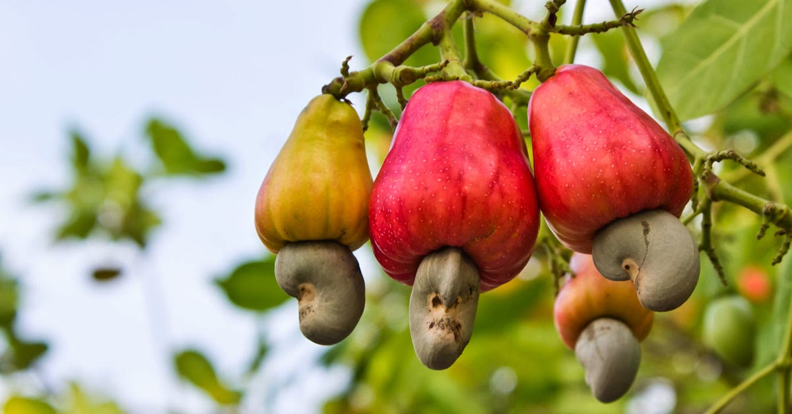
Presentation Flow
Quick facts
Usage of cashew
Emerging prospects
Challenges & expectations
Way Forward

Slide 3
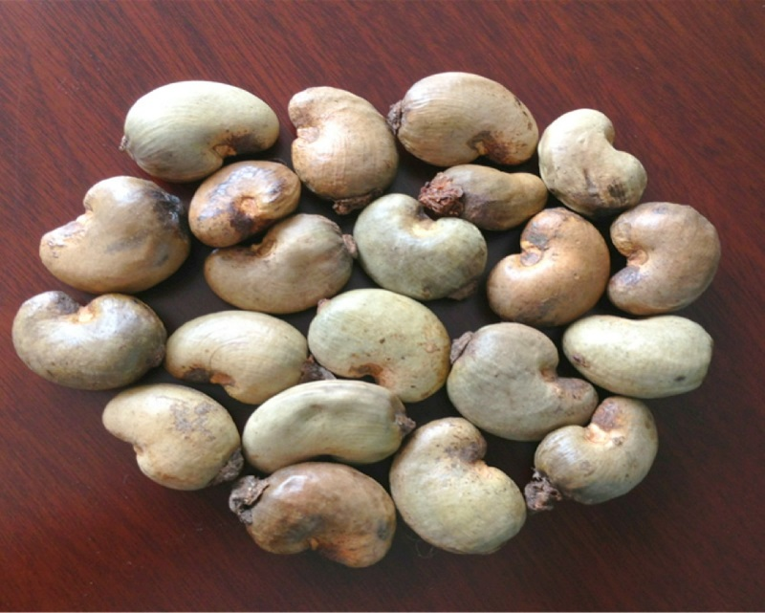
Quick facts
Tropical dried fruit
Native of Brazil
Introduced into India by the Portuguese
Cashew planted along Indian coastline to arrest soil erosion
India soon became a major producer of cashew

Slide 4
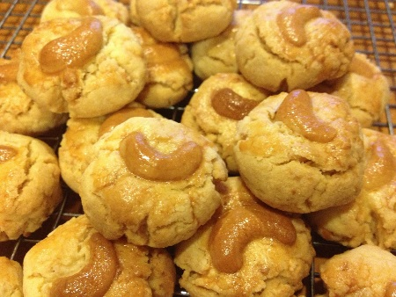


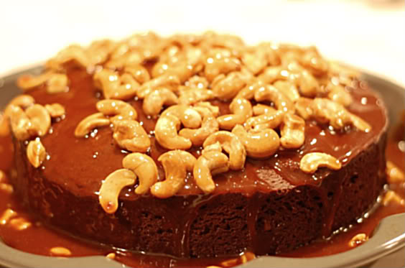
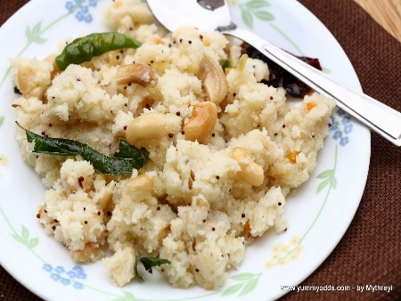
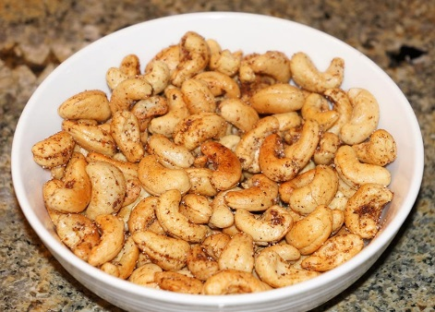
Wide usage of cashew
Traditional sweets
Breakfast cereals
Homemade foods to curries
Biscuits
Snacking
Confectionery
Bakery
Ice Creams
Chocolates
Beverages

Slide 5
India: Leading consumer of cashew
Affordable
Tasty
Healthy
India is the leading cashew consumer with consumption of
over two and half lakh tons per annum

Slide 6
Emerging prospects
Higher disposable income levels resulting in increase in cashew consumption
Rising local demand for value added products
Increasing demand for organic cashew
Increasing demand for cashew in the international markets

Slide 7



Slide 8




Price volatility
Weather vagaries
Currency fluctuations
Factors leading to constrained supplies
Government policies & regulations

Slide 9
Low crop productivity
Mostly old plantations
Reasons for low crop productivity
Scarce land resource
No increase in actual acreage

Slide 10
Supply chain constraints
India produces around seven and half lakh tons of raw cashew
India imports higher raw cashew than it produces
Poor visibility on crop aspects pertaining to West Africa
Frequent quality / traceability issues impacting cashew supply chain
Geo political issues across producing West African nations impacting imports into India
Unorganized and non uniform trading platforms across nations

Slide 11
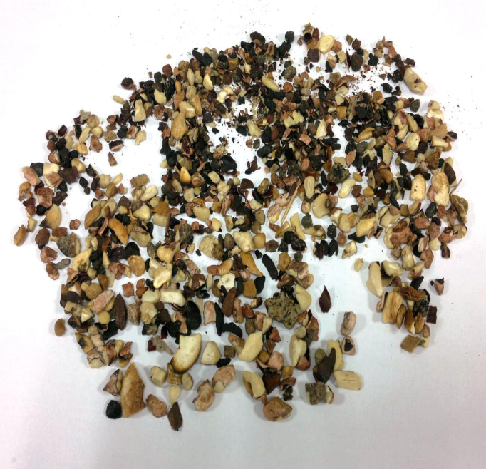
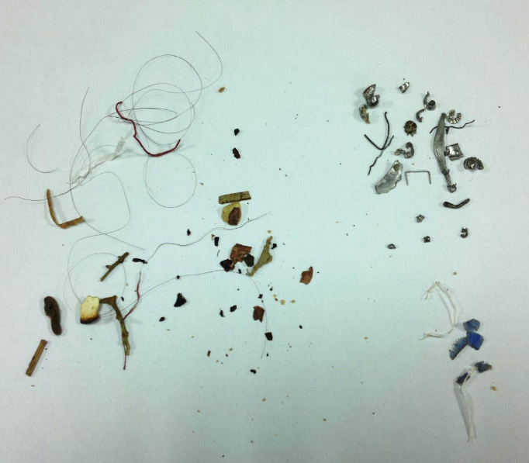
Quality concerns
Poor handling systems
Infrastructural issues
Highly unorganized sector
Poor status of automation of cashew units
Unhygienic process areas
Lack of awareness on FSSAI compliances

Slide 12
Way Forward
Making the cashew industry organized will help in providing visibility and collaboration across supply chain
Automation of labour intensive industry will result in driving efficiency
Awareness of FSSAI compliance requirements will help in achieving quality standards

Slide 13


Slide 14


