Slide 1
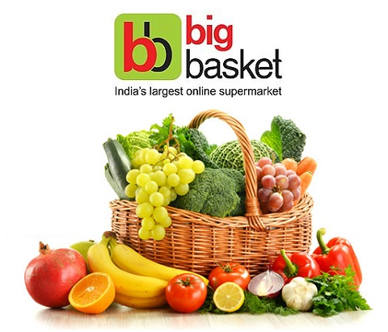
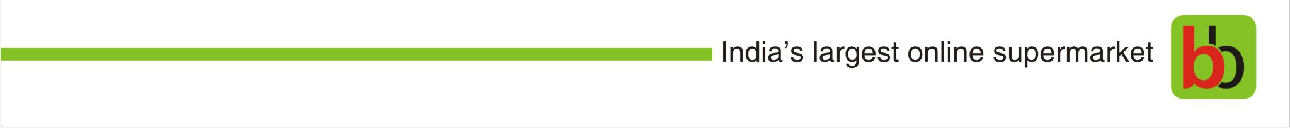
Bigbasket- Agri Commodities

Slide 2
About Us

Slide 3
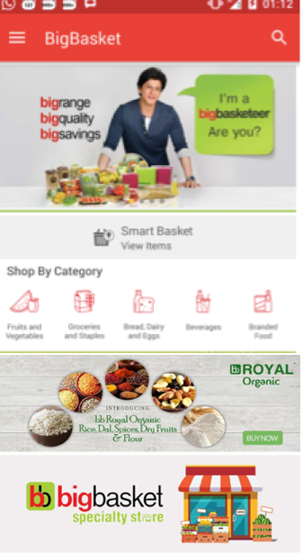







BigBasket Snapshot
India’s Leading
Online Grocery Store
Dec 2011
Launch Month
30
Cities
12,000 employees; 11,000 employees from lower income groups
20k+
Products
1,000+ Brands
1.2Mn+
Monthly Orders⁽¹⁾
~85%
Repeat Orders⁽²⁾
Loyal customer base
2.0
Million
Monthly Unique Visitors⁽³⁾
3x
FY15
Revenue Growth⁽⁴⁾ $250 m (Rs 1500Cr) FY 16-17
4.0
Million Registered Customers
Note: (1) May 2016 (2) FY15 (Fiscal year ending March 31, 2016) (3) May 2016 (4) FY16 over FY15
3

Slide 4
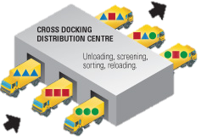

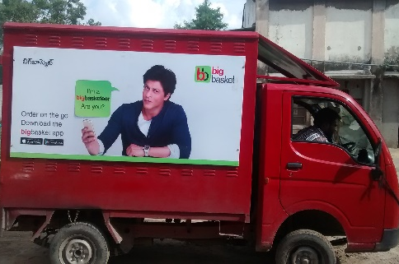

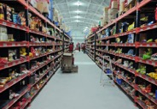
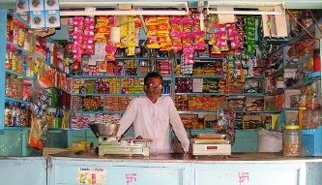


Consumer Centric Model Based on Strong Back-end Supply Chain
‘One Stop Shop’
Catering to a variety of consumer demands
Technology Enabled End-to-End Supply Chain
Branded Food
(40%)
Hubs
Full Service Slotted Delivery
Distributors/ Brands
DC
Dark Stores
Private Label Food
(35%)
Farmers
Kirana Stores
Express Delivery in 90 Minutes
Manufacturers
Non-Food
(25%)
Local food Stores
Distributors/ Brands
4
Notes:
BigBasket product offering with over 14,000 SKUs
Products delivered at a fixed time same day or following day
Caters to the time sensitive demand
Delivered within 90 minutes
Served by ‘Dark stores’, strategically located across the city, stocked with 400 fast moving SKUs
Convert highly fragmented unbranded ‘Mom & Pop’ grocery) stores to BigBasket branded stores
Provide technology & inventory
Cater to offline & time sensitive demand
Home delivery for region specific / fresh / occasion led food products

Slide 5
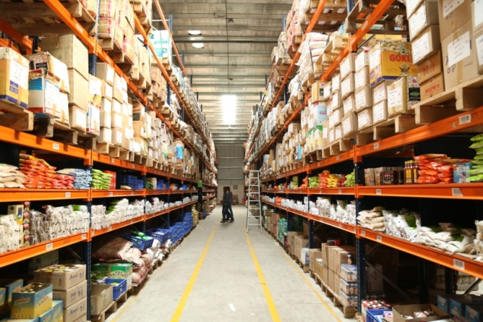
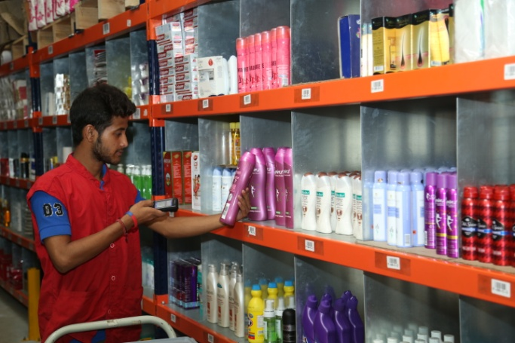
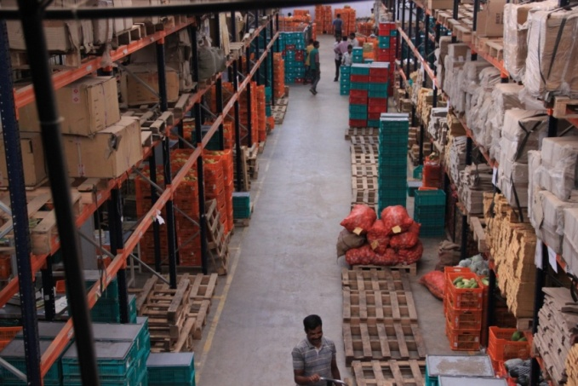
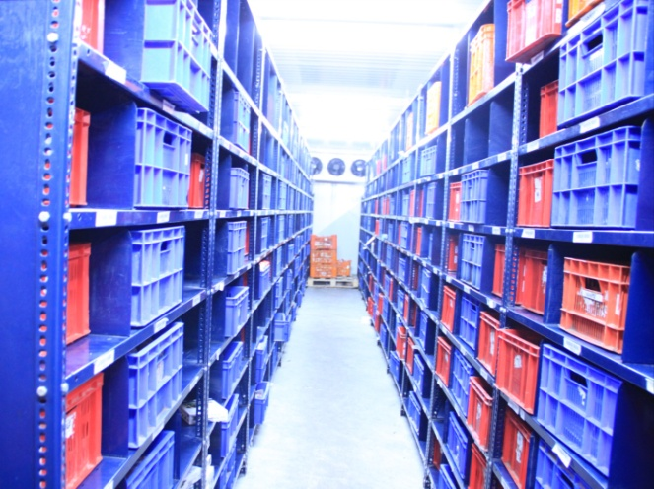
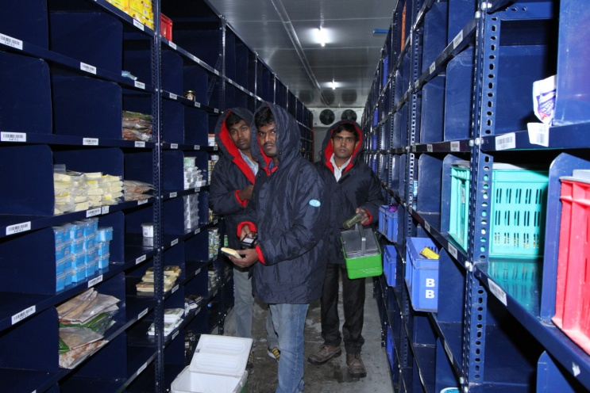
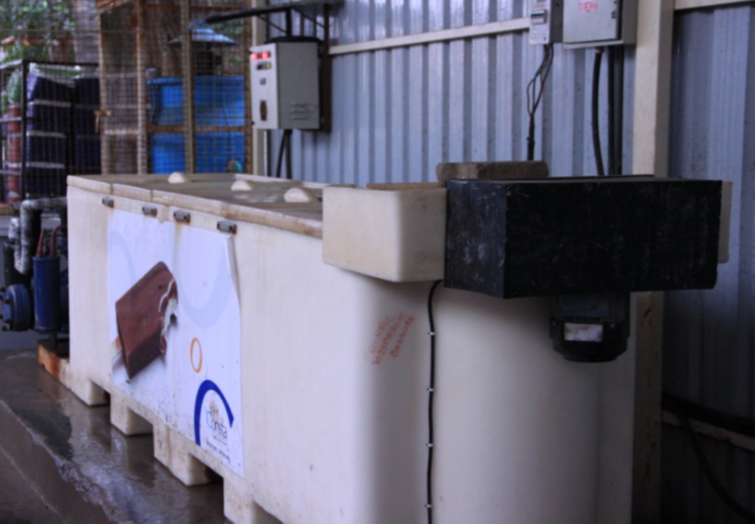
Bigbasket Distribution Centre

Slide 6





Category Leading Operational Benchmarks
Exceptional execution of our differentiated business model has led to us achieving category leading (India) operating metrics, and on the way to matching Ocado, the global category leader
Aug 2014
Dec 2016
FY15
(1)
3,391
45000
27,857
Avg Orders/Day
97.6%
99.0%
95.3%
On-Time Delivery
98.9%
99.3%
99.3%
Accurate Delivery
8,300
20,0 00
47,000
No. of Products
Note: (1) Ocado FY15 Annual Report
6

Slide 7



All of Which Lead to a Strong Growth Story
BRAND
India‘s most customer friendly brand
9,000 Cr
7,000 Cr
SALIENCE
Largest grocery retailer
in India
4,500 Cr
1,900 Cr
REVENUES
9,000 Cr by FY 20
220 Cr
650 Cr
28

Slide 8
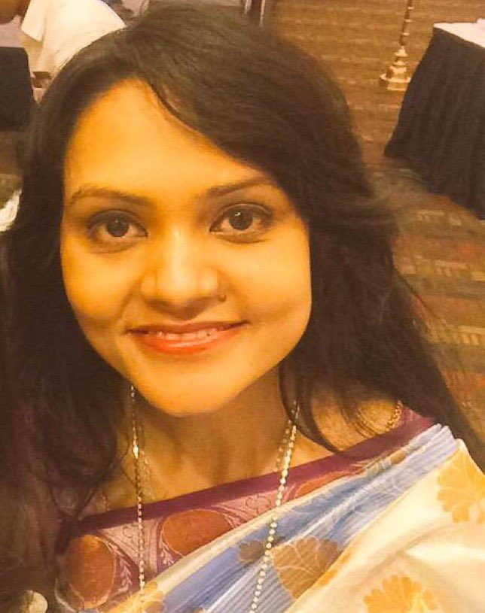
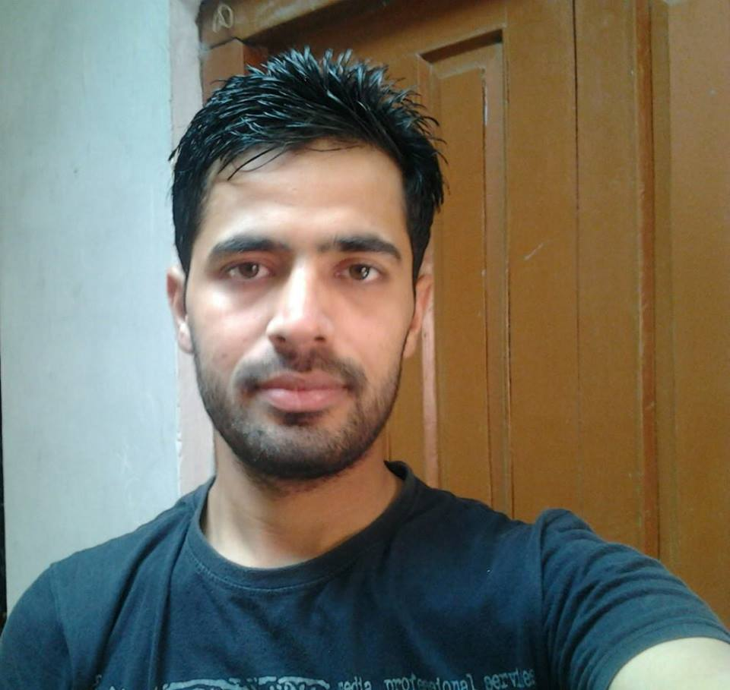
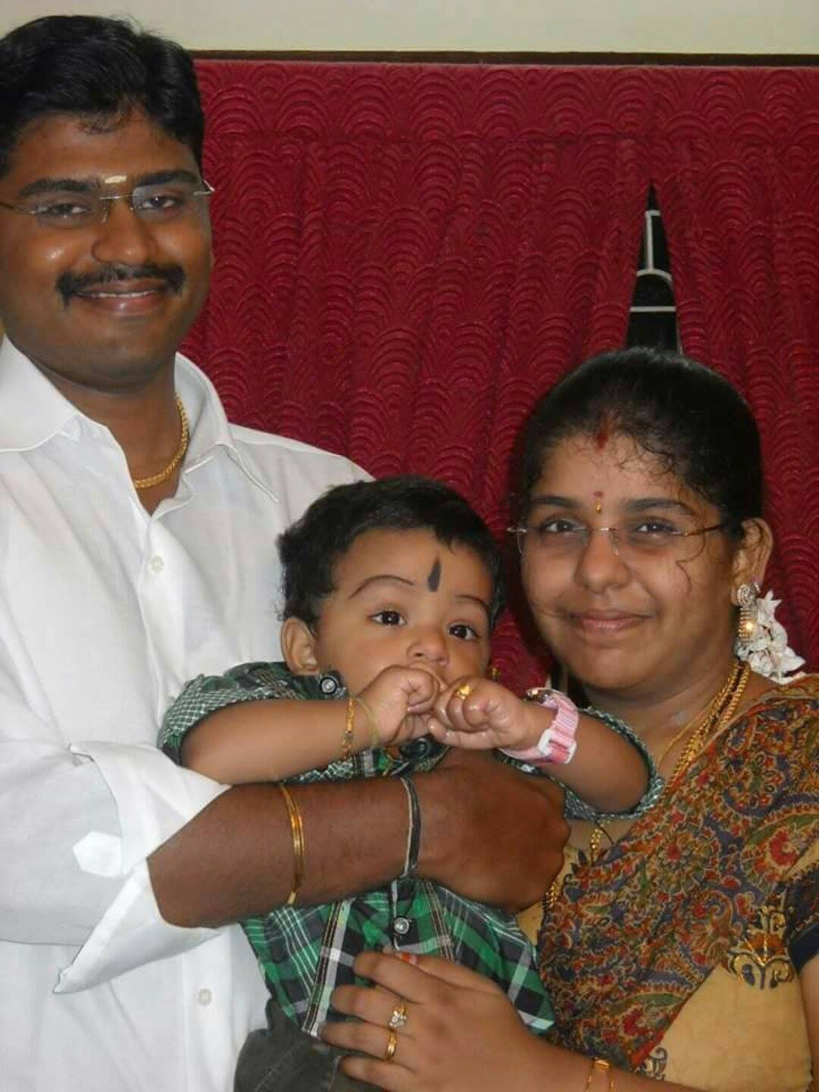
Some Customer Experiences
“Imagine shopping your groceries from your MacBook at 1 in the morning! Big Basket spells that magic, which not only saves my time but brings a whole new experience to life! I am a proud big basketeer , are you ?”
- Nabomita Chatterjee
“There are several grocery sites in market but bigbasket is quite different from them. Quality products, timely delivery, convenient payment mode, supportive customer support team… Would surely love to recommend it to all my friends”
– Rahul Tandon
“Being a working professional and a mother of two kids, I didn't have time to get groceries from local shop.. Thanks to big basket! It made my daily life easy and simple... More than myself, my in-laws felt very very happy with their service. All items which I buy from bigbasket are delivered on time. I appreciate all the members of the bigbasket family for providing a customer friendly service..”
- Sujitha Thayanithi, Chennai

Slide 9



The Bigbasket Farmer/ Grower Outreach

Slide 10
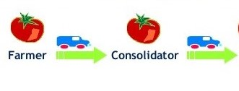
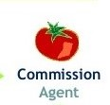
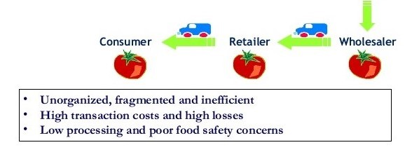
Traditional Agri Commodities Supply Chain
Margin play
10%
5-8%
20-25%
10%
Unorganized, Fragmented and Inefficient Market
High Transaction Costs and High Losses
No Sorting and Grading
Poor Food Safety Concerns
High Lead Time(Farm to Fork) : 36 to 72 Hours

Slide 11
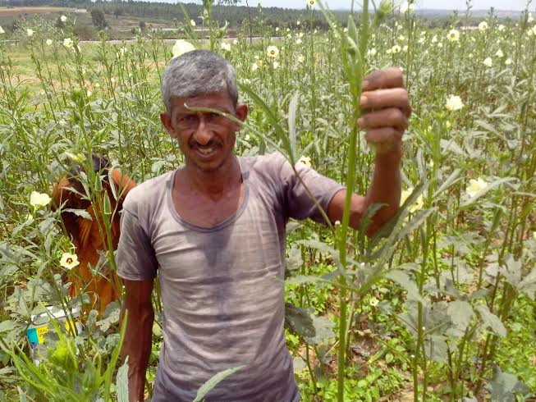
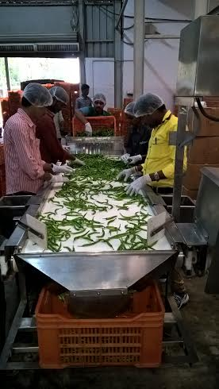
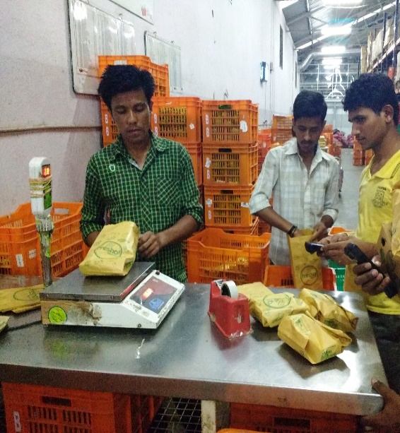
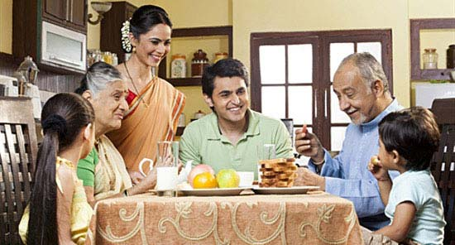
Bigbasket Farm to Fork Cycle
Farmer harvesting vegetables at 7 am
Sorting & Grading at Collection Centre
between 9-12pm
Packaging at DC between
1-3 pm
Shipped to hubs and Dark Stores by 4pm
Reach customer plate by 7 pm
Disintermediation
Better Handling, Lesser wastage
Fresher Produce; Farm to Fork Lead time: 12 to 24 hours
Better Quality Standards

Slide 12
Farmer Engagement Pillars
Collection Centre
Market Access
Training & Skilling
Financial & Infrastructure support
Sustainability

Slide 13


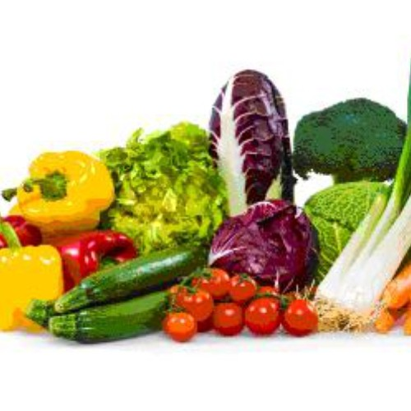


Market Access
Field Geo-tagged
Monitoring sowing & harvesting progress
Demand Forecasting
Wider Assortment
High Value Agriculture
Market for Organic Products
Price as per grade – Quality Enhancement
Premium over Mandi Price
Market Access
Same Day Payment
Automatic Transfer to Bank Account

Slide 14
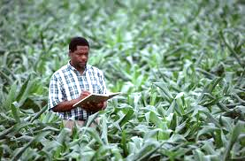

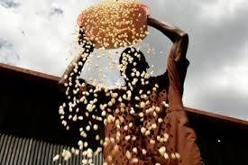



Training & Skilling Inputs
Agronomist stationed at each CC
Pre & Post- Harvest Management
Training & Skilling
Optimal Use of agri-inputs

Slide 15



Financial & Infrastructure Support to Farmers
  Access to institutional finance
Financial & Infrastructure support
Linking Farmers with Government Schemes

Slide 16




Sustainability Initiatives
Organic Cultivation
Soil and Water Conservation
Sustainability
Seasonal Crops

Slide 17
The Virtuous Cycle of bb Farmer Engagement Program
Farmers
Better Yield
Better Quality
Better Realization
Best Practices
Better Agricultural Practices
Loyalty to bb
Motivating him to adopt sustainable practices,
Post Harvest Handling and proper sorting grading

Slide 18
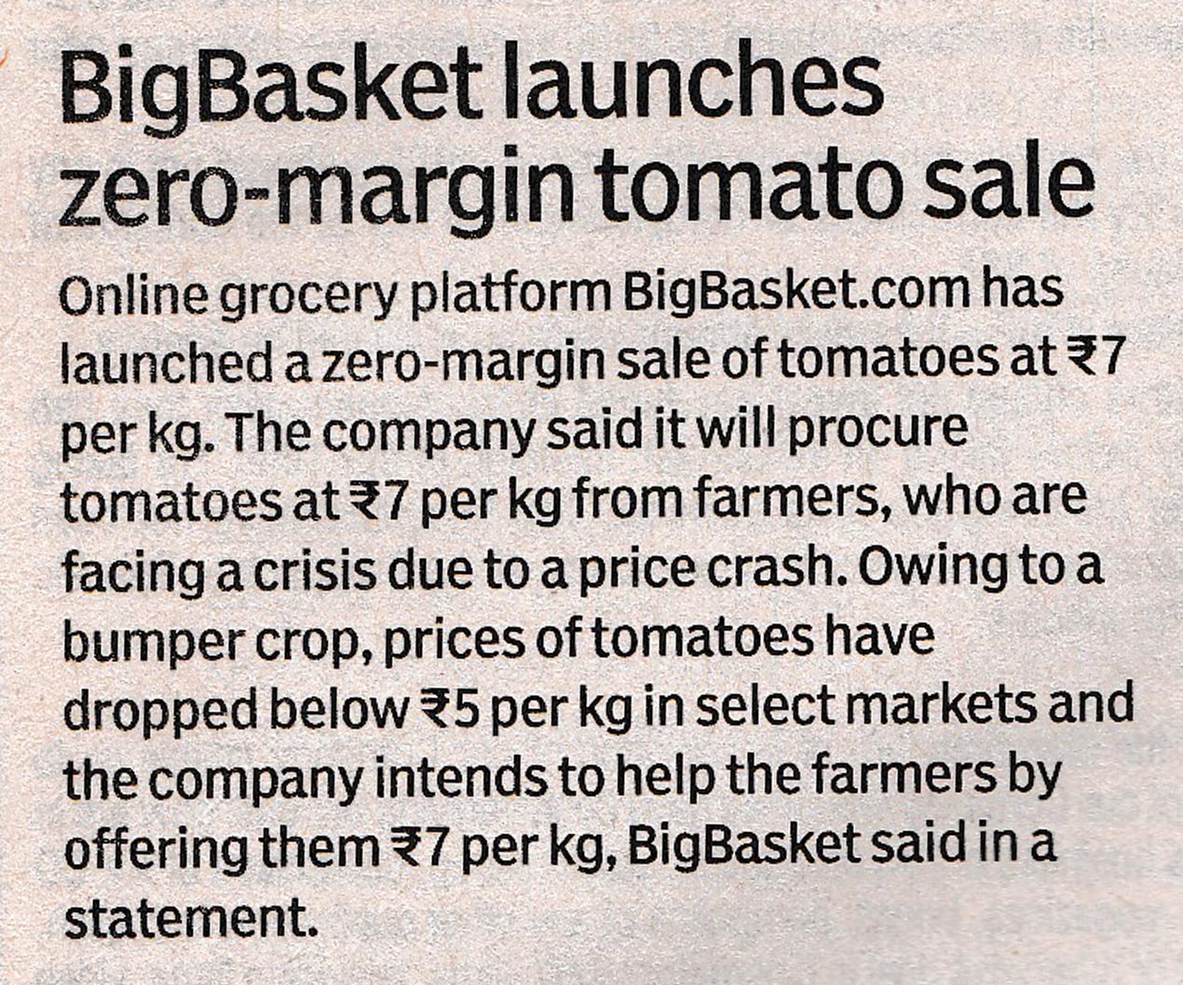
Social Responsibility
bigbasket took the initiative to pay farmers at least the cost of production when the prices crashed by 30% of cost of production (Rs. 5 per kg)
Helped in increase the demand for tomato to uplift the market situation
http://www.prnewswire.co.in/news-releases/bigbasketcom-comes-to-aid-of-crisis-hit-farmers-ikarnataka-sets-subsistence-price-for-tomatoes-in-bangalore-591366991.html

Slide 19
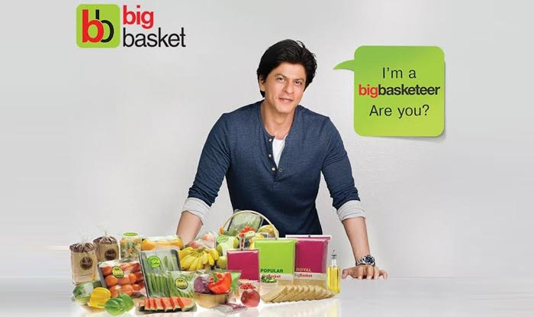
    THANK YOU....

