Slide 1
INTRODUCTION
Cashews can loose their space to other nuts ( almonds & walnuts) if the price not corrected.
Demand fallen by 15-20% due to high prices
Almonds imports grown by 54% to India since the last year due to high cashew prices.
Need to make cashew farming more scientific.

Slide 2

Problems in 2016 especially to Indian processors – leading to fall in exports from India
RCN import duty in India
High RCN prices at origin centres
High labour Wages
Depreciating currency

Slide 3
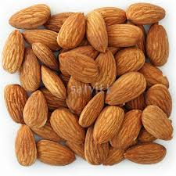
Almonds can replace cashew demand in India in the following segments due to high prices
As a table nut in households
In gifting segment during festive season
Confectionary segment
Snacking segment
USA & China are getting bigger in Walnut crop which may also challenge cashew sector in the coming years

Slide 4
BREXIT IMPACT
Fall in pound sterling was more than Euro so possibility of fall in UK imports due to high costs in comparison to other nuts.
Rest of Europe demand may not be impacted as Euro has almost recovered.
India & China looking more towards almonds due to high cashew kernel prices.
Vietnam dong has been devalued regularly.

Slide 5
Demonetisation & gst
Demonetisation in the month of November & December led to big fall in sales & prices of all the nuts.
Demonetisation will lead up to GST and will be good for the industry.
GST will help not only the government but also the cashew industry to increase revenue in the future.
GST will lead to tax rationalisation and will give a level playing field to all the states.

Slide 6
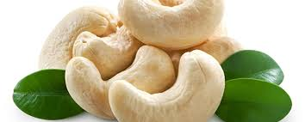
conclusion
Reasonable price fall in cashews vis-à-vis other nuts will push the cashew industry into the growth mode again in years to come

