Slide 1




Organised By
Women Ground-breakers in Cashew Business
Facilitation by Rita Weidinger, ComCashew/ GIZ
February 10, 2017
Title Sponsor
Platinum Sponsor
09-11 February, 2017
Grand Copthorne, Singapore

Slide 2
Panelists
Mlle Achta Cherif, Caronut
Madam Dalada Ferdjani, FMA Industry
Madam Minata Kone, SOTRIA-B; ACA
Mrs Vidya Kamath, Bola Cashew
Your company logo

Slide 3
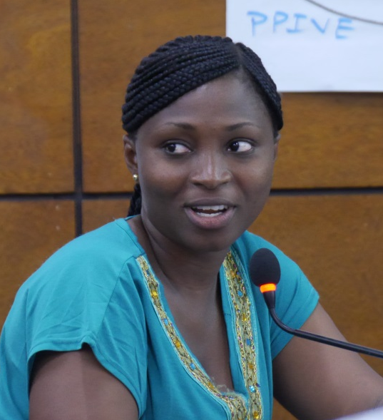
Mlle Achta Cherif
CARO NUT Country Supervisor in
Côte d´Ivoire
BSc Business Administration
Manager of Cashew Processing
Company ABC
Master Trainer ComCashew/ ACA

Slide 4
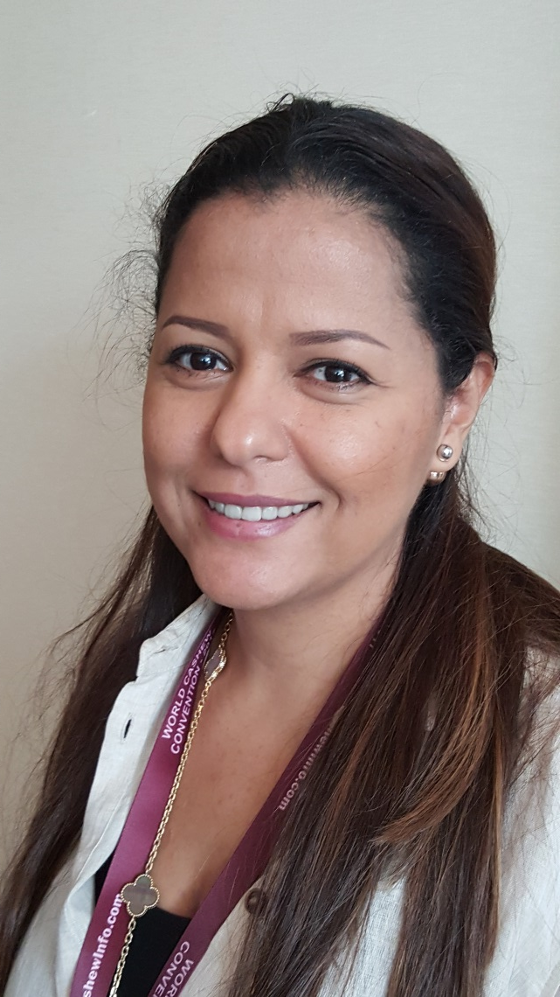
Madam Dalada Ferdjani
Master in International Trade
Relationship manager in Bank
General Manager of
cashew processing company
FMA Industry in Côte d´Ivoire,
since 2015
Trading company – green tea

Slide 5
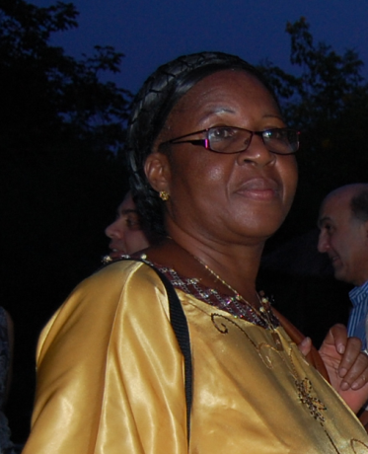
Madam Minata Kone
Master in Technology
Founder and CEO of cashew
processing company
SOTRIA-B in Burkina Faso
15 years Ministry of Agriculture
President of Interprofessional Body
in Burkina Faso
Member of Executive Committee
African Cashew Alliance (ACA)

Slide 6
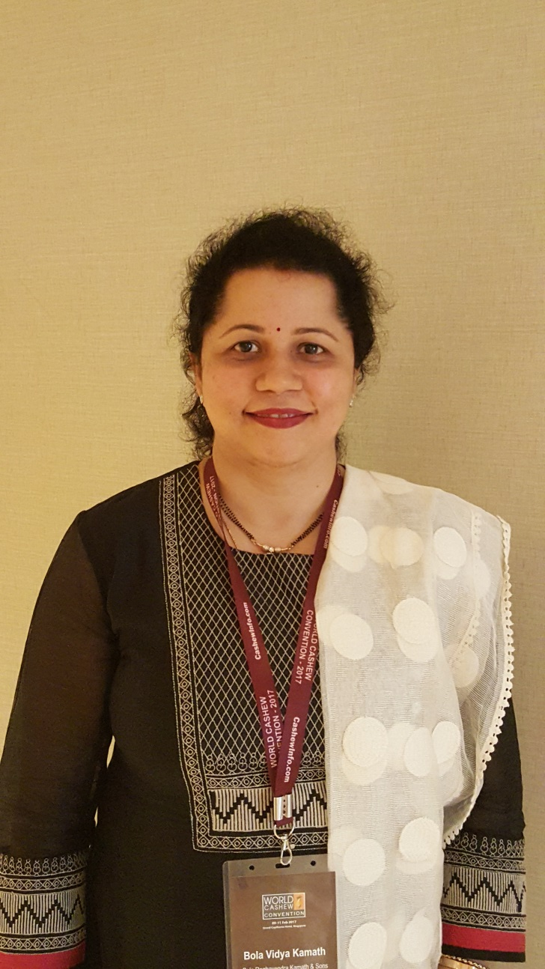
Mrs Vidya Kamath
Graduate in Business Management
Export Manager in family business
Bola Raghavendra Kamath & Sons,
India
House Manager

Slide 7

Women in Cashew Harvest – 80%

Slide 8
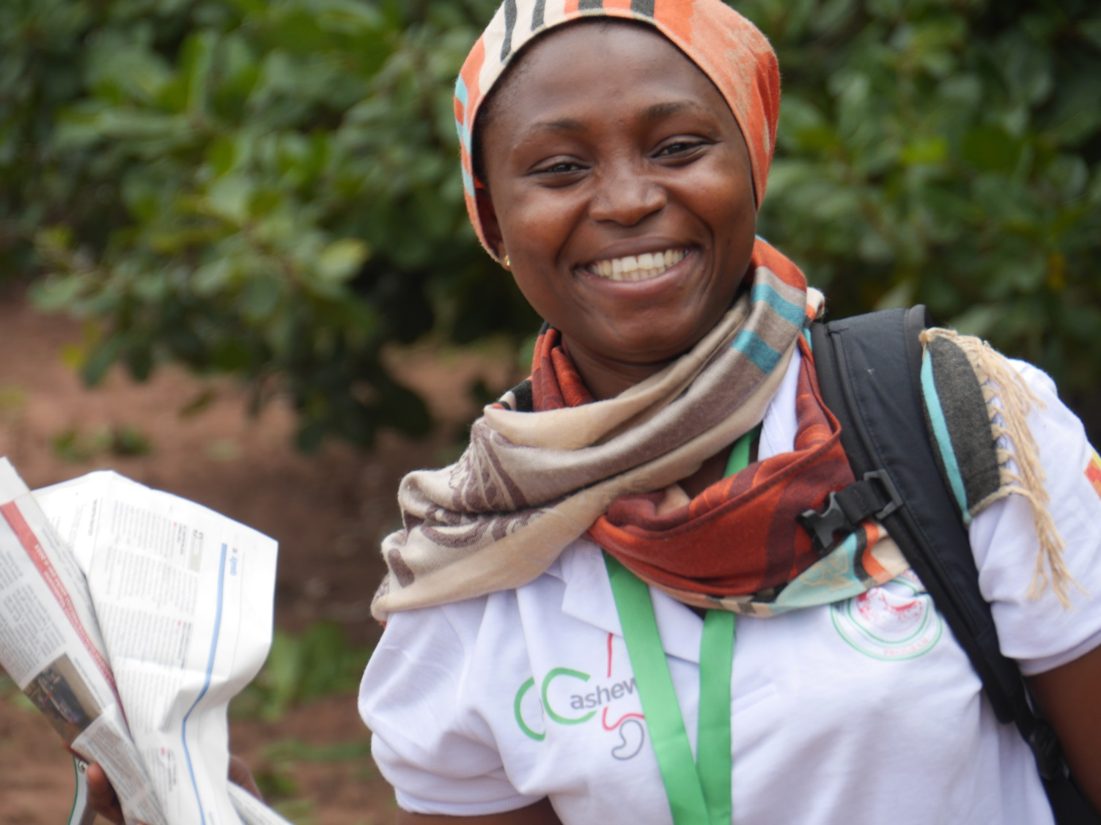
… Trade, Research and Extension – 10%

Slide 9
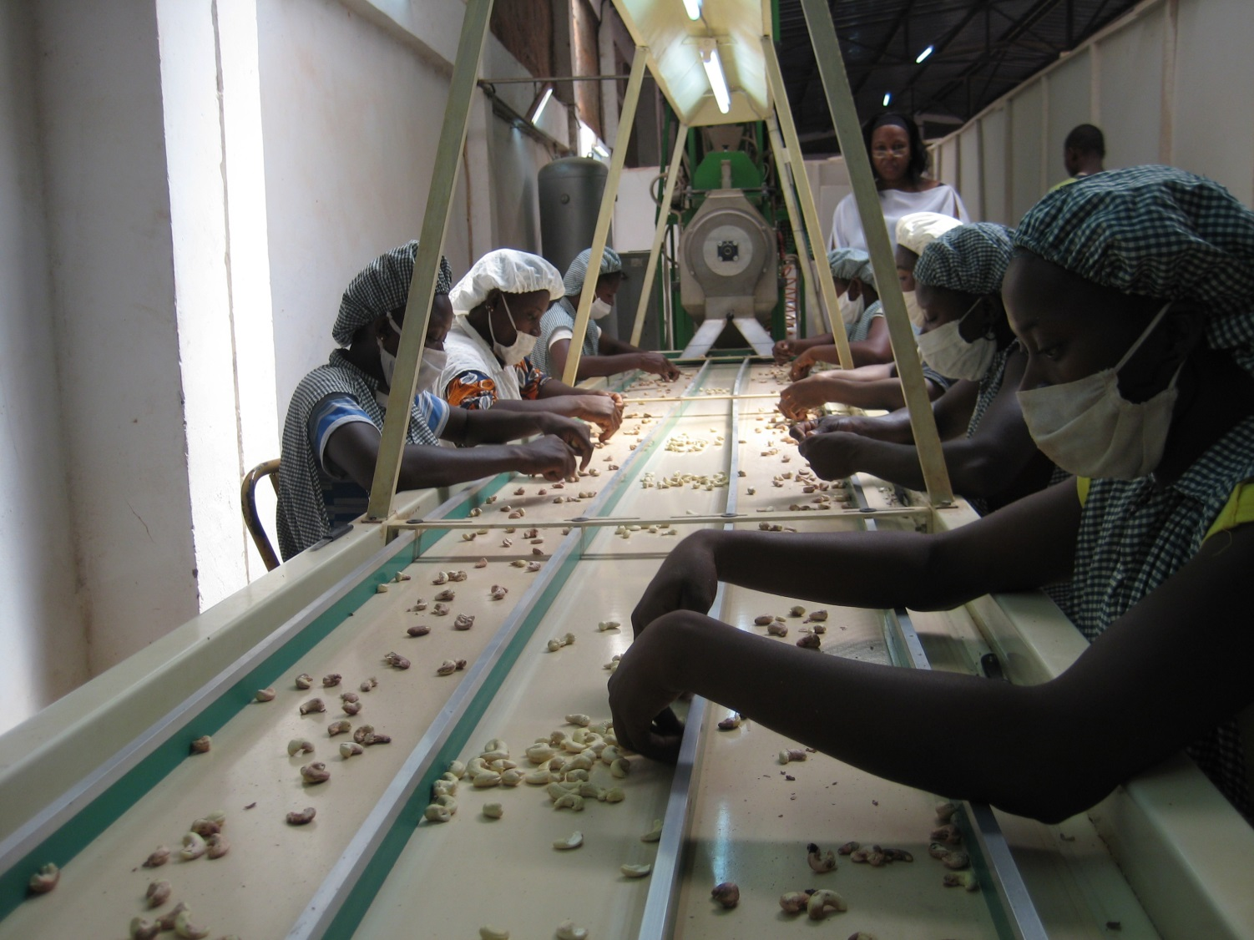
…Processing – Managers 10%; Workers 80%

Slide 10
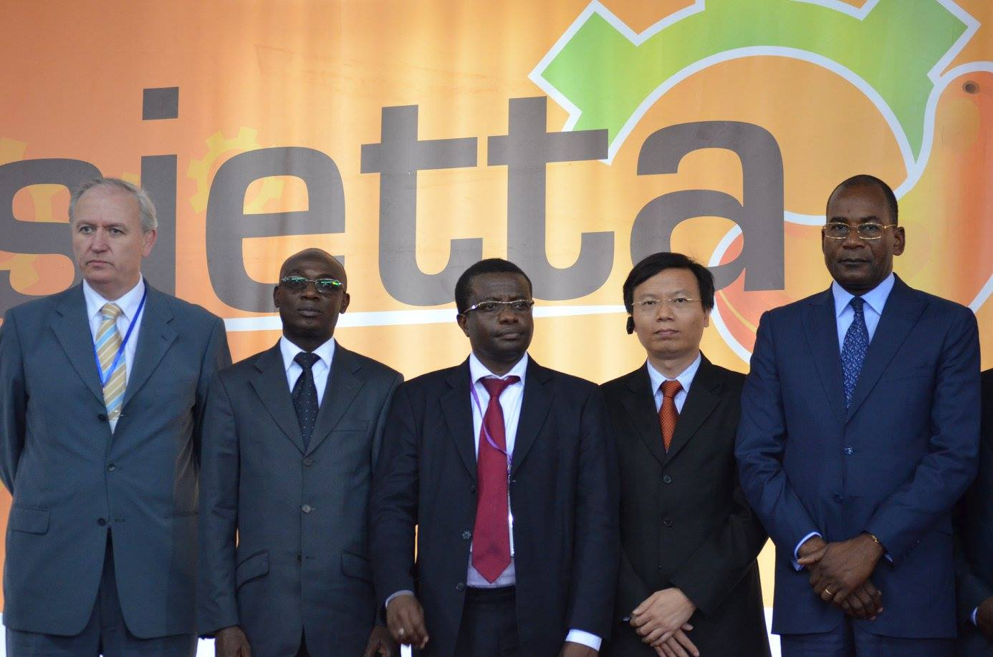
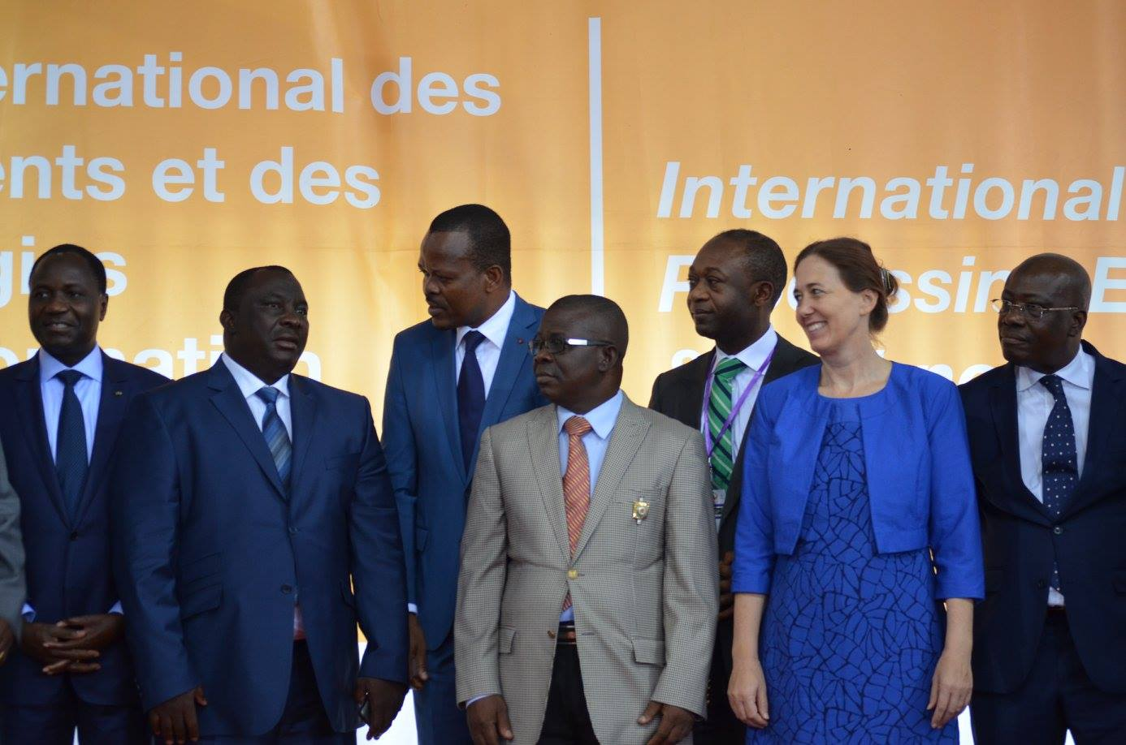
…in governing the sector – ? %

Slide 11
… womens´ stories
What are their vision and aspirations?
Do women their business differently?
Do they have challenges?
Whats their secret for success?

