Slide 1






Organized By
USA & CANADA CASHEW MARKETS
RANJEET WALLIA
Title Sponsor
Platinum Sponsor
09-11 February, 2017
Grand Copthorne, Singapore

Slide 2

SWOT
STRENGTHS SUPER FOOD WITH HEALTH BENEFITS WEALTHIER MIDDLE CLASS TASTE PREFERENCE- Love Cashews POPULATION GROWTH (7B TO 9.8B BY 2050) GENERATIONAL CHANGES: The Rise of the Millennials + Baby Boomers | WEAKNESSES SLOW ARRIVALS IN 2017 MUCH LIKE 2016? TRANSIT TIME - 7/8 MONTHS FROM FARM TO FORK
OPPORTUNITIES QUALITY SOCIAL MEDIA MESSAGE > Sustainability > Farmers livelihood/income 60 PCT of the world productions in the next 3 months TASTE /PRICE/ HEALTH BENEFITS are the main drivers of snack food purchases MECHANISATION increased productivity | THREATS QUALITY SOCIAL MEDIA “ CASHEWS PRICE ARE GOING NUTS” -Bloomberg SLOW ARRIVAL IN 2017 MUCH LINE 2016? UNCERTAIN PRICING IN 2017 TRUMP FACTOR: Buy Made in USA STABLE ALMOND PRICES resulting in “ Store Promotions” USA ALMOND consumption is up 12% over last year. FORMULA CHANGES in premium mixed nuts

Slide 3
Prices of cashews vs. Other tree nuts
DECEMBER 2016

Slide 4
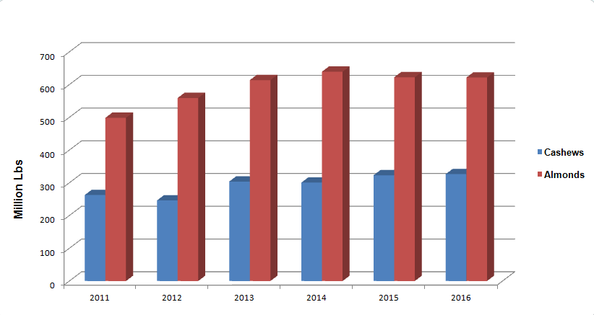
CASHEW VS. ALMOND USA CONSUMPTION

Slide 5
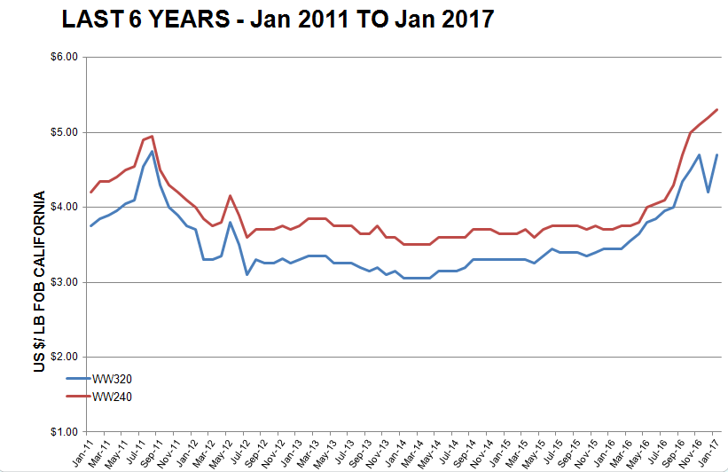
WW320 vs. WW240 Market Price Trend

Slide 6
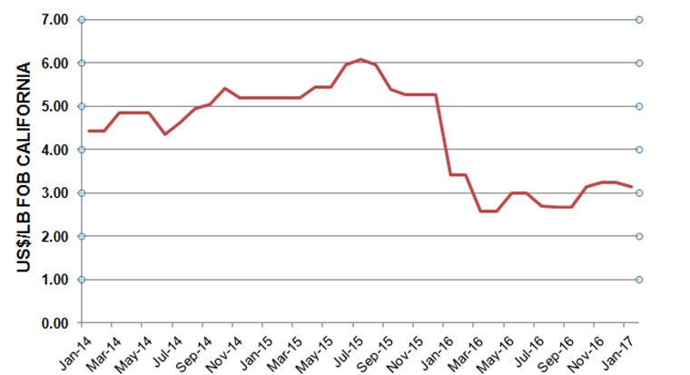

Slide 7
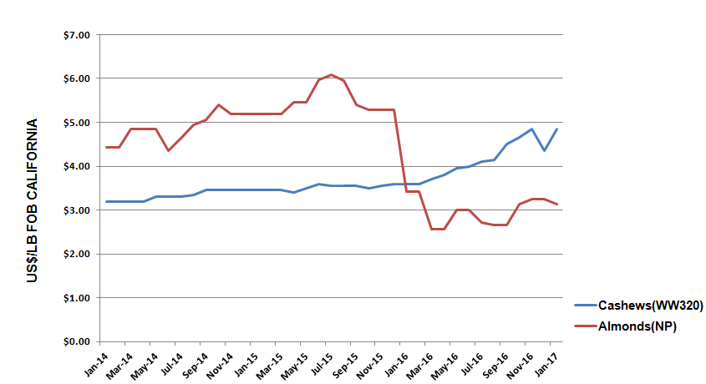
CASHEW VS. ALMOND PRICES 2014-2017

Slide 8
THANK YOU
WORKS CITED
INC – INTERNATIONAL NUT COUNCIL
WCC – WORLD CASHEW COUNCIL
AFI – ASSOCIATION OF FOOD INDUSTRIES
ALMOND BOARD OF CALIFORNIA

