Slide 1

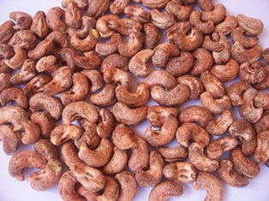
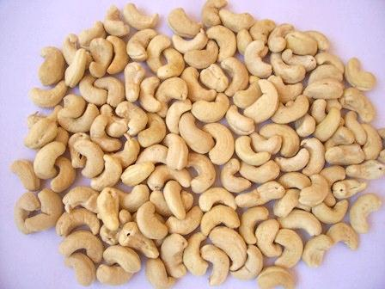
Post Peeling Technologies
Hari Nair Western India Cashew Company
Krishnan Nair KGN & Company
Evan Hefei Meiya
Bruce Xiao Hefei Taiho
A Barathy GI Technologies
Sasisekar nanoPix
Stefano Massari Oltemare

Slide 2

Post peeling - what does it mean?
The two actual processes in Cashew processing
Shelling (Removal of outer shell)
Peeing (Removal of adhering testa)
Further processes for marketability
Grading
Packing

Slide 3
Post peeling Challenges
Natural issues from RCN
- Spotted - Speckled - Immature
- Dessert - Yellow - Oily
- Rotten
Manually sorted to White, Scorched and Scorched Seconds/Dessert.
Manual process also upgrades the quality of Cashews, by scraping, cutting out spots, etc.
Problems from the Factory - Shelling and Peeling
Shelling: Loose Shell, CNSL contamination, Dust
Peeling: Loose Testa, Adhering Testa, Dust
Much more in Mechanical Shelling and Peeling
Infestation

Slide 4
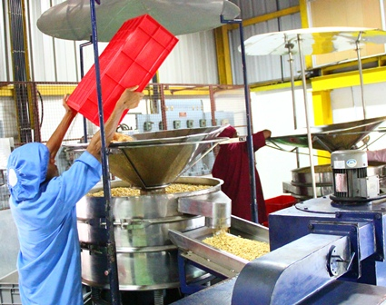
Post peeling Presently used technologies
Air Aspirator
(Remove dust – Cashew are soft
and generate dust in every stage)
Sifting and Sieving
(Remove small pieces)
Gravity separator/Destoner
(Remove foreign mater and stones)
Optical sorting

Slide 5
Post peeling – Optical sorting
Colour sorting
- Camera sorting (B/W, CCD, Infra-Red, NIR)
- Laser sorting
Optical size sorting (W240, W320, W450, etc.)
Optical Shape sorting
Final Quality Control – Metal Detection, X-Ray Detection
Insect Control – Chemical and Low Oxygen Fumigation

Slide 6

Thank You

