Slide 1





Organised By
Financing the cashew value chain
Fanja Ravoavy
Senior Operation Officers
IFC
10 February 2017
Title Sponsor
Platinum Sponsor
09-11 February, 2017
Grand Copthorne, Singapore

Slide 2

IFC: A MEMBER OF THE WORLD BANK GROUP
IBRD
International
Bank for Reconstruction and Development
IDA
International Development Association
IFC
International Finance Corporation
MIGA
Multilateral Investment Guarantee Agency
ICSID
International Centre for Settlement of Investment Disputes
Loans to middle-income and credit-worthy low-income country governments
Interest-free loans and grants to governments
of poorest
countries
Guarantees of foreign direct investment’s non-commercial risks
Solutions
in
private
sector development
Conciliation and arbitration of investment disputes

Slide 3
WHAT WE DO Integrated Solutions, Increased Impact
INVESTMENT
Loans
Equity
Trade and Commodity Finance
Syndications
Derivative and Structured Finance
Blended Finance
ADVISORY
Innovative Solutions Combining IFC’s Expertise and Tools to:
Help Create New Markets
Unlock Investment Opportunities
Strengthen Clients’ Performance and Impact
IFC ASSET MANAGEMENT COMPANY
Mobilizing and Managing Capital for Investment

Slide 4
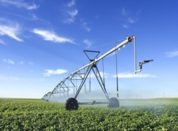
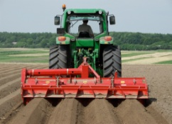
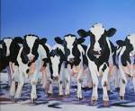
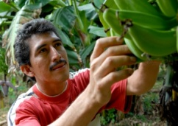
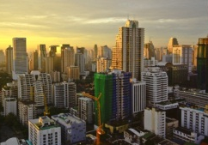

IFC Investment/Advisory Services Involve in the Agribusiness Value Chain “From Farm to Fork”
The Six Themes That Drive Our Agenda
Our Interventions and Goals
Corporate & Project Finance
Input Producers and Distributors
Farmers/
Plantations
Traders/
\Supply
Chain
Mgmt
Food Processors
Distributors/
Wholesalers
Retailers
Water
Global Irrigation Program
Inputs (e.g. seeds)
Land
Princ. of Responsible Agri Investment
Africa Hybrid Investments
Farming inputs
Grain/Oil Seeds/Sugar
Tree Crops
Horticulture
Livestock & Dairy
Trader/ supply chain manager
FMCG
Beverage
Agribusiness strategic interventions
across the value chain
Animal Protein
Mitigate impacts of full value chain (e.g., feed efficiency)
Investment Climate (Business environment)
Small Farmers
Inclusive supply chains
Global Food Security Program (GAFSP)
Infrastructure/Logistics, Public-Private Partnerships
Advisory/Technical Assistance
Environmental and Social Ecosystem Services
Urbanization
Safe food processing & efficient supply chains
Food affordability
Three-fourths of the world’s poor live in rural areas. IFC’s private sector investments are part of the World Bank Group’s efforts to boost shared prosperity and end poverty. IFC invests to:
ENHANCE FOOD SECURITY
by increasing production, reducing losses, and raising incomes
PROMOTE INCLUSIVE DEVELOPMENT
by focusing on opportunities for small farmers, women, and risk management
SUPPORT ENVIRONMENTAL & SOCIAL SUSTAINABILITY
by helping the sector reduce its footprint
Nutrition & Innovation
Food ingredients
Fortified foods and drinks
#1
#2
#3
Notes:
Annex - 1

Slide 5
IFC Investment/Advisory in cashew value chain
Planting
Farming
Storage
Processing
Export
Financing / Investment | Equipment, seed, fertilizer | Working capital | Capex | Working capital | Working capital
 |  | Agri equipment |  | Equipment | Capex
Financing/ Advisory Services | Training and capacity building | Training and capacity building | E&S Management | Training and capacity building | E&S Management
 |  |  |  | E&S Management
 |  |  |  | Food safety
 | T R A C E A B I L I T Y
Notes:
Usually, working capital is at the same amount than the investment.

Slide 6
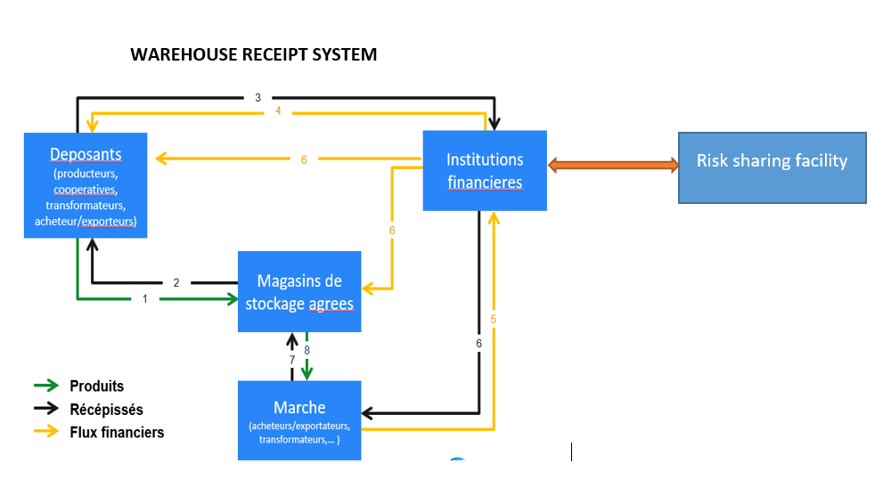
Cashew processing – Working capital – IFC response

