Slide 1
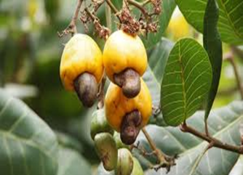
PAPER DELIVERED BY
MR TOLA FASERU
NATIONAL PRESIDENT, NATIONAL CASHEW ASSOCIATION OF NIGERIA(NCAN)
AT THE
WORLD CASHEW CONVENTION, SINGAPORE
9TH- 11TH FEBRUARY, 2017

Slide 2
Welcome to the annual World Cashew Convention, 2017 themed “Embracing Change”.
I bring you greetings from the cashew stakeholders in Nigeria. Incidentally, we flagged off the beginning of our cashew season on Monday 6th February, 2017 and so the season has begun and is in full swing.

Slide 3
RCN MARKET OUTLOOK
The 2016 season was a particularly challenging season for Nigerian cashew and indeed African cashew, the flowering started very late because of climate change and the crop size was small compared to our projection.

Slide 4
.Our total production quantity for 2016 was 175,000mt, just a little over our quantity of 160,000mt for 2015. The gains from proper post-harvest handling activities compensated for the short crop of the year.

Slide 5
In 2016, we rolled out the Cashew Road map, a four-year plan for cashew development which was presented to the Honorable Minster of Agriculture and his team. The road map is geared at increasing primary production from 175,000mt to 500,000mt by 2020.

Slide 6
This will be achieved by planting 53 million new cashew trees across the country. The private sector has already keyed into the road map and has started commercial cashew plantations across the country. As we speak, not less than 20,000 hectares have been cultivated for cashew.

Slide 7
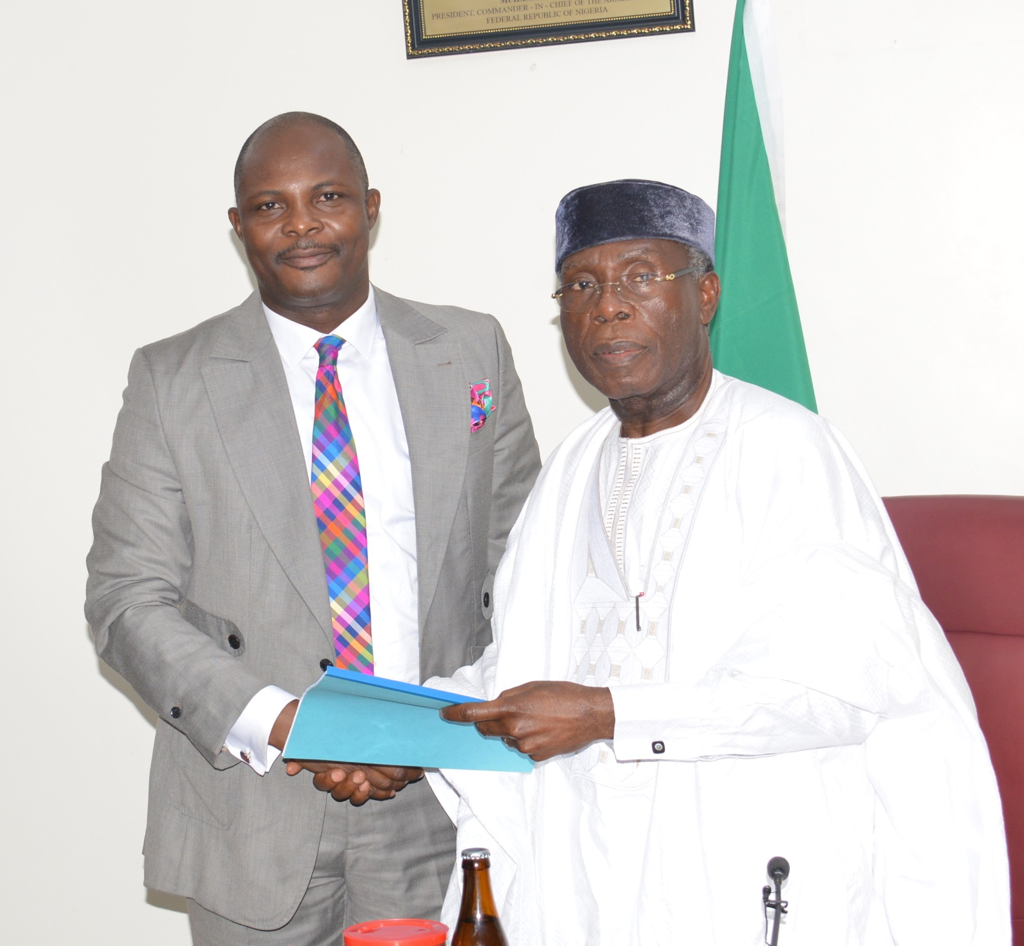
PRESENTATION OF CASHEW ROAD MAP TO THE HONORABLE MINISTER OF AGRICULTURE

Slide 8
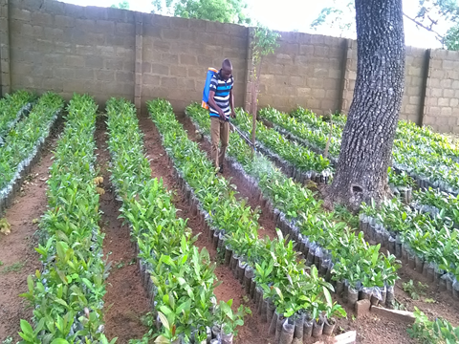

Slide 9
The government has also joined forces with the private sector as the very first official planting season was flagged off in South West Nigeria which is a major production zone of the country.

Slide 10
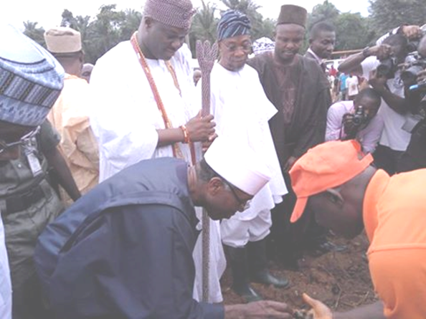
His Excellency, the Honorable Minister of Agriculture at the flag off of the Cashew Planting season

Slide 11
The road map also focuses on Cashew processing, Cashew marketing and Cashew research & development

Slide 12
Our projected volume for 2017 is about 200,000mt which is a recovery from the 2016 season. The weather was favorable this season and the crop has begun to leave the farm gates for the port city.

Slide 13
Our estimation is based on the favorable weather which encouraged fruiting at the right time, the reduction of post-harvest handling losses at the time of harvest and the rehabilitation/regeneration of old cashew trees.

Slide 14
Our farmers have been continually sensitized on the need to dry their cashew to 8 percent at the farm gate; we are refusing to compromise on the quality of our cashew nuts. Quality is very important to us and it has become our top priority.

Slide 15
We continue to engage the various shipping companies and other service providers in our quest to reduce the transit time of our cashew between the load port and the destination port & we have achieved considerable success.

Slide 16
Finally, there’s a concerted effort in place to totally eliminate the activities of foreign encroachers at the farm gate with NCAN task force fully in place and empowered to enforce same. This will drastically reduce price distortions at the farm gate and improve quality.
.

Slide 17


