Slide 1




Organised By
RCN Markets in 2017: Crop Status and Outlook
B.I.G
(Burkina Faso – Ivory Coast – Ghana)
Suraj Rao
Platinum Sponsor

Slide 2
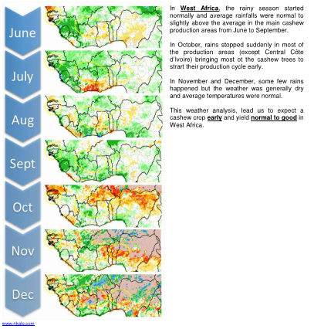
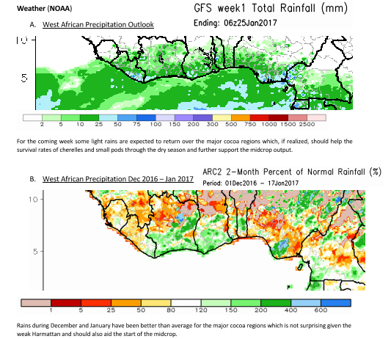
Weather Forecast - Regional

Slide 3
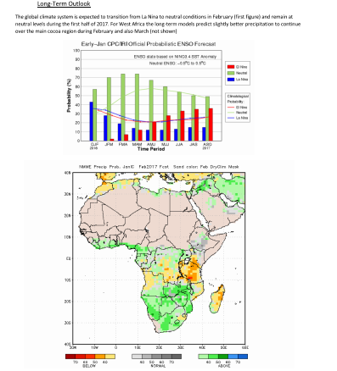
Weather Forecast - Continental

Slide 4
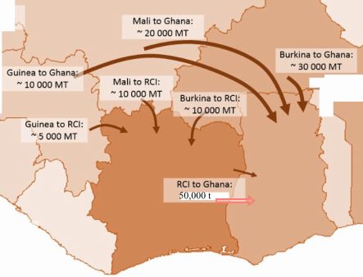
Crop Forecast – B.I.G
Country | 2015 | 2016 | 2017 **est | Quality - avg
Burkina Faso | 75,500 | 71,000 | 80,000 | 45lbs
Ivory Coast | 702,510 | 649,857 | 725,000 | 46lbs
Ghana | 65,000 | 85,000 | 85,000 | 48lbs

