Slide 1

responsAbility Investments AG
FINANCING THE CASHEW
SECTOR
Shiru Mwangi,
Regional Head Agriculture Debt Investments Sub Saharan Africa

Slide 2

UNE PLATEFORME POUR L’INVESTISSMENT
Deux Catégories d’Actifs et trois secteurs
Finance
Agriculture
Energie
Financement par emprunt Privé
Plateforme intégrée avec une puissante méthode d’investissement systématique et des personnes expérimentéessur le terrain
Placement en Actions Privé
2
Please refer to the disclaimer pages and/or the
appendixes for the applicable legal information

Slide 3
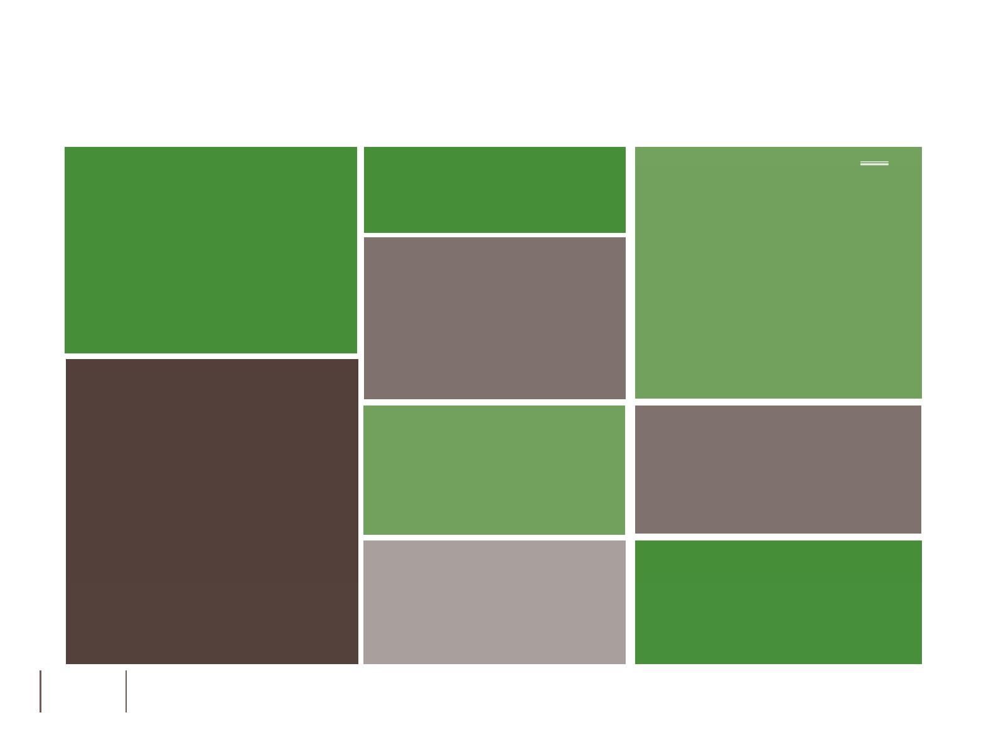
FINANCEMENT PAR EMPRUNT DE L’AGRICULTURE
Finance
Solide Palmarès
USD 248m
investis
42%
production
37%
transformation & logistiques
21%
distribution & détail
USD 1 bn
déboursés
131
clients
303 deals
Très bien structurés avec des charges fixes et flottantes sur les actions
CMAs, garanties des sociétés etc.
Investis dans 50
25%
Financement à long terme
Pays
Experience
dans
7
16
5
Responsables des Investissement
produits
3
as of 30.12.2016

Slide 4
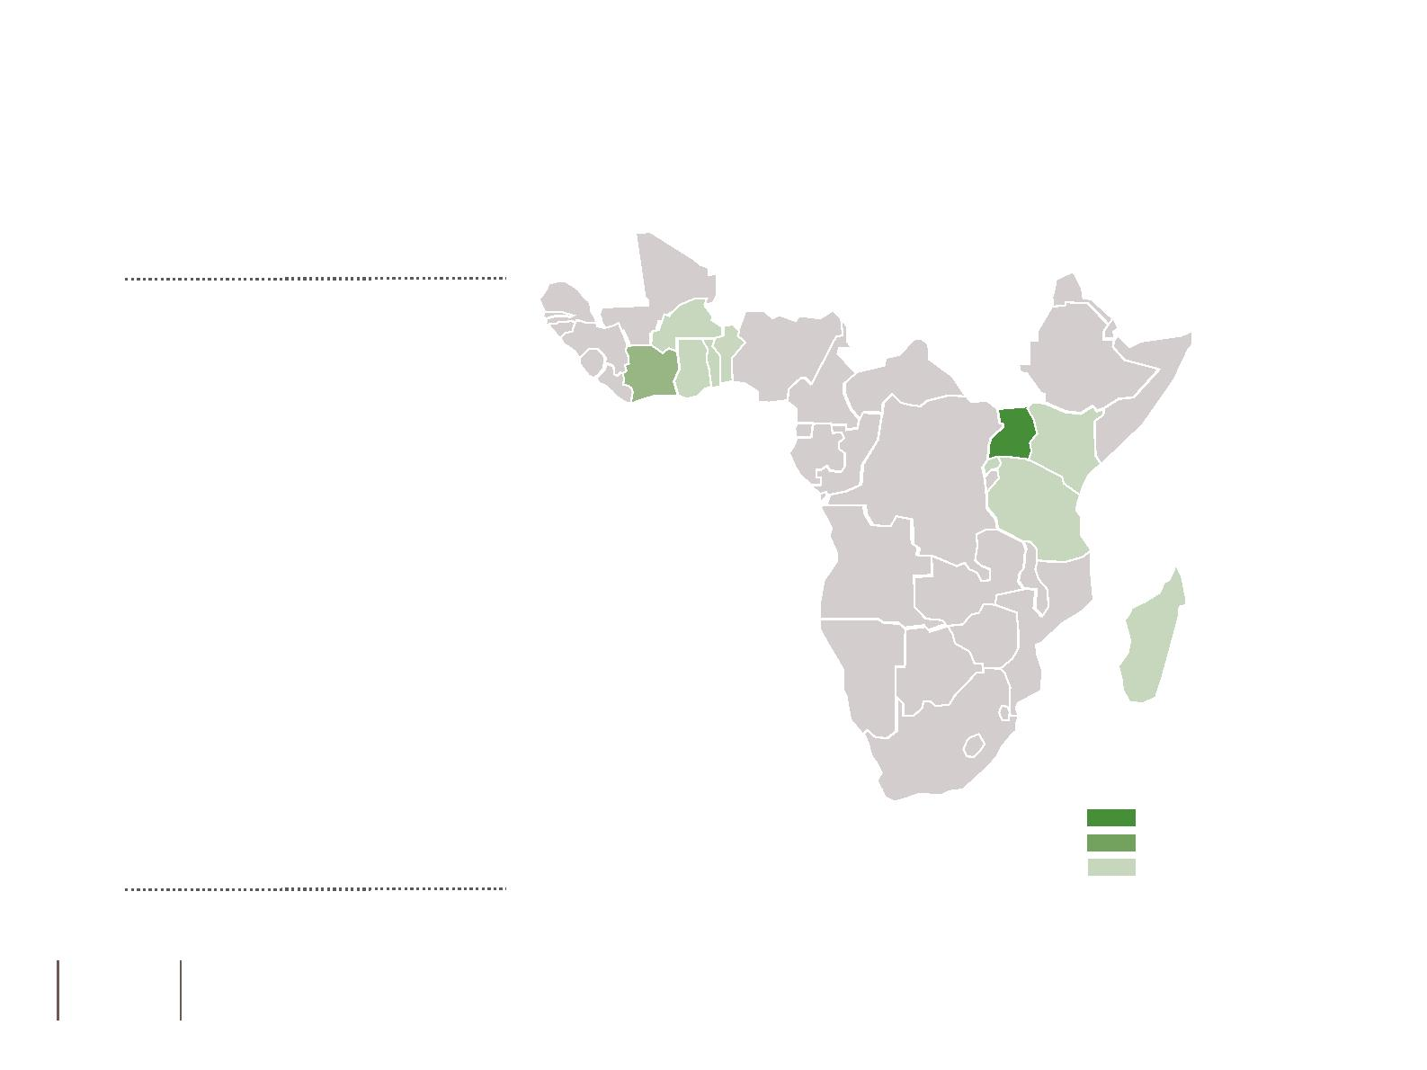
PORTE-FEUILLE AFRIQUE SUB-SAHARIENNE
Exposition à la dette Agricole dans la région
60m USD de volume investi
11
32
14
pays
contreparties
Matières Premières
21%
Investissements à long terme
Investment volume per country
as of 30.12.2016
more than USD 10 million
USD 5 – 10 million
less than USD 5 million
4
Please refer to the disclaimer pages and/or the appendixes for the applicable legal information
SSA – Sub-Saharan Africa

Slide 5
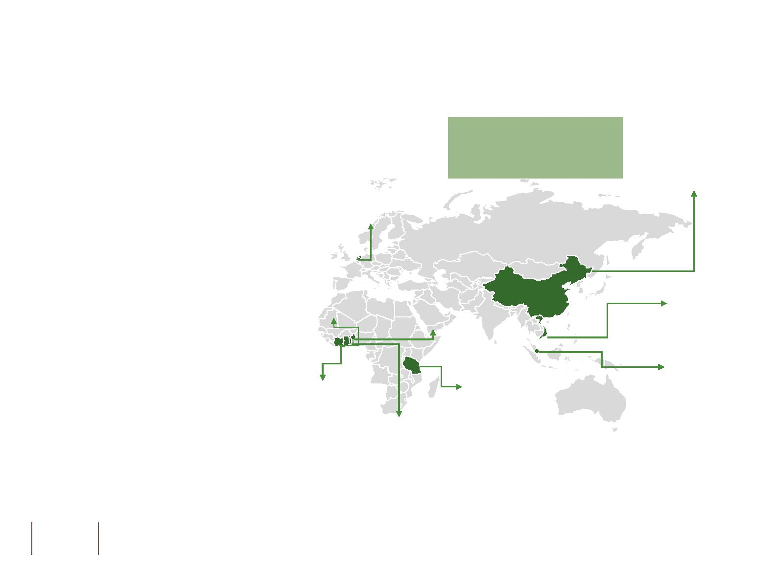
FINANCEMENT DU CAJOU
Structure: portefeuille (USD)
Sociétés Ciblées:
USD 20m
Transformateurs se conformant aux critères S&E
.
China
1.2m
.
Membres du réseau ACA
Netherlands
1,2m
Pays Ciblés:
.
Afrique de l’Ouest:
Côte d’Ivoire, Ghana, Benin,
Togo, Burkina Faso, Guinea
Bissau
Côte d’Ivoire
0,2m
Vietnam
11m
Benin
0,5m
.
.
Afrique de l’Est:
Tanzanie, Mozambique
Asie:
Singapore
2m
Tanzania
0.6m
Inde, Vietnam, Indonésie
Ghana
1.6m
Togo
1.8m
Types de prêts:
. Court et long terme
5
Please refer to the disclaimer pages and/or the appendixes for the applicable legal information
NB: Committed amount as of 30.12.2016

Slide 6
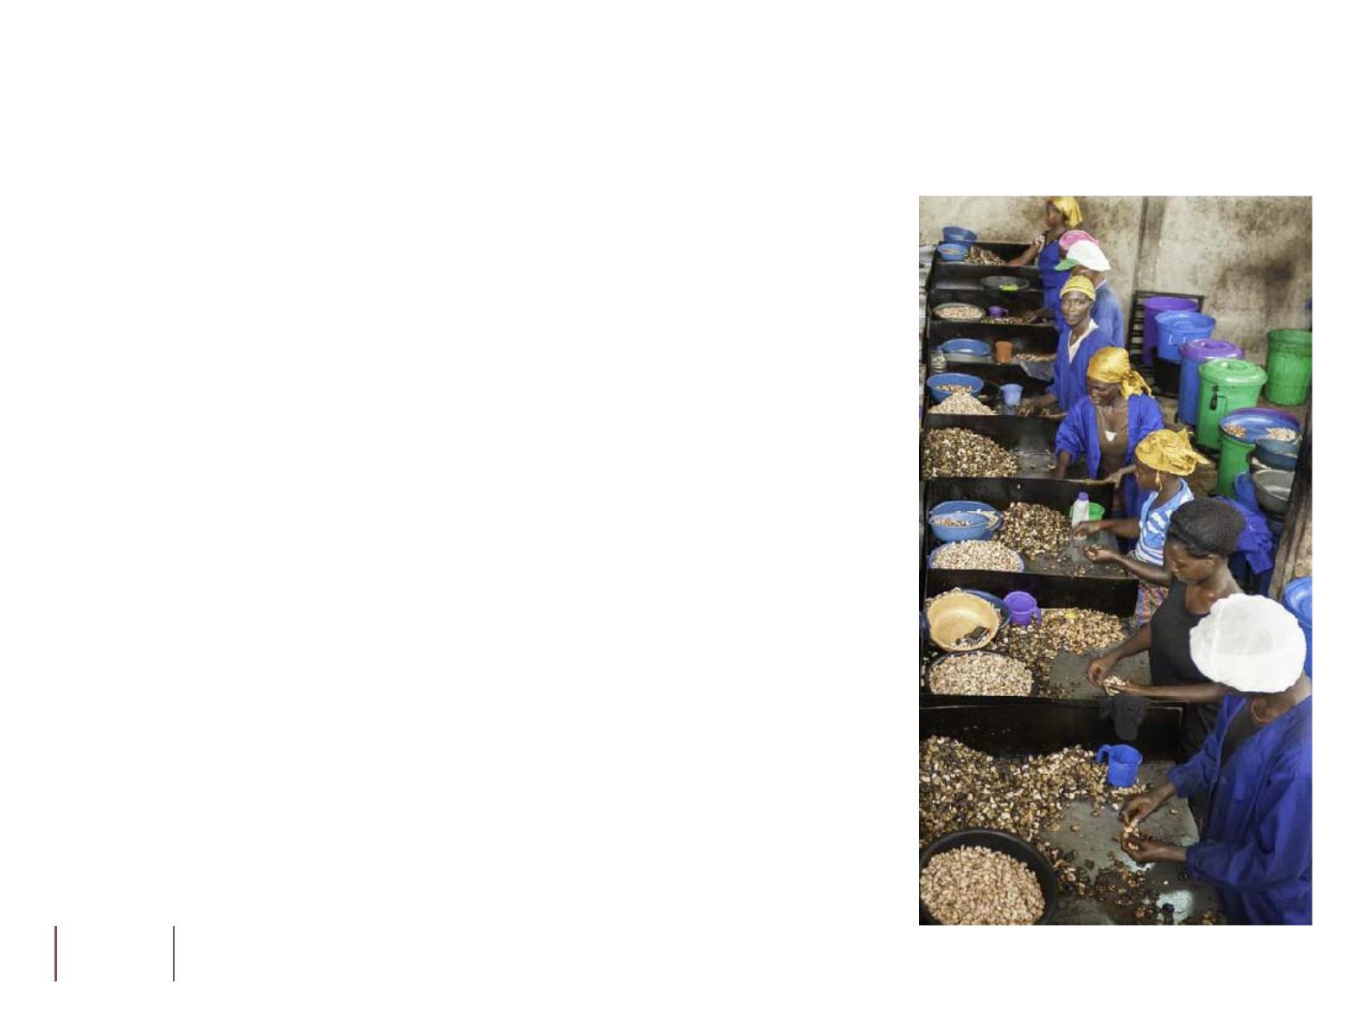
BESOIN DE FINANCEMENT DANS LE SECTEUR DU CAJOU
Commerçants de Noix de Cajou brutes:
Financement de la lacune entre le paiement des noix de cajou brutes aux agriculteurs et le paiement de la part des acheteurs (habituellement quelques semaines/un mois)
.
Financement des véhicules et Entrepôts
.
Pour les Usines de Transformation
.
Financement de la lacune entre le paiement des noix de cajou brutes aux agriculteurs et le paiement de la part des acheteurs (habituellement quelques semaines/jusqu’à un mois)
.
.
Financement des coûts de transformation
Achat de Véhicules, Machines et Equipements
.
Construction d’Usine
6/76

Slide 7
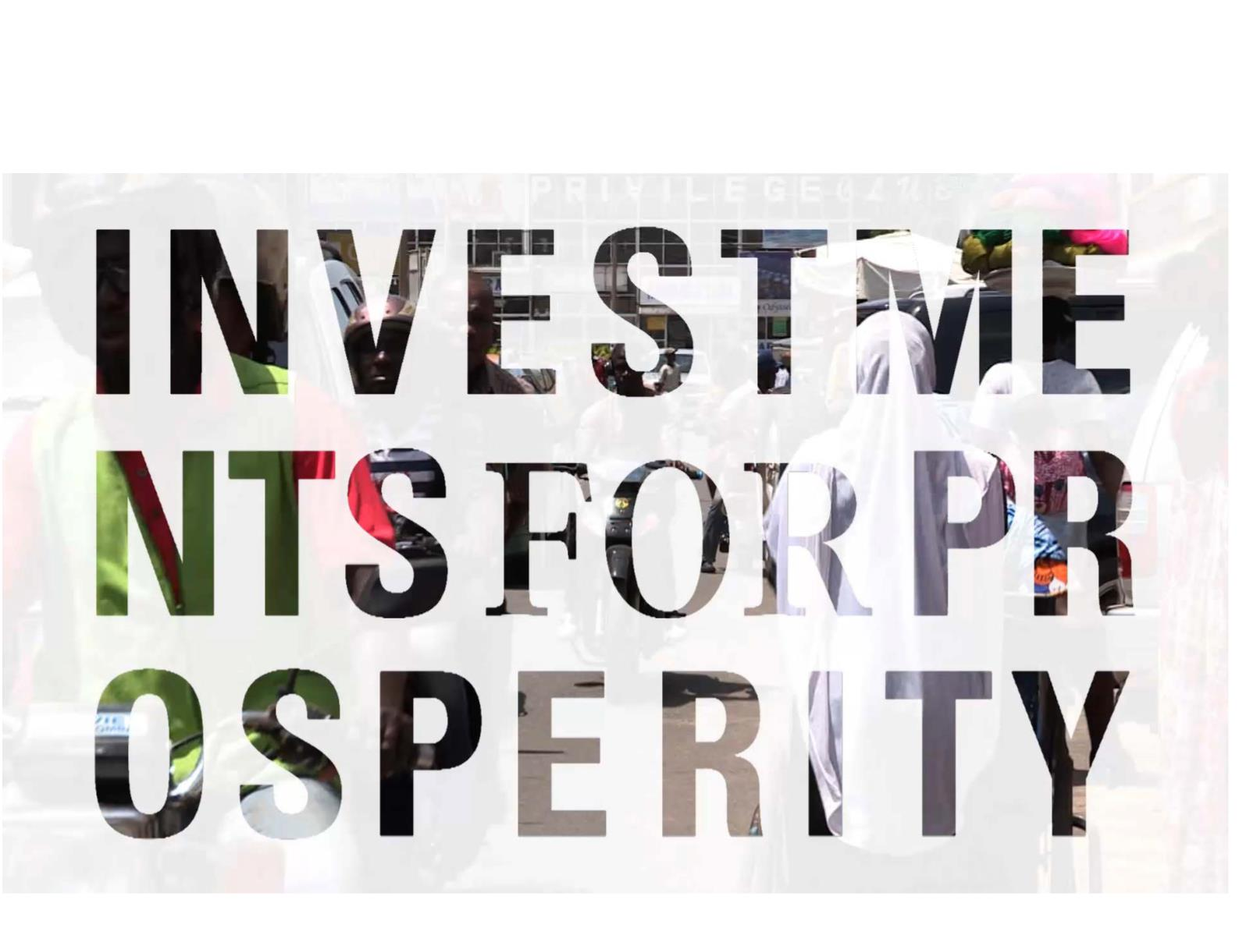
FINANCEMENT DU CAJOU
Une vidéo vaut un millier de mots
7
Please refer to the disclaimer pages and/or the appendixes for the applicable legal information

Slide 8

Tel. +41 44 250 99 30 | Fax +41 44 250 99 31 | info@responsAbility.com
2016 responsAbility Investments AG. All rights reserved.
©

Slide 9

LEGAL DISCLAIMER
This information material was produced by responsAbility Investments AG and/or its affiliates with the greatest of care and to
the best of its knowledge and belief. However, responsAbility Investments AG provides no guarantee with regard to its content
and completeness and does not accept any liability for losses which might arise from making use of this information. The
opinions expressed in this information material are those of responsAbility Investments AG at the time of writing and are subject
to change at any time without notice. If nothing is indicated to the contrary, all figures are unaudited. This information material is
provided for information purposes only and is for the exclusive use of the recipient. It does not constitute an offer or a
recommendation to buy or sell financial instruments or services and does not release the recipient from exercising his/her own
judgment. The recipient is in particular recommended to check that the information provided is in line with his/her own
circumstances with regard to any legal, regulatory, tax or other consequences, if necessary with the help of a professional
advisor. This information material may not be reproduced either in part or in full without the written permission of responsAbility.
It is expressly not intended for persons who, due to their nationality or place of residence, are not permitted access to such
information under local law. Neither this information material nor any copy thereof may be sent, taken into or distributed in the
United States or to any U. S. person. Every investment involves risk, especially with regard to fluctuations in value and return.
Investments in foreign currencies involve the additional risk that the foreign currency might lose value against the investor's
reference currency. It should be noted that historical returns and financial market scenarios are no guarantee of future
.
Copyright © 2017 responsAbility Investments AG. All rights reserved.
9
Please refer to the disclaimer pages and/or the
appendixes for the applicable legal information

