Slide 1

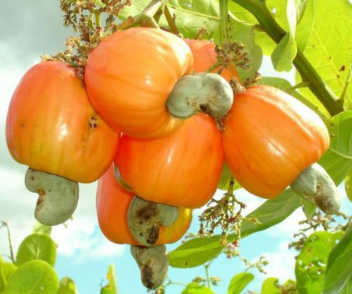

RCN Markets – A Global Perspective
Dr.R.K.Bhoodes
Vice-Chairman, CEPCI

Slide 2
Glimpses of Global RCN Trade …
When cashew trees were introduced from Brazil to the rest of the world, it was meant for preventing soil erosion only.
Raw nut was a waste product just meant for reproduction only
Later on in the late 18th century , cashew kernels found a way as a food item and was traded in the local markets in India
When Cashew kernels found an entry in the international trade, RCN were sourced locally .
It was India that nurtured cashew as an Industry and it was she who introduced cashew as a commodity in the international trade.

Slide 3
Glimpses of Global RCN Trade …
RCN attained the status of an international commodity in the mid 1960’s with shipments made from East Africa (Tanzania) to India.
RCN trade attained a new outlook after Liberalisation, Privatisation and Globalisation of trade during the 1990’s.
The increased consumption of Cashew Kernels all across the world demanded the supply of more raw nuts for processing, that ultimately resulted in processing countries importing bulk quantities of RCN for processing.
While the processing countries concentrated more in processing, the producing countries concentrated more in production (Theory of Comparative advantage)
Mechanisation and automation has brought in a feel of comfort for producing countries to step into processing

Slide 5
Production, Area of Production & Productivity of RCN – A comparison of Growth Rate
Sl.No | Region | Production | Area | Productivity
1 | India | 4.30 | 2.79 | 1.51
2 | Vietnam | 12.32 | 4.45 | 7.87
3 | Brazil | 2.11 | 1.00 | 1.11
4 | East Africa | 3.72 | 2.13 | 1.59
5 | West Africa | 13.87 | 11.07 | 2.81
6 | Others | 5.06 | 5.71 | (-)0.65
7 | WORLD TOTAL | 6.35 | 4.78 | 1.57

Slide 7
Almonds | Brazil Nuts | Cashew | Hazel nuts | Mechadamias | Pistachios | Wallnuts
7.40% | 0.90% | 10.10% | 7.60% | 11.40% | 8.80% | 8.70%

Slide 8
Kernel Price Vs RCN Price …..
Year | C.K (USD/LBS) | RCN (USD/M.T) |  | Year | C.K (USD/LBS) | RCN (USD/M.T)
2000 | 2.59 | 834 |  | 2008 | 3.08 | 970
2001 | 1.98 | 559 |  | 2009 | 2.82 | 892
2002 | 2.00 | 631 |  | 2010 | 3.52 | 1682
2003 | 1.89 | 665 |  | 2011 | 4.39 | 1886
2004 | 2.41 | 843 |  | 2012 | 3.69 | 1302
2005 | 2.43 | 851 |  | 2013 | 3.56 | 1504
2006 | 2.24 | 676 |  | 2014 | 3.65 | 1740
2007 | 2.61 | 765 |  | 2015 | 3.78 | 1786
Source: Public Ledger, London , DGCIS, Kolkatta

Slide 11
Transitions…
The consumption has grown at un-imaginary levels that resulted in shortage/ high demand for Raw nuts.
The prospects of cashew consumption growth is restricted to the extent of raw nut produced.
There is a big pull by both emerging markets and existing markets of Raw nuts both in terms of quantity and the realisation.
This has resulted in the processors directly purchasing from producing countries

Slide 12
Transitions contd…
The producing countries started processing directly
The mechanisation has enhanced the processing capacities to exhaust almost all available quantities of RCN
Big Governmental supports in the Producing countries Vs reduced levels of Governmental supports in the processing countries
Restrictions imposed by the Producing countries in export of raw nuts
Low / Negative levels of returns in processing

Slide 13
The Result….
Lack of proper quality control on Raw Nuts
Un-healthy competition and trade practices.
High price of RCN at non-parity levels with Kernel prices.
Processors to work with low processing costs that affected the income of workers.
Processors from processing countries setting up processing units in producing countries.
Imposition of heavy duties on export of raw nuts and low returns to farmers.
Ban / Controls on exports of raw nuts in producing countries.

Slide 14
Strength.
Big processing capacities
Well established global trade networks
Mechanisation and Automisation in processing
Weakness
Shortage to cater to the demand
Low productivity
Wide price fluctuations
Opportunities
Increasing consumption of Cashew nuts world over
Scope for Area Expansion
High / Early Yielding breeds of tree

Slide 15
Threats
Most of the yielding trees in West Africa /Vietnam planted in the late 1990’s are at its peak level of yield, which may come down in the coming years resulting in shortage of raw nuts.
Old and senile plantations in India and West Africa regions
Lack of proper Pre & Post Harvest Management
The productivity is almost stagnant
Lack of a pricing mechanism in rcn trade
Lack of regulatory body / arbitration in raw nut trade.

Slide 16
Action Plan
Production point of View
Processing countries to concentrate more on Production of RCN
Producing countries to concentrate more on increasing the productivity
Adopt improved Pre & Post Harvesting Management
Area Expansion
Replanting Old & Senile Trees with Hybrid Varieties

Slide 17
Action Plan
Trade point of View
Adopt suitable Price Control Mechanism
International Regulatory body for RCN Trade
International Arbitration for RCN Trade
Adoption of Uniform Customs & Practices (UCP) in RCN Trade
Key Points
A well drafted contract solves most of the problems
The right parnters in your business brings down the risk factors.

Slide 18

The Best Approach
Plan well before you start a deal- Follow the tailor & Carpenter theory:-
“Measure Twice But Cut Once”

