Slide 1




Organised By
IMPACT OF GOVERNMENT INTERVENTION ON RCN EXPORTS FROM AFRICA
Title Sponsor
Platinum Sponsor
Karim BERTHE
Cotton and Cashew Council of Cote-d’Ivoire
Technical Adviser of the DG
09-11 February, 2017
Grand Copthorne, Singapore

Slide 2
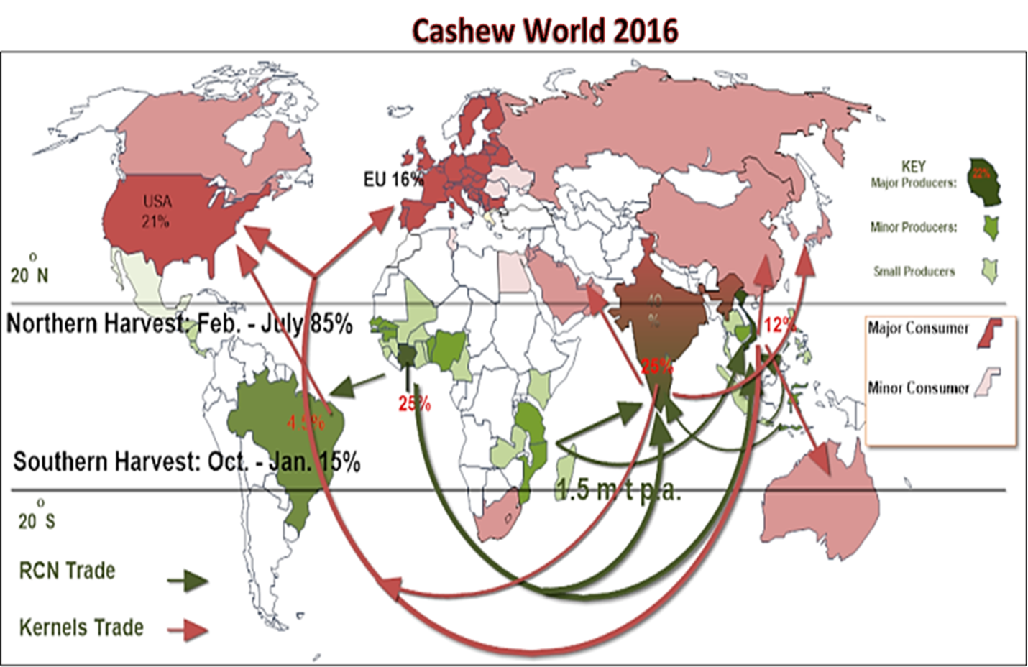
Rising demand
High dependence on Vietnam
Rising food safety needs
Concern for environment and csr.
WORLD CASHEW MARKET
Supply deficit
Falling production
Dependence on imported RCN
Food safety non compliance
Title Sponsor
Platinum Sponsor
Rising costs
Labour problems
Fast growing consumption
Production drop
Factory closures
Lack of processing.
Opportunity for growth.
Need for financial services and upskilling.
RCN trade
Lost traceability
Volatility and speculation
Carbon footprint
09-11 February, 2017

Slide 3

WORLD CASHEW MARKET
Africa:
RCN availability
Umployment
Limited Proces. Capacity
Land (Indus. Production)
Lack of investments
Lack of competitiveness
Kernel Market:
(USA, EU…)
Growing demand
Food Safety and traceability issues
Social and Environment issues
Asia:
Production slowing
RCN imports
Labor issues
Far from markets (EU,USA…)
RCN
2 mil mt
Kernel
0,4 mil mt
Consequences along the value chain:
  Weak treacebility, Carbon footprint, Speculations and volatility on RCN prices
Your company logo

Slide 4
MAIN OBJECTIVES OF
GOVERNMENT INTERVENTION IN CASHEW INDUSTRIES
              Discourage RCN Export
              Strenghten local processing (local and international investors)
              Ship out kernels from Africa instead of RCN
              Add value
              Create job for Young and women
Your company logo

Slide 5
IMPACTS OF GOVERNMENT INTERVENTION ON RCN EXPORTS
AFRICA:
Processing +/-2 mil mt
Invest, Technologies, Technical Assist, Know How
ASIA:
Processing +/-1,5 mil mt
Kernel in bulk, RCN
Kernel Market:
(USA, EU…)
Growing demand
Food safety and traceability issues
Social and Environnent issues
Kernel
Kernel
Your company logo

Slide 6
IMPACTS OF GOVERNMENT INTERVENTION ON RCN EXPORTS
THANK YOU
Your company logo

