Slide 1
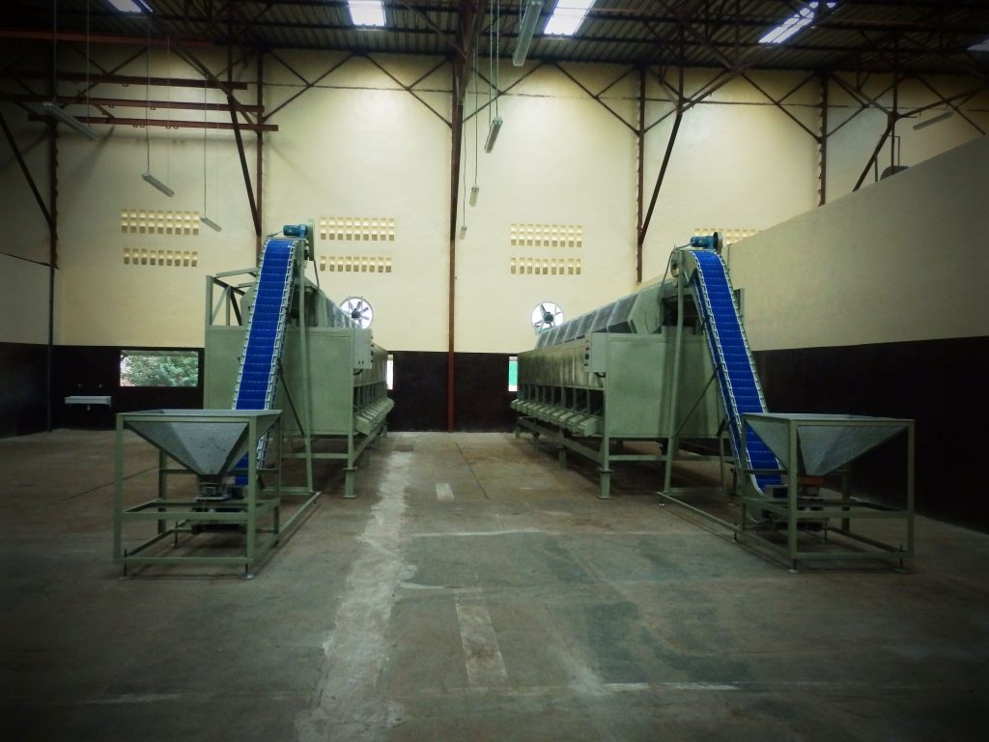


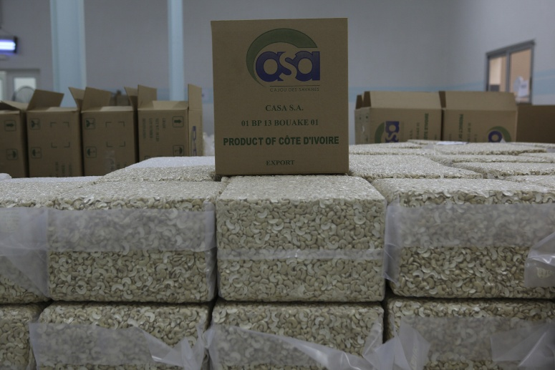



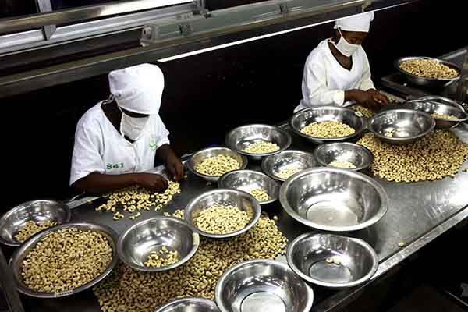
RCN PROCESSING IN AFRICA CHALLENGES & OPPORTUNITIES CAJOU DES SAVANES COTE D’IVOIRE
ADOTEVI JOHANNA 08-02-2017
Notes:
David:
Budget & Seuil de rentabilité avec 2 équipes
BP est sur une hypothèse de 250 FCFA/kg - expliquer la difficulté clairement d’atteindre une profitabilité avec le modele existant
HG: revoir la capacité actuelle avec 2 équipes
We should not look at new investments to increase capacity, but rather to increase productivity and optimise costs (ie labor)

Slide 2
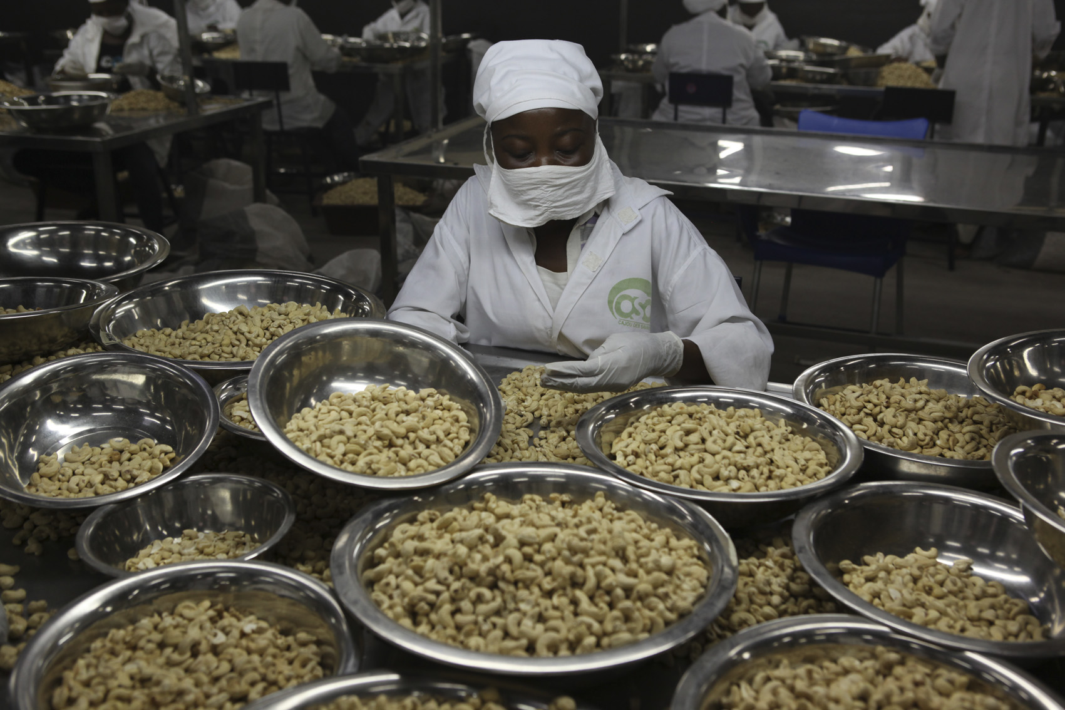


RCN PROCESSING IN AFRICA OPPORTUNITIES &CHALLENGES
CAJOU DES SAVANES –SA (CASA .SA ) Cote d’Ivoire
Presentation of CASA .SA
Opportunities
3. Challenges

Slide 3
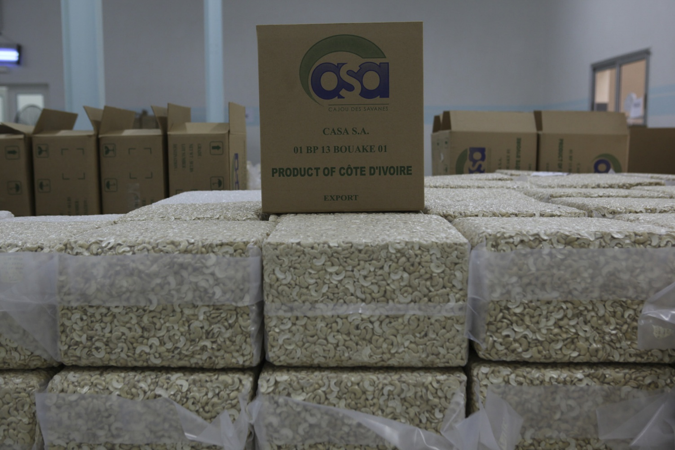
CAJOU DES SAVANES –SA (CASA .SA ) Cote d’Ivoire
CREATED in 2014 BY IVOIRE COTON SA ( 40% of Cotton market share in Cote d’Ivoire ) to enable cotton farmers to increase their net revenue
Based on market analysis and growing trends in cashew production of Cote d’Ivoire who has become the 1st world producer of RCN ( 700 000 tons in 2015 )
Vision was to contribute to development of the North West region of Ivoire Coton and be in line with the IPS vision to add value to raw material
Objectif was to also create employement and offer a sucess story in agro alimentary business
Intial business plan based on capacity of processing 5000 T RCN to rapidly increase to 10 000 T RCN by 2020
ACA seal January 2016
WALMART SCAN audit December 2016
To be certified BRC by end 1st quarter 2017

Slide 4
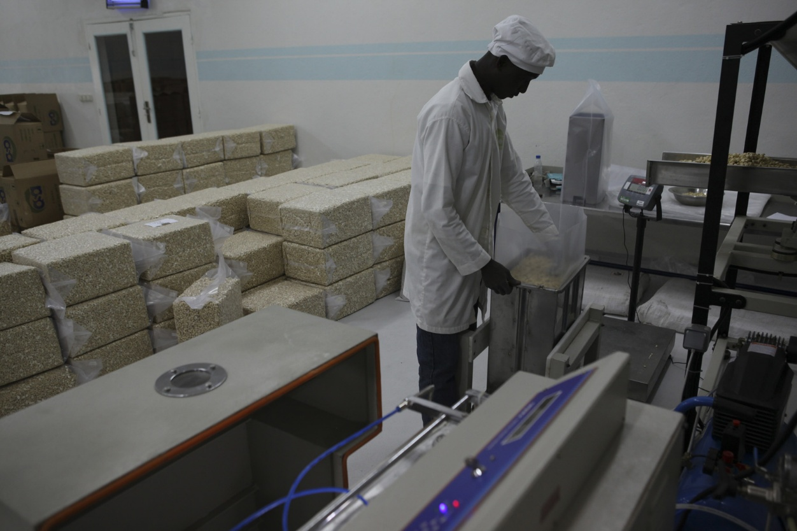
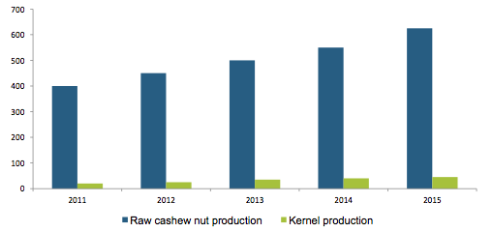


RCN world production Côte d’Ivoire in 1st position , but less than 10% processed locally ( source ICA 2016 )

Slide 5
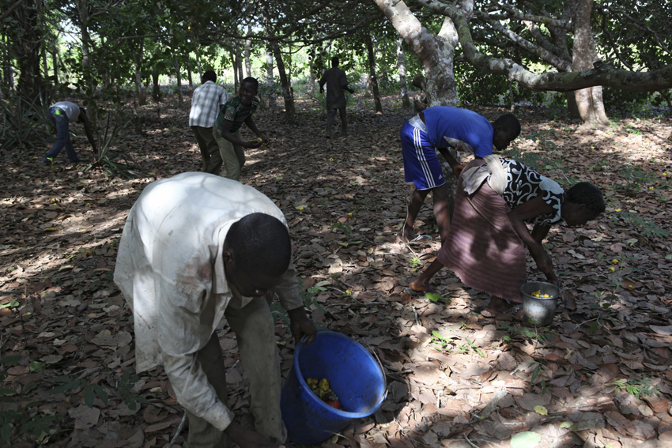
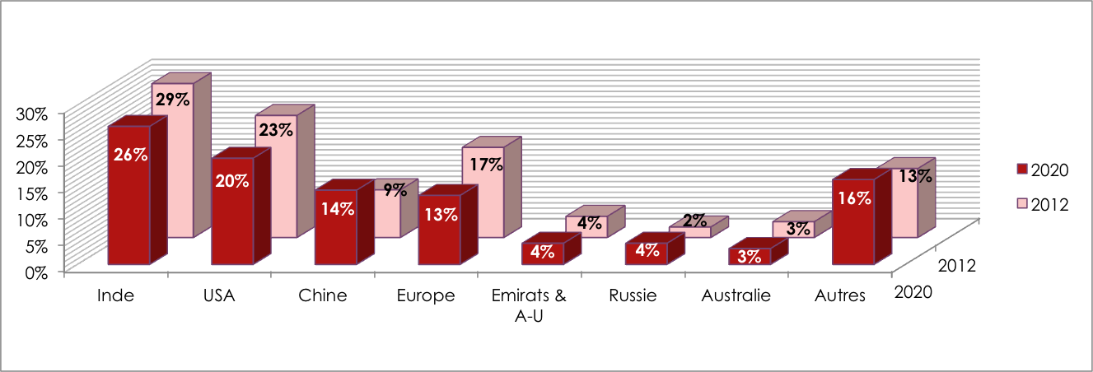


Slide 6
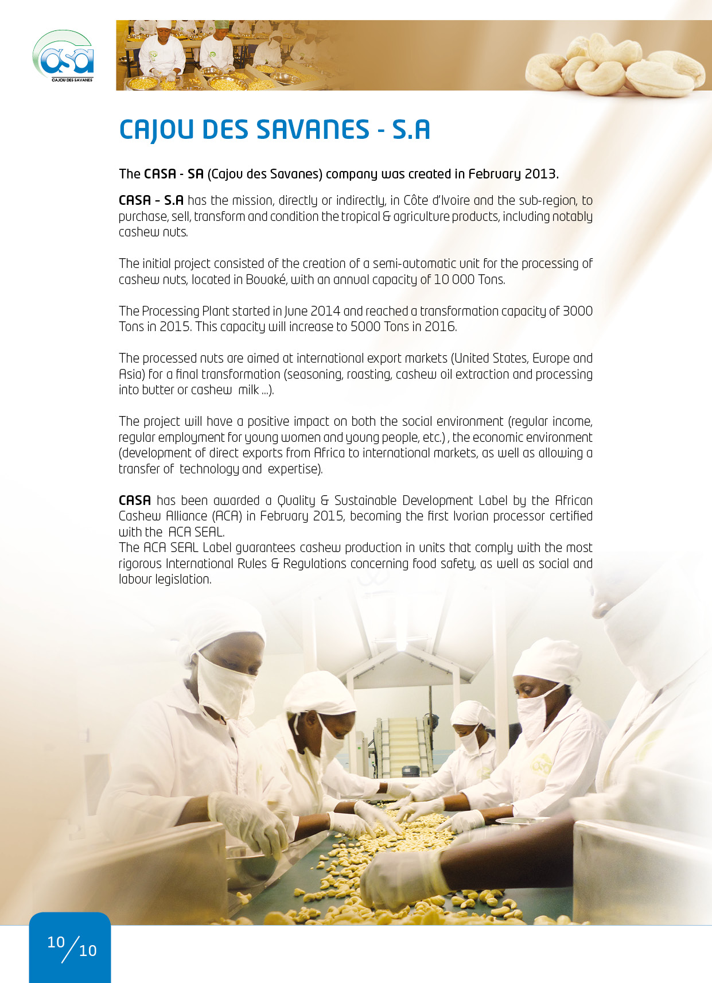

Slide 7
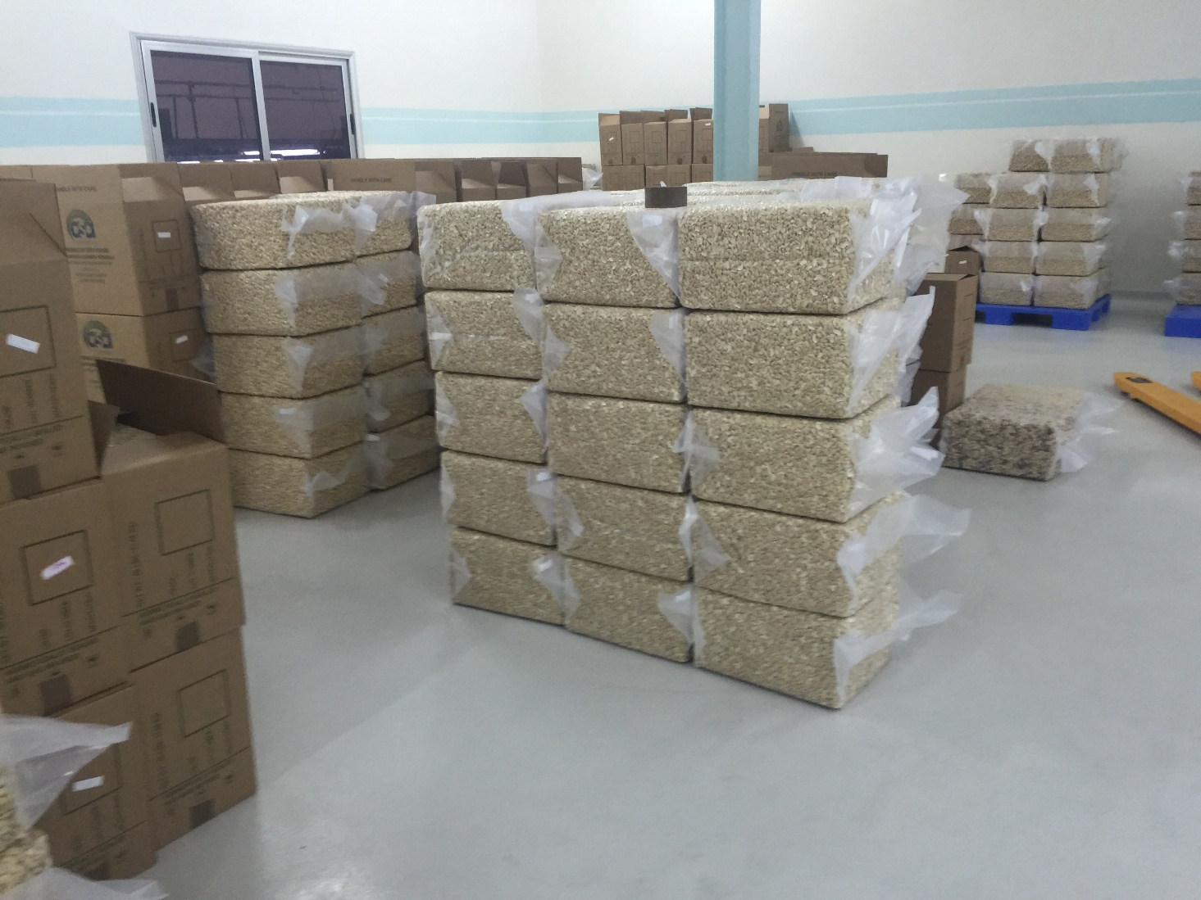
CAJOU DES SAVANES –SA (CASA .SA ) Cote d’Ivoire
Opportunities : RCN available ( 1st world producer ) , market in demand , good kernel price , Gouvernement policy to encourage the local processing , strong governement policies ( SIETTA 2016 , subsidies paid of 400 FCFA / kgs kernel equivalent 80 FCFA / kgs RCN exported )
Cote d’Ivoire to host the CCIC ( government platform launched in november 2016 )
Awareness of the FDA standards and certification
Good practices & expertises
Motivated Shareholders
Challlenges :
Very High competition from RCN exporter
Price of RCN paid by exporter stil very high and attarctive vs what processors are paying
High cost of production ( labor , electricity , taxes , logistics )
Poor Local market ( Non AFI grades who have same cost of production )

Slide 8
 | 2015 estimé | 2016 Budget | 2017 BP | 2018 BP | 2019 BP | 2020 BP
Quantité noix brute achetée (kg) | 1 959 773 | 5 200 000 | 7 500 000 | 10 000 000 | 10 000 000 | 10 000 000
Prix unitaire achat (fcfa/kg) | 530 | 530 | 500 | 500 | 500 | 500
KOR (Kernel Output Ratio) (lbs/sac 80 kg) | 45 | 47 | 48 | 48 | 48 | 48
Production amande (kg) | 712 757 | 941 600 | 1 500 000 | 2 000 000 | 2 000 000 | 2 000 000
Quantité amande vendue (kg) | 759 367 | 928 780 | 1 500 000 | 2 000 000 | 2 000 000 | 2 000 000
Prix de vente moyen (fcfa/kg) | 3 979 | 4 532 | 4 532 | 4 532 | 4 532 | 4 532
Chiffre d'affaire (fcfa) | 3 021 438 454 | 4 208 933 205 | 6 794 400 000 | 9 059 200 000 | 9 059 200 000 | 9 059 200 000

Slide 9













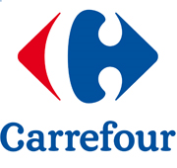

CUSTOMERS
2015-2016: * Clients directs | ** Clients indirects
*
**
*
*
*
**
*
*
**
2017: Target End Users

Slide 10

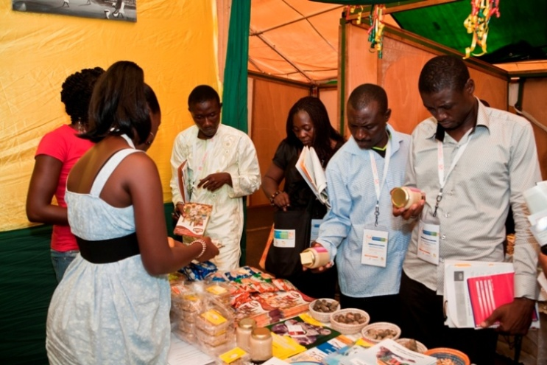
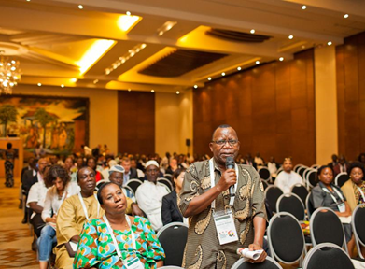
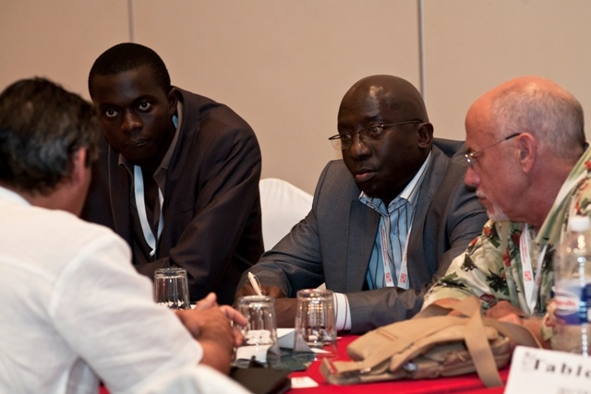
Be Part of Africa’s Largest Cashew Event!!!
18 -21 September, 2017
Cotonou - Benin
Monday, 18 September 2017
Registration
ACA General Assembly
Opening Ceremony/ Inauguration of the Exposition 2017
Welcome Cocktail
Tuesday, 19 September 2017
Plenary Session
Exposition 2017
Wednesday, 20 September 2017
World Cashew Forum
Business to Business (B2B) Forum
Gala Dinner
Exposition 2017
Thursday, 21 September 2017
Field Trips ( visit a cashew farm, factory and a cultural site)

Slide 11

