Slide 1





Organised By
RCN Processing in Africa: Opportunities and Challenges
Mechanical Cashew Processing at FLUDOR-BENIN S.A.
JC Reddy, Technical Head
FLUDOR-BENIN S.A. VINK CORPORATION DMCC
9th Feb 2017
Title Sponsor
Platinum Sponsor
09-11 February, 2017
Grand Copthorne, Singapore

Slide 2

Cashew Project Synopsis
GROUP : TGI
COMPANY : CAJOU PROJECT/FLUDOR-BENIN S.A.
TECH EXPERIENCE : 20 YEARS OF MFG IN BENIN (VEG OIL)
TRADE EXPERIENCE : 15 YEARS OF RCN TRADE IN BENIN
LOCATION : BOHICON, BENIN REPUBLIC
COMMERCIAL RUN : JAN 2016
PLANT CAPACITY : 18000 MT OF RCN
FENCED AREA : 5.5 ha
CONSTRUCTION AREA : 15,000 sq.m
CAPACITY BUILT UP : 3 PHASE PDCA APPROACH
FORWARD INTEGRATION : CNSL PLANT/ INGREDIENT CENTRE
BACKWARD INTEGRATION : FARMER’S DEVELOPMENT PROG
INVESTMENT : DIRECT FOREIGN INVESTMENT
INVEST THESIS : ORIGIN BASED SUSTAINABLE PROCESSING
PROJECT COMPLETION : 14 MONTHS

Slide 3

Primary African Challenges
CROP SIZE
RCN COST
TRACEABILITY
PROJECT EXECUTION
LOW POPULATION DENSITY
EXPENSIVE TRANSPORTATION
SPARE PART AVAILABILITY
NO SCHEDULED WAGE STRUCTURE!
BEHAVIOURAL LIVING WAGE CONTENTMENT
GOVERNMENT POLICIES (Make or break!)
MOBILISATION OF BROKENS & FULL FCL’s
DEPENDENCY ON EXPAT MANPOWER
HIGH PROCESSING COST (+USD 200 PMT)
HIGH VOLUMES IN A SHORT SEASON (working capital!)
WAREHOUSING &DRYING YARDS (seasonal congestion!)

Slide 4

Critical Points for African processing
PLANT LOCATION (Crop or convenience)
PROJECT DESIGN & EXECUTION (HACCP First!)
TECHNICAL & PRODUCT EXPERTISE
WORKERS AVAILABILITY & TRANSPORT
WORKER EFFICIENCY & TRAINING
PLANT MAINTENANCE CAPABILITIES
WORKERS HYGIENE & FOOD SAFETY
SHEQ ISSUES
CULTURAL SENSITIVITIES
PARITY OF BROKENS
RISK MITIGATION PLAN
BYPRODUCTS MANAGEMENT

Slide 5
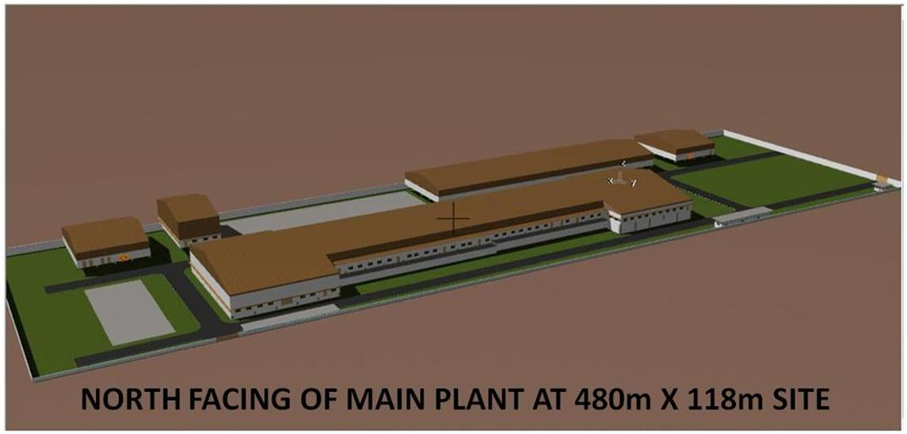
Project Design
MECHANICAL CASHEW PROCESSING UNIT OF FLUDOR-BENIN S.A.
AT BOHICON, REPUBLIC OF BENIN

Slide 6
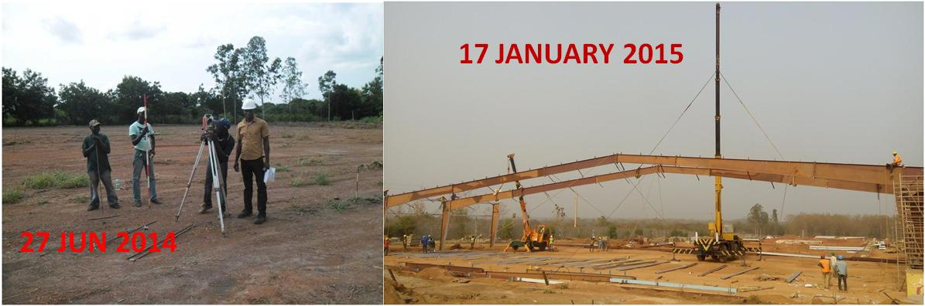
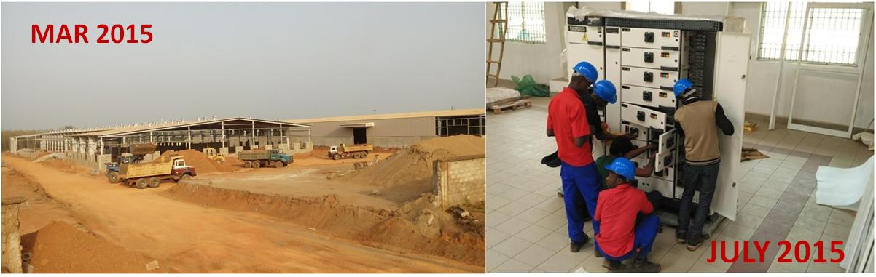
Project Execution

Slide 7
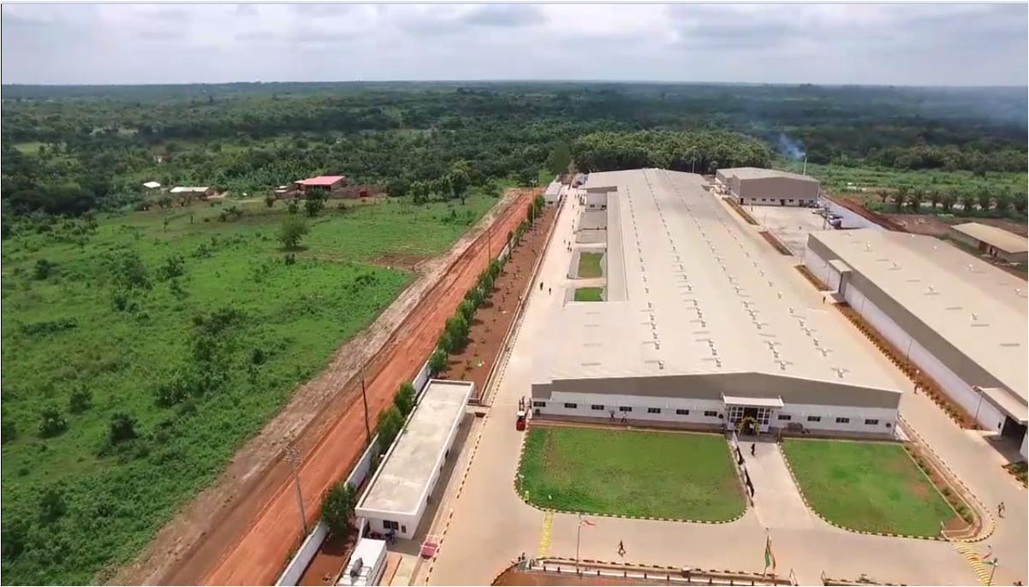
Plant Aerial View

Slide 8
Project Design
MULTI LEVEL EXPAT TEAM
STRONG LOCAL TECHNICAL TEAM
PROJECT TO PROCESS ALIGNMENT
PLANT LOCATION & LAYOUT
(Local crop area Vs convenience?)
(layout first, building next!)
PROCESSING EQUIPMENT & MATERIAL FLOW
(Long life tailor made! For African maintenance!)
(Uniform flow! Cross contamination!)
SITE TOPOGRAPHY & CHALLENGES
(Minimal land fill & excavation / gravitational flow!)
DESIGN AGAINST INFESTATION & HARMATTAN

Slide 9
Case Study: Topography & land slope
FOLLOWED SIMPLE LINEAR FLOW OF 200M
DESIGNED TO FLOW ALONG WITH GRAVITATIONAL FLOW
6.5M
9.5M
GROUND SLOPE- WITH IN 200M BUILDING IS 3 M
GROUND SLOPE- WITH IN 500M LAND IS APPROX 7 M

Slide 10
Project Design
WORKERS AVAILABILITY & TRANSPORT
1. Study on workers availability.
2. Assess workers income levels
3. Consider cultural challenges
4. Minimise transportation
WORKER EFFICIENCY & TRAINING
Offline and online training
Re-training & alignment of low performers
Productive based compensation from day 1.
Incentive & motivation for best performers
Brief local village heads on payments and performance

Slide 11
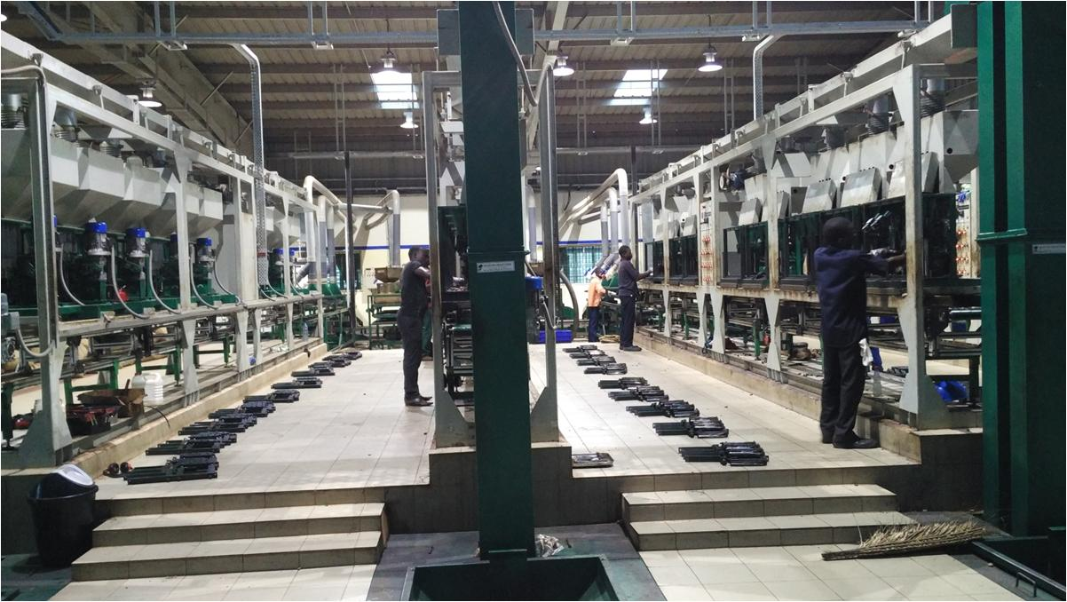
Project Design
  SCHEDULED CLEANING & DE-GREASING ARE FUNDAMENTALS

Slide 12
Project Design
WORKERS HYGIENE & FOOD SAFETY
1. Isolation of toilets & canteen
2. Hand wash & leg wash system
3. Best of class toilet & canteen / Change rooms
5. Pest Control measures
SAFETY, HEALTH & ENVIRONMENTAL ISSUES
Addressed hand burning issues from day one
Maintained health records
Effective EMS for stacks, drainage, STP
Health Centre
Comprehensive CCTV footage
High security access control

Slide 13
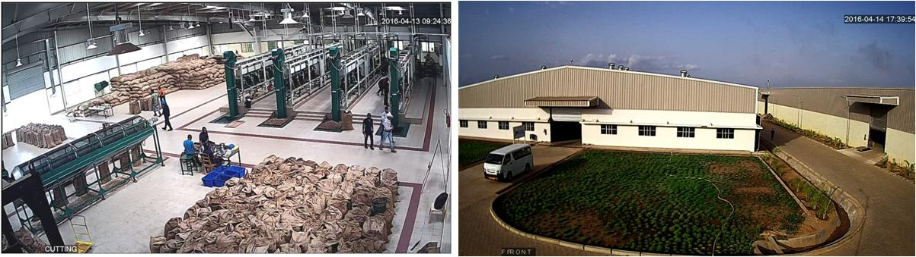
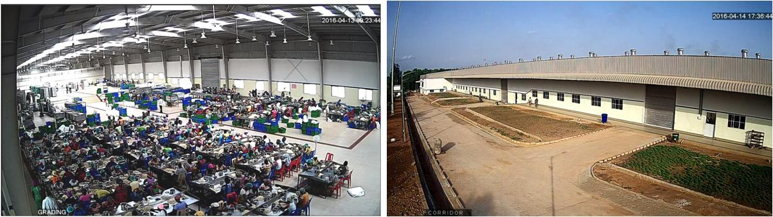
Safety & Security-real time CCTV image
INTERNAL PLACE MONITORING
EXTERNAL SECURITY COVERAGE

Slide 14
Project Design
WORKERS CULTURAL SENSITIVITIES
Tested toilet & wash room design
Food habits & Canteen design
Local beliefs & concerns on envious impacts
Design of uniform for convenient & culture
Addressed high sweating issues
Discourage entry of school going & aged personnel
GOVERNMENT POLICIES
Exemption of VAT & import duties on machinery
Earlier window for RCN buying

Slide 15
Project Design
RISK MITIGATION PLAN
Crop failure & RCN availability
Workers efficiency & wage structure / Technology transfer
Viability / Scalability of operations
Competitive edge with Asia
Government Policies
BYPRODUCTS MANAGEMENT
CNSL Plant
Ingredient Concept
Shell cake mobilisation Plan
Local Animal feed assessment for rejects
Initiate Power Plant Assessment with agro waste

Slide 16
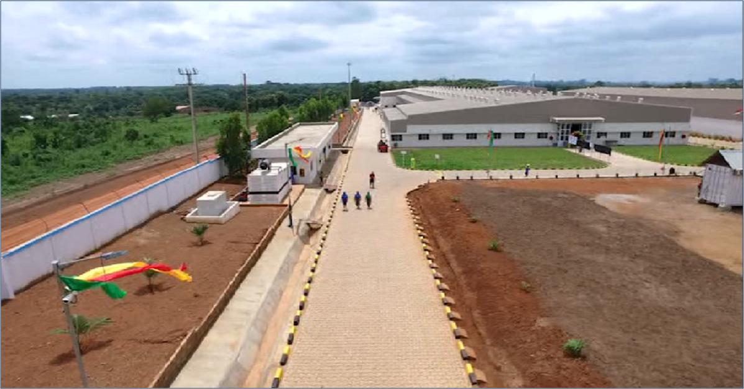
Plant Front View

Slide 17
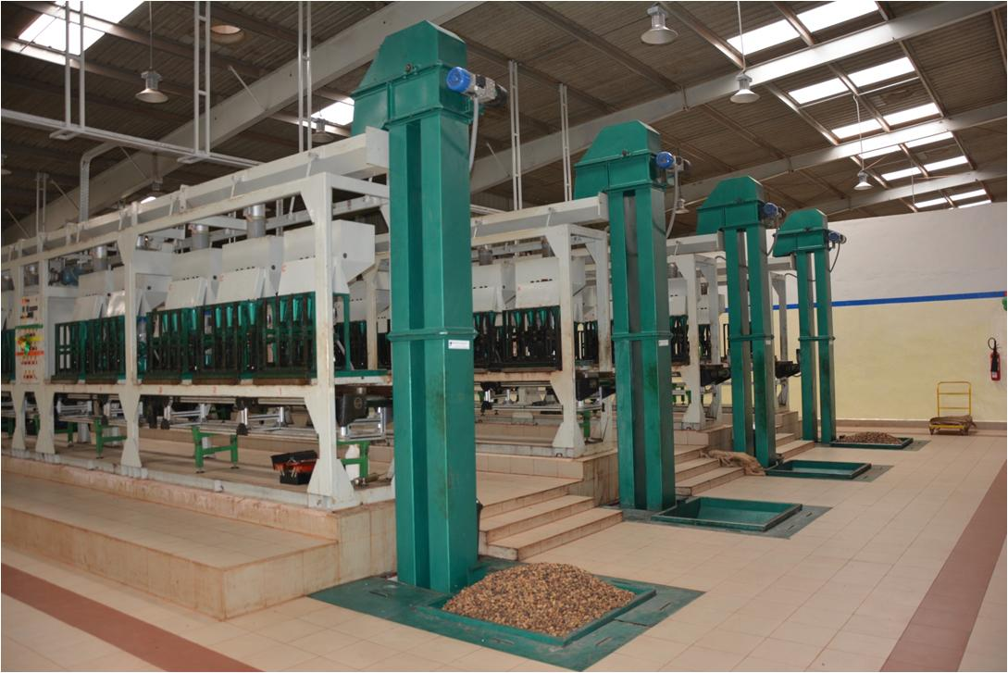
Shelling Lines

Slide 18
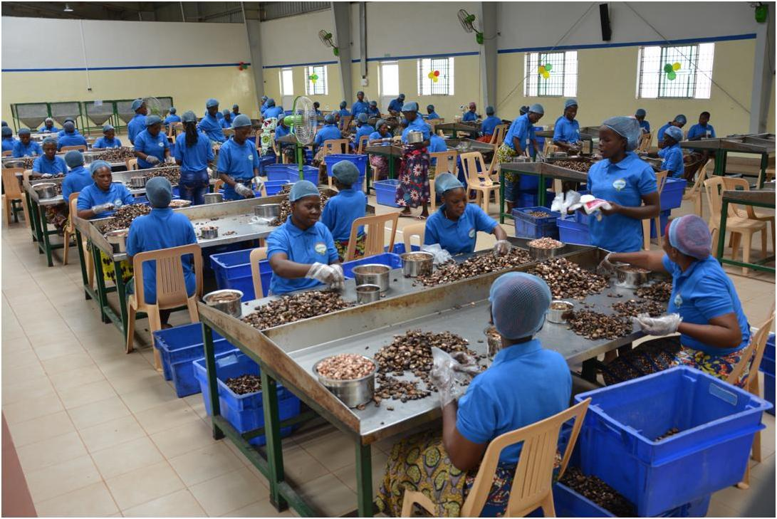
Manual Scooping Section

Slide 19
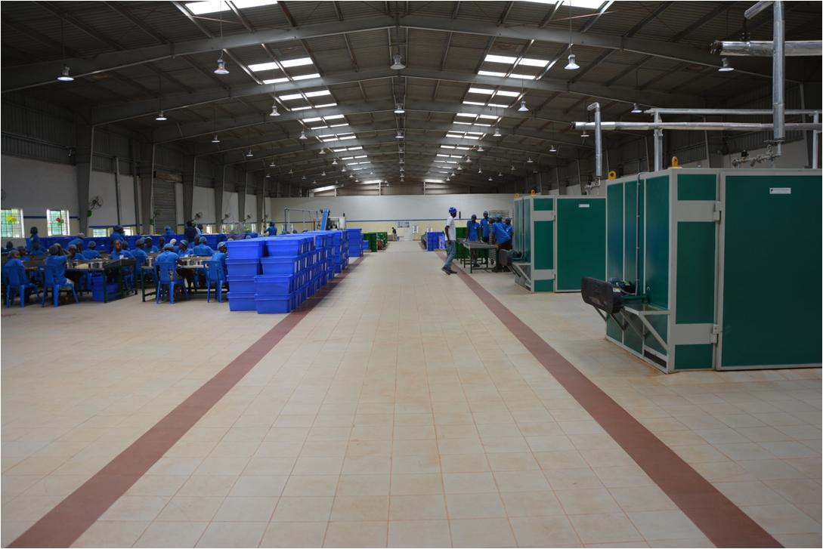
Steam Borma Section

Slide 20
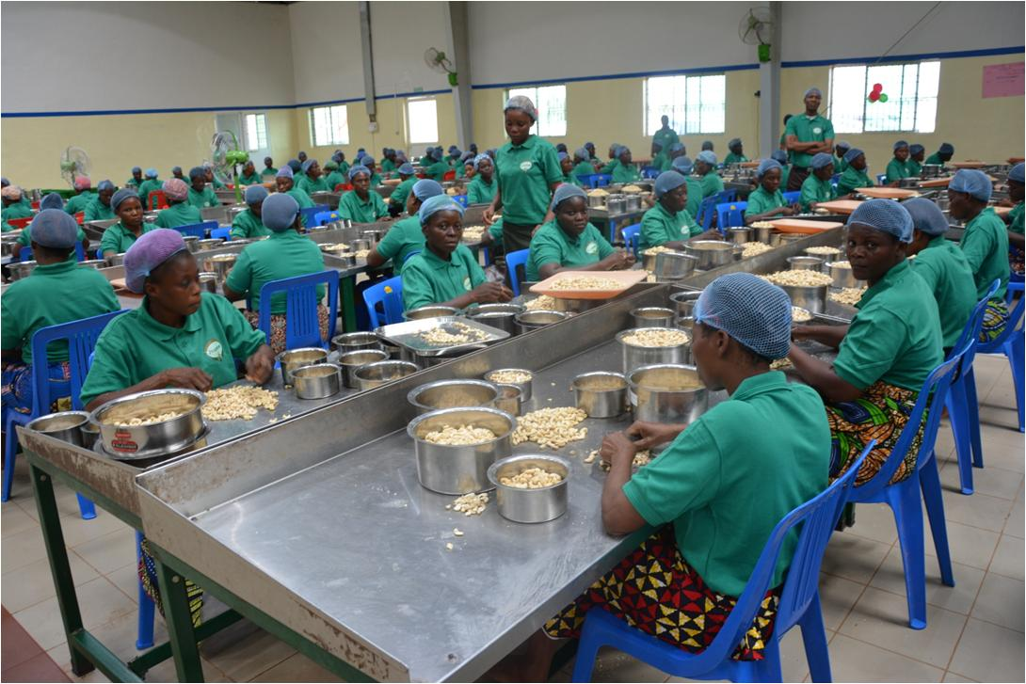
Peeling & Grading Area

Slide 21
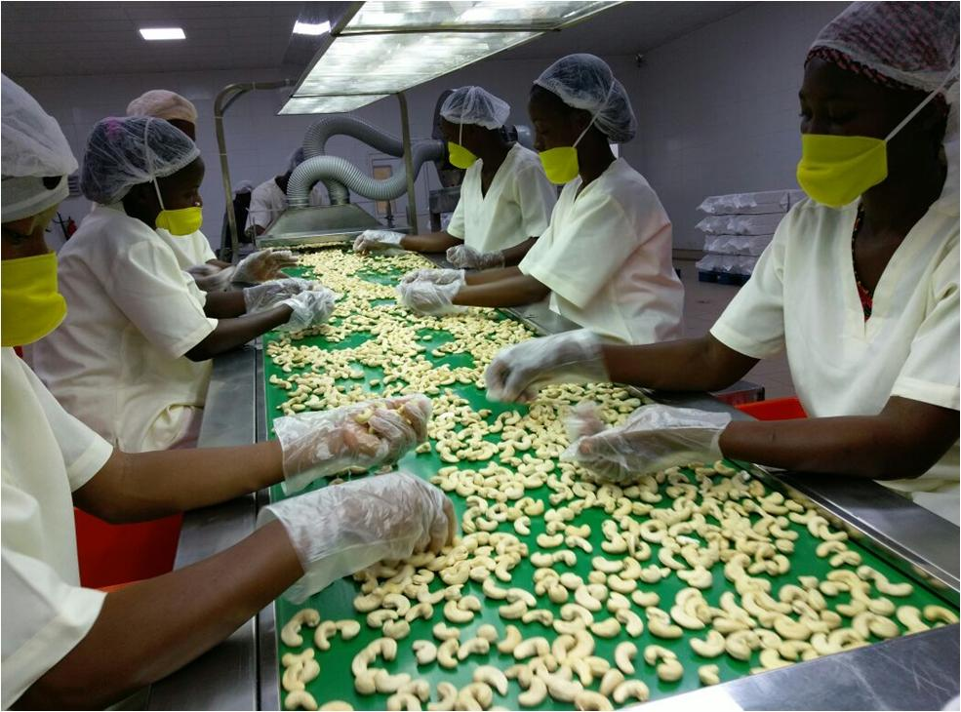
Filling Centre

Slide 22
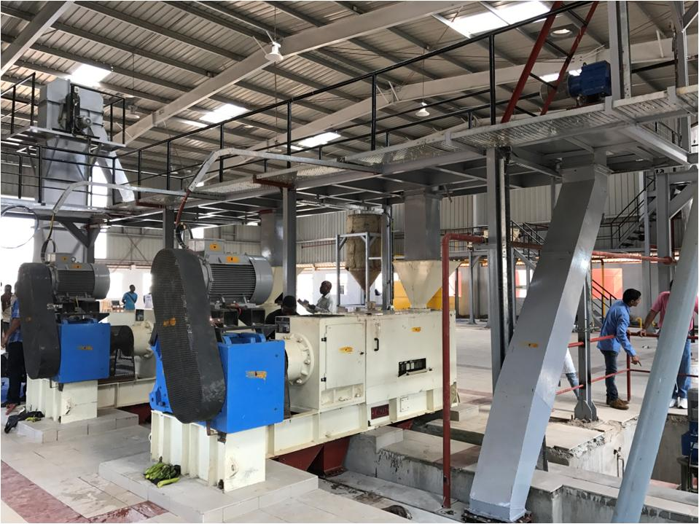
CNSL Plant Interiors

Slide 23
Targeted Operational Efficiencies
  WORKERS PER BAG: 2.5
  CAPACITY UTILISATION: 90%/Q4/2016
  UN-CUT AT SINGLE PASS: 5-8%
  SHELLING WHOLES VS PIECES : 90% + 10%
  PACKABLE WHOLES VS PIECES: 70% + 30%
  PROCESSING TIME: < 9 DAYS
  FUMIGATION: MANDATORY
  FIRST PASS FULLY PEELING WHOLES: Min 55%
  FIRST PASS PEELING BROKENS : Around 12%

Slide 24
Actual Production Vs Installed(Phase-1)

Slide 25
Conclusion
  SINGLE ORIGIN IS AN ASSET & LIABILITY.
  INTER STATE RCN TRANSFERS ARE EXPENSIVE
  GOVT POLICIES CAN MAKE OR BREAK THE PROCESSING - AFRICA IS NO EXCEPTION.
  LOW WORKERS EFFICIENCY & MIN WAGES ARE VERY CRITICAL TO ADDRESS – REQUIRES CONTINUAL AUTOMATION TO MITIGATE THE RISK.
  HIGH VOLUME GAME IS MANDATORY FOR CORPORATES
  STRONG PROCESSING & TECHNICAL TEAMS MAKES ALL DIFFERENCE.
  ADOPT STANDALONE MINDSET FOR PROCESSING & RCN TRADING.
  SCHEDULING EFFECTIVE CSR & FARMERS DEVELOPMENT PROG.
  HACCP/GFSI/ETI OUTLOOK DURING PROJECT DESIGN&IN PROCESS

Slide 26

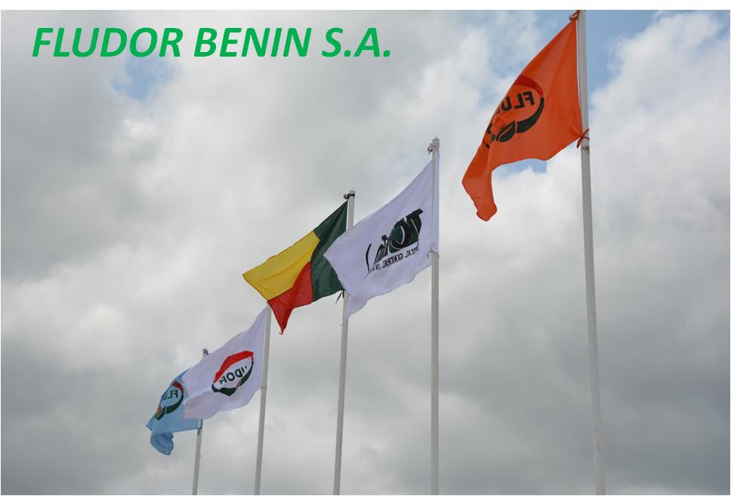
  AFRICAN PROCESSING IS TOUGH & CHALLENGING, EXPOSED TO RISK.
  AND VIABLE WITH SUSTAINABLE MFG & BUSINESS TECHNIQUES
THANK YOU / MERCI

