Slide 1
Complying with FSMA:
What a cashew exporter to the U.S. needs to do.
Bob Bauer, President
Association of Food Industries

Slide 2
Introduction
Who is AFI?
What is FSMA?

Slide 3
FSMA in a Nutshell
Most expansive changes since 1938 Act
Ambitious schedule for increased inspections
Substantial new regulatory requirements
Major new program activities for FDA
Sweeping new enforcement authorities, including ability to require recalls and authority to collect fees (facility re-inspections, re-inspection of imported foods & recall costs.)

Slide 4
Seven Major Rules
Preventive Controls for Human Food***
Preventive Controls for Animal Feed
Third-Party Lab Accreditation
Produce Safety Standards
Foreign Supplier Verification Program*
Sanitary Transportation of Human and Animal Food
Intentional Adulteration
Also, several guidance documents – possibly 40+

Slide 5
Registration/Re-Registration
Facilities Had to Register in 2003 and Onward.
Foreign facilities Had to Name a U.S. Agent.
Beginning October 22, 2012, All Facilities Had to Re-Register.
Renewal will take place October 1-December 31 in Even-Numbered Years.
Agent Issues.

Slide 6
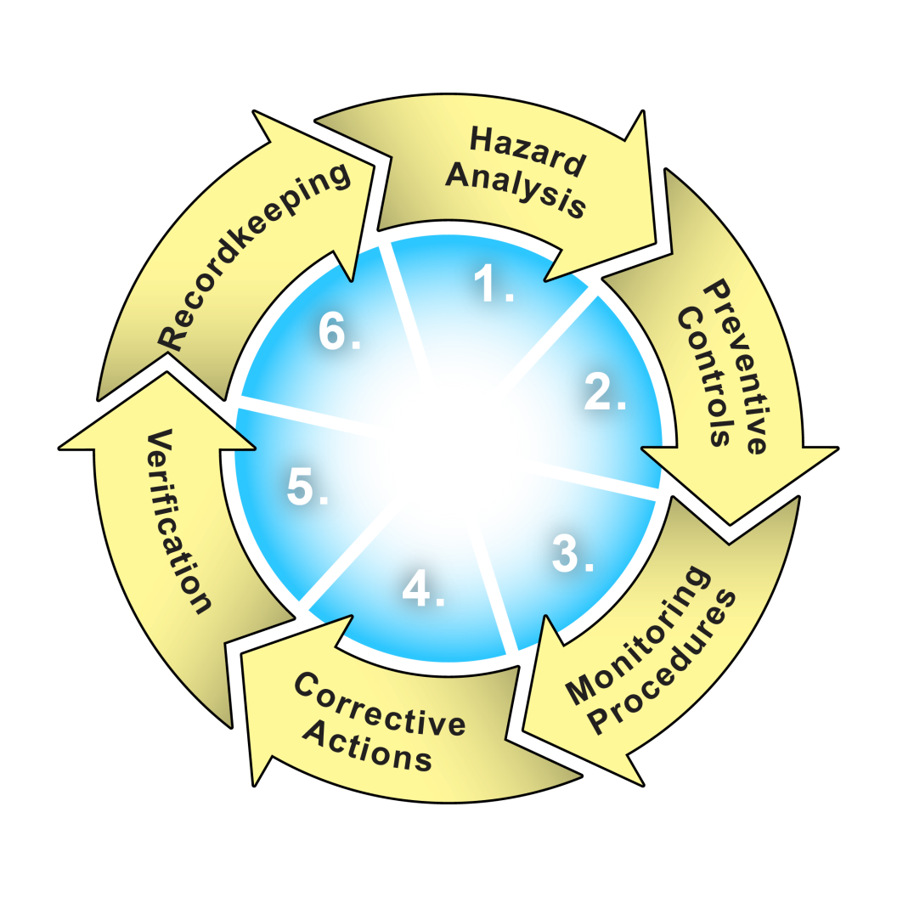
Preventive Controls Rule
HACCP

Slide 7
Hazard Analysis
Identify known or reasonably foreseeable hazards for each food type to determine whether there are hazards that are reasonably likely to occur.
Must consider hazards that may occur naturally or may be unintentionally introduced.
Must include biological, chemical, physical and radiological hazards.

Slide 8
Hazard Evaluation
Determine whether the hazards are reasonably likely to occur, including an assessment of the severity of the illness or injury if the hazard was to occur.
Must look at every step of the production cycle:
  Formulation of the food;
  Facility & equipment;
  Raw materials & ingredients;
  Transportation;
  Manufacturing/processing procedures;
  Intended or reasonably foreseeable use; and
  Sanitation, including employee hygiene.

Slide 9
Required Controls
Process controls.
Food allergen controls:
  Cross contact; and
  Labeling.
Sanitation controls:
  Cleanliness of food-contact surfaces; and
  Prevention of cross-contact and cross-contamination.
Recall plan.

Slide 10
Recall Plan
Written procedures that describe steps to:
  Directly notify the direct consignees of the food being recalled;
  Notify the public, when appropriate, to protect public health;
  Conduct effectiveness checks to verify the recall is carried out; and
  Appropriately dispose of recalled food.

Slide 11
Monitoring
Facility must have written procedures, including frequency they are to be performed, for monitoring the preventive controls.
Monitoring must be documented in records.

Slide 12
Corrective Actions
Facility must establish and implement written corrective action procedures to:
  Identify and correct a problem with implementation of a preventive control.
  Ensure affected food is evaluated for safety.
  Ensure adulterated food is prevented from entering into commerce.

Slide 13
Verification
Validation
Calibration
Review of records

Slide 14
Reanalysis
At least every three years.
Whenever there is a significant change that creates the potential for a new hazard or a significant increase in one previously identified.
When there is new information about a potential hazard associated with a food.
When a preventive control is ineffective.

Slide 15
Required Records
Written food safety plan.
Records that document monitoring of the preventive controls.
Records that document corrective actions.
Records that document verification.
Records that document training for the qualified individual.

Slide 16
Qualified Individual
Must have successfully completed training in the development and application of risk-based preventive controls or be otherwise qualified through job experience to develop and apply a food safety system.
Qualified individuals will
  Prepare the food safety plan;
  Validate the preventive controls;
  Review records; and
  Re-analyze the plan.

Slide 17
The Process
Rulemaking Process
  Proposed Rule
  Comment Period
  Final Rule
  Implementation

Slide 18
What to Do Now
Don’t Wait
Importers
  Request re-registration confirmation from all shippers. Make certain your office is registered.
  Inform all shippers of expected preventive control requirements and request copy of preventive control plan within a set timeframe.
Shippers to U.S.
  Make certain all facilities are registered properly.
  Design/review preventive control plan and take needed steps to validate, audit, etc.

Slide 19
Thank You
Bob Bauer, President
Association of Food Industries
3301 Route 66
Suite 205, Building C
Neptune, NJ 07753
Phone: 732-922-3008
Fax: 732-922-3590
Email: Bobbauer@afius.org

