Slide 1
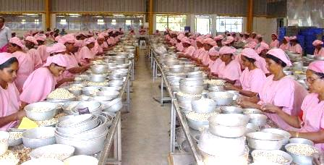
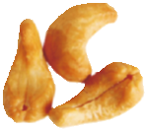
The Great Indian Cashew Market
PRESENTED BY:
HARI NAIR
Western India Cashew Company

Slide 2

The Great Indian Cashew Market
Worlds No 1 Market
Worlds No 1 Producer : 680,000 MT of RCN
Worlds No 1 Processor : 1,584,700 MT of RCN
Worlds No 1 Consumer : 232,000 MT of Kernels
Population of 1.3 billion
Growing income levels

Slide 3
The Great Indian Cashew Market
Cashews traditionally used in food – Gravy, Sweets, Ingredients and Snacks
Difficult to estimate usage trends as data scarce.
Demographic Dividend – Fastest growing middle class

Slide 4
Consumption of cashews in India
(Quantity in (‘000 M.Ton) | 2005 | 2006 | 2007 | 2008 | 2009 | 2010 | 2011 | 2012 | 2013 | 2014
Local (RCN) | 573 | 620 | 665 | 690 | 613 | 695 | 650 | 670 | 723 | 680
Import (RCN) | 565 | 571 | 599 | 648 | 727 | 540 | 790 | 833 | 788 | 904
Total RCN | 1,138 | 1,191 | 1,262 | 1,338 | 1,340 | 1,235 | 1,440 | 1,503 | 1,511 | 1,584
Kernels Import |  |  |  |  |  |  | 2 | 6.1 | 4.8 | 1
Total Kernel Production | 261 | 273 | 291 | 307 | 305 | 283 | 329 | 348 | 349 | 360
Export | 119 | 117 | 115 | 111 | 106 | 95 | 110 | 100 | 116 | 128
Consumption | 142 | 156 | 176 | 196 | 199 | 188 | 219 | 248 | 233 | 232

Slide 5
Indian Cashew consumption
Year 2005 to 2014

Slide 6
Indian Cashew & Almond consumption
Almonds next biggest nut sold in India

Slide 7
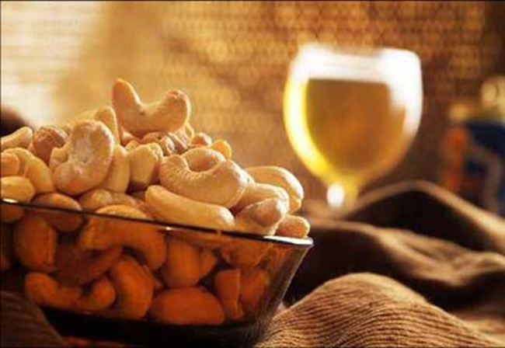
Thank you
Hari Nair
hari@wenders.com
www.wenders.com

